Slide 1
Chapter 5
Adjectives & Adverbs

Slide 2
modifies nouns and pronouns
ADJECTIVE
ADVERB
modifies verbs, adjectives, and other adverbs

Slide 3
MODIFIERS
describe other words
help us say exactly what we mean

Slide 4
ADJECTIVE ?’s
What kind?
Which one?
How many?
How much?
Whose?

Slide 5
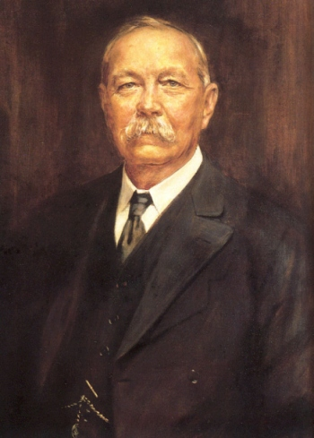
What kind?
Sir Arthur Conan Doyle wrote detective stories.

Slide 6
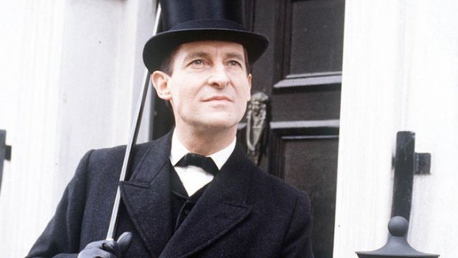
Which one?
The main character in his stories is Sherlock Holmes.

Slide 7
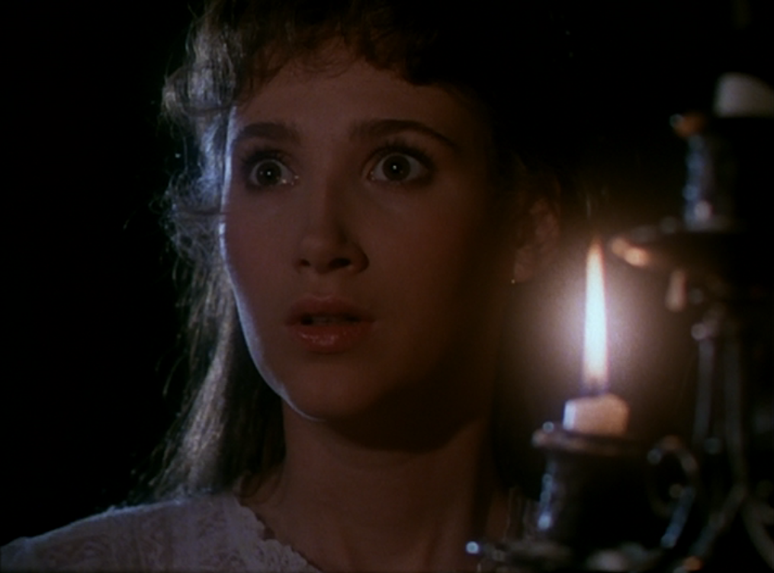
How many?
He wrote 56 short stories and 4 novels featuring Holmes.

Slide 8
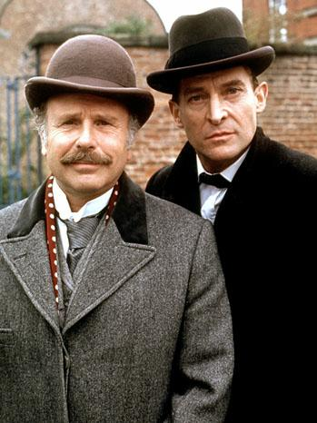
Whose?
The stories are told by Holmes’s friend, Dr. Watson.

Slide 9
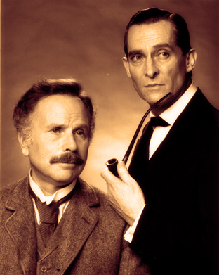
Adjective
test frame
The _____ thing or person is very _____ .

Slide 10
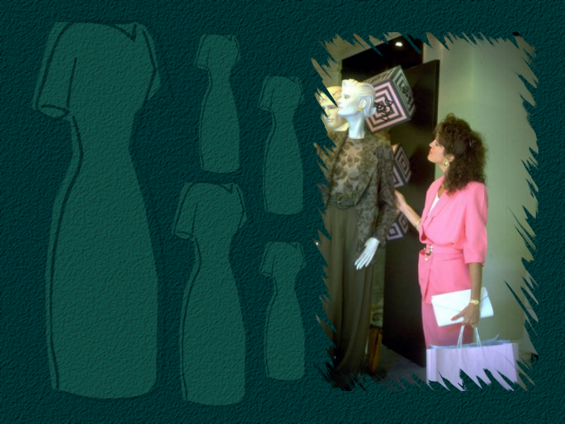
the old dress’s owner
the old dress’s

Slide 11
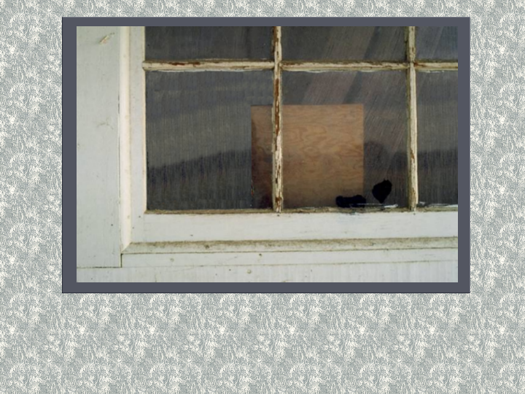
The window, large and grimy, overlooks the parking lot.

Slide 12
Practice the Skill 5-1, p. 115

Slide 13
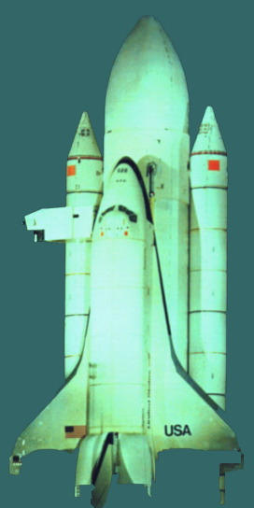
1. Different countries have always competed in various areas.

Slide 14
2. One area of
fierce competition
was the race to
space.

Slide 15
3. Many countries have explored the universe.

Slide 16
4. However, the United States and the Soviet Union were in particularly intense competition.

Slide 17
5. In the early years, accomplishments in space determined a country’s leadership in science, engineering, and national defense.

Slide 18
Review the Skill 5-2, p. 116

Slide 19
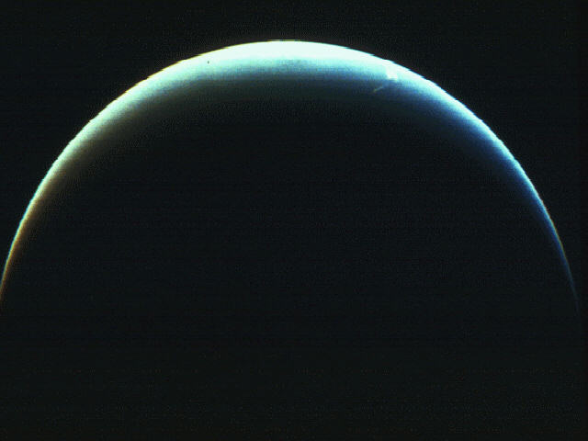
Space provides a unique opportunity for study. Our human curiosity about the universe is a natural inclination.
1000000000000000 . . .

Slide 20
Planets, stars, and galaxies are tiny dots within the vast expanse of space. For example, the great distances between stars can be measured only in light-years.
1000000000000000 . . .

Slide 21
A light-year equals the distance that light travels in one year.
1000000000000000 . . .

Slide 22
Determiner
signals that a noun is coming
always before the noun
always before descriptive adjectives

Slide 23
Articles
a, an, the

Slide 24
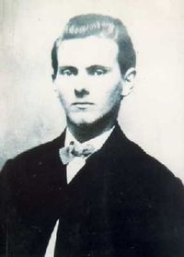
Notes:
Jesse James picture

Slide 25
Indefinite
Articles
a, an
modify nonspecific nouns
I want to read a book about Jesse James.
An unbiased biography of him is hard to find.

Slide 26
Definite
Article
the
modifies specific nouns
The book I found is by Jesse James’s grandson.
He wrote the biography in first person.

Slide 27
Posssives
possessive pronouns
Jesse James left a sad legacy for his grandson to record.
possessive noun
The grandson’s story tried to explain James’s motives.

Slide 28
Possessive
Phrase
The entire possessive phrase shows possession.
The other famous James brother’s name is Frank.

Slide 29
Independent
Possessive
The author was glad that the legacy was his in spite of James’s lifestyle.
The lawmen’s response to James’s death was relief; his wife’s was sadness.

Slide 30
Demonstratives
this, that, these, those
That biography of Jesse James shows the personal side of this brilliant man.
That is the book which showed me how intelligent and creative Jesse James was.

Slide 31
Interrogatives
which, what, whose
Which story about Jesse James is your favorite?
Which is the one that took place in Liberty, Missouri?

Slide 32
Indefinites
Many people know some famous stories about Jesse James’s exploits.
Some are just legends, but many are true.

Slide 33
Modifying Noun
a noun that modifies a noun
always appears right before it
The butterfly landed on my hand.
She wore a costume with butterfly wings.

Slide 34
Proper Adjectives
One day I would like to visit Italy.
Italian food smells and tastes delicious.

