Slide 1
BIBLE FINAL EXAM
50 points
Know:
Know Philippians 2:5-8; I Tim. 6:8-9)
Review Lessons 9, 10, 11, 13, & 14 in your book. Study the questions!
Study your notes.

Slide 2
Philippians 2:5-8
Let this mind be in you,
Which was also in Christ Jesus:
Who, being in the form of God,
Thought it not robbery to be equal with God:
But made himself of no reputation,
And took upon him the form of a servant,
And was made in the likeness of men:
And being found in fashion as a man,
He humbled himself, and became obedient unto death,
Even the death of the cross.

Slide 3
1 Timothy 6:8-9
And having food and raiment
Let us be therewith content.
But they that will be rich
Fall into temptation and a snare,
And into many foolish and hurtful lusts,
Which drown men in destruction and perdition.
Notes:
Perdition=eternal punishment and damnation

Slide 4
1 Timothy 6:10 (Extra Credit for Test 2)
For the love of money is the root of all evil: which while some coveted after, they have erred from the faith, and pierced themselves through with many sorrows.
Notes:
Perdition=eternal punishment and damnation

Slide 5
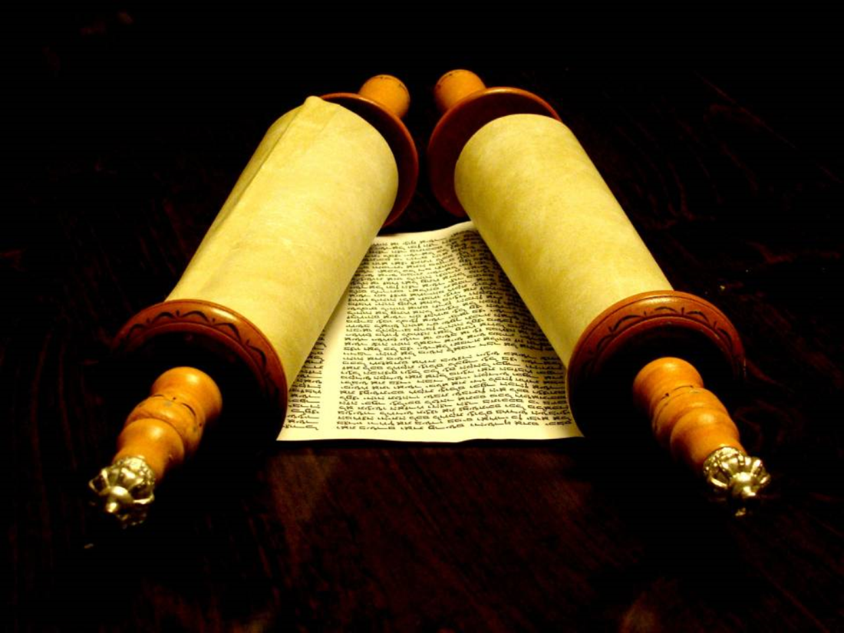
Jeopardy
NT Review

Slide 6
Categories
Philippians
I Timothy
Verse Challenge
Teacher Trivia

Slide 7
Philippians
Return
10
20
30
40
50

Slide 8
10 points
Return
Who were Paul’s first converts in Macedonia?
the Philippians

Slide 9
20 points
Return
What was Paul’s reaction in prison when he heard that others were spreading the gospel out of envy?
He rejoiced!

Slide 10
30 points
Return
Theme of Philippians: “Every Christian should be a __, following the example of Christ.”
servant

Slide 11
40 points
Return
Paul had an amazing resume. Name 2 major privileges that he enjoyed.
Hebrew of the Hebrews, tribe of Benjamin, Roman citizenship, Pharisee, persecutor of Christians, keeper of the law, smart, powerful speaker/writer, etc.

Slide 12
50 points
Return
Paul desired to know the __of Christ’s sufferings.
fellowship

Slide 13
Verse Challenge
Return
10
20
30
40
50

Slide 14
10 points
Return
Not of __ lest any man should boast. (Eph. 2:9)
works

Slide 15
20 points
Return
If ye then be risen with Christ, seek those things which are ___. (Col. 3:1)
above

Slide 16
30 points
Return
Let this __ be in you, which was also in Christ Jesus. (Phil. 2:5)
mind

Slide 17
40 points
Return
He humbled himself, and became obedient unto __, even the death of the cross. (Phil. 2:8)
death

Slide 18
50 points
Return
But be thou an example of the believers, in __, in __, in __, in __, in __, in purity.
word, conversation, charity, spirit, faith

Slide 19
I Timothy
Return
10
20
30
40
50

Slide 20
10 points
Return
Sincerity means ___and ___in Greek.
“sun” & “judgement”

Slide 21
20 points
Return
What is our common purpose?
to bring glory to Jesus Christ

Slide 22
30 points
Return
Our safeguard against false teachers is ___.
A thorough understanding of the Word

Slide 23
40 points
Return
List one of the four specifics of sound doctrine?
(1) Christ is both God and man—God in human flesh. (2)The gospel of Christ is open to people of any ethnic background. (3) Salvation comes through faith in Christ alone. (4) Christ will one day return for His own.

Slide 24
50 points
Return
__ __ is Satan’s most powerful weapon.
false religion

Slide 25
Teacher Trivia
Return
10
20
30
40
50

Slide 26
10 points
Return
List one of the cities Miss Buiter will work in this summer.
Shanghai, Beijing, Chang Chun

Slide 27
20 points
Return
Miss Buiter once had to ride a bike with pumpkins in her backpack while traveling in ___(country?).
Africa

Slide 28
30 points
Return
Miss Buiter has __ siblings.
2

Slide 29
40 points
Return
Miss Buiter lives on 5th floor of CVA. Another teacher who taught for 53 years at BJA lives on the same floor. Her name is ______________.
Miss Markham

Slide 30
50 points
Return
This is Miss Buiter’s __ (#) year of teaching at the Academy.
14th

Slide 31
DONUT TIME!!!!

