Slide 1
It’s Friday!
Have out your poem, a pen, and a grading pen!
Notes:
Lizard: © iStockphoto.com/colematt
Theme:

Slide 2
BAON Quiz
Parent Signature?

Slide 3
Sonnet 116
Due on 2/12

Slide 4
Resume Cover Letter
Due Next Friday
?=Have you taken the color career test . . . just . . . for . . . fun?

Slide 5
Resume Cover Letter
Letter Structure:
Introduction
3 supporting paragraphs (5 sentences per paragraph)
Conclusion
Details:
Double space
Neat Handwriting
Typed: 12 point font/traditional style
Indent
spelling, capitalization, punctuation

Slide 6
By Any Other Name
Santha Rama Rau
Notes:
Lizard: © iStockphoto.com/colematt
Theme:

Slide 7
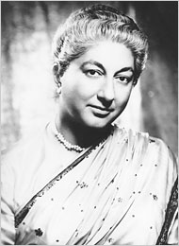
Notes:
Student Guide A Activity
Answer to About the Essay Question 4
Ship, business man, map, queen: clipart.com
Map, & Queen: Clipart.com

Slide 8
Notes:
Student Guide A Activity
Answer to About the Essay Question 4
Ship, business man, map, queen: clipart.com
Map, & Queen: Clipart.com

Slide 9
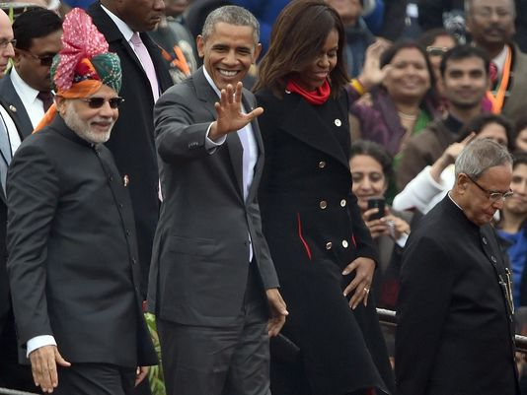

Slide 10
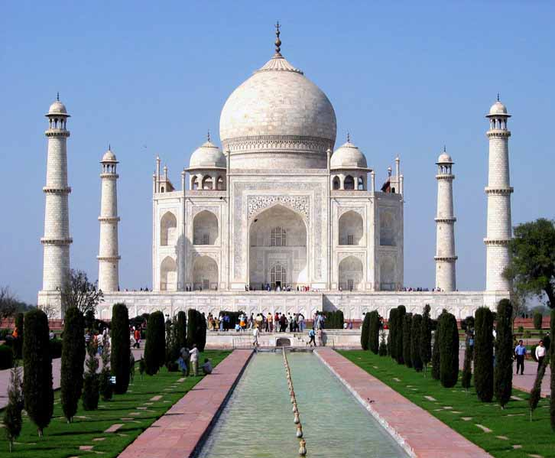

Slide 11
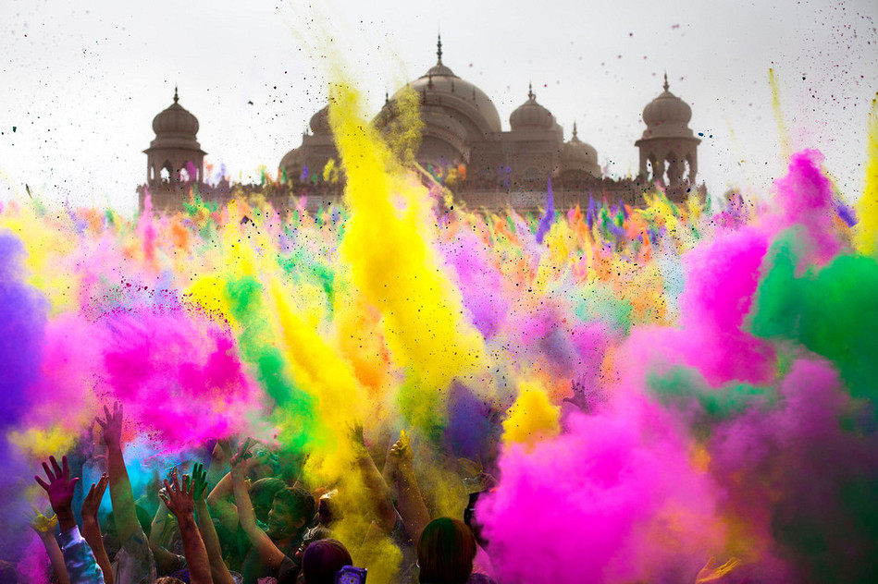

Slide 12
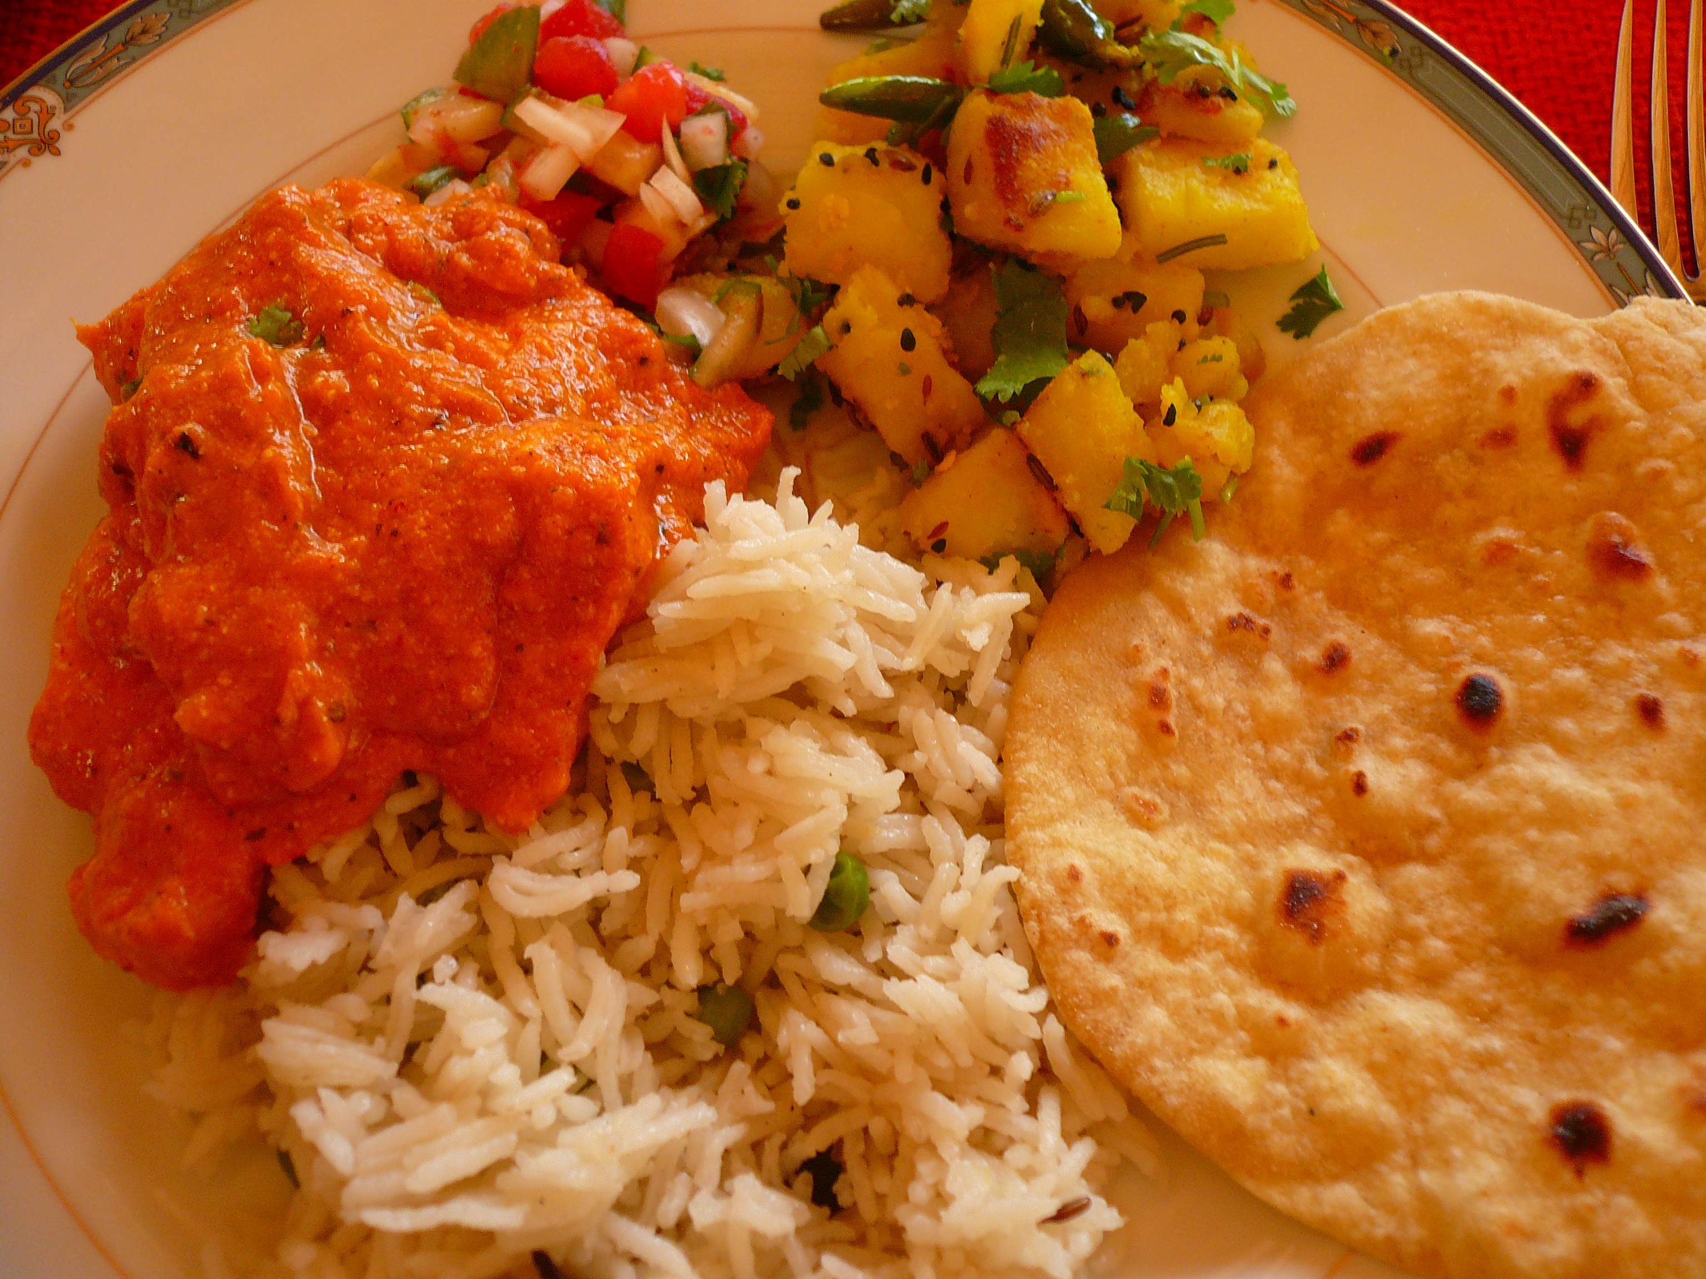

Slide 13
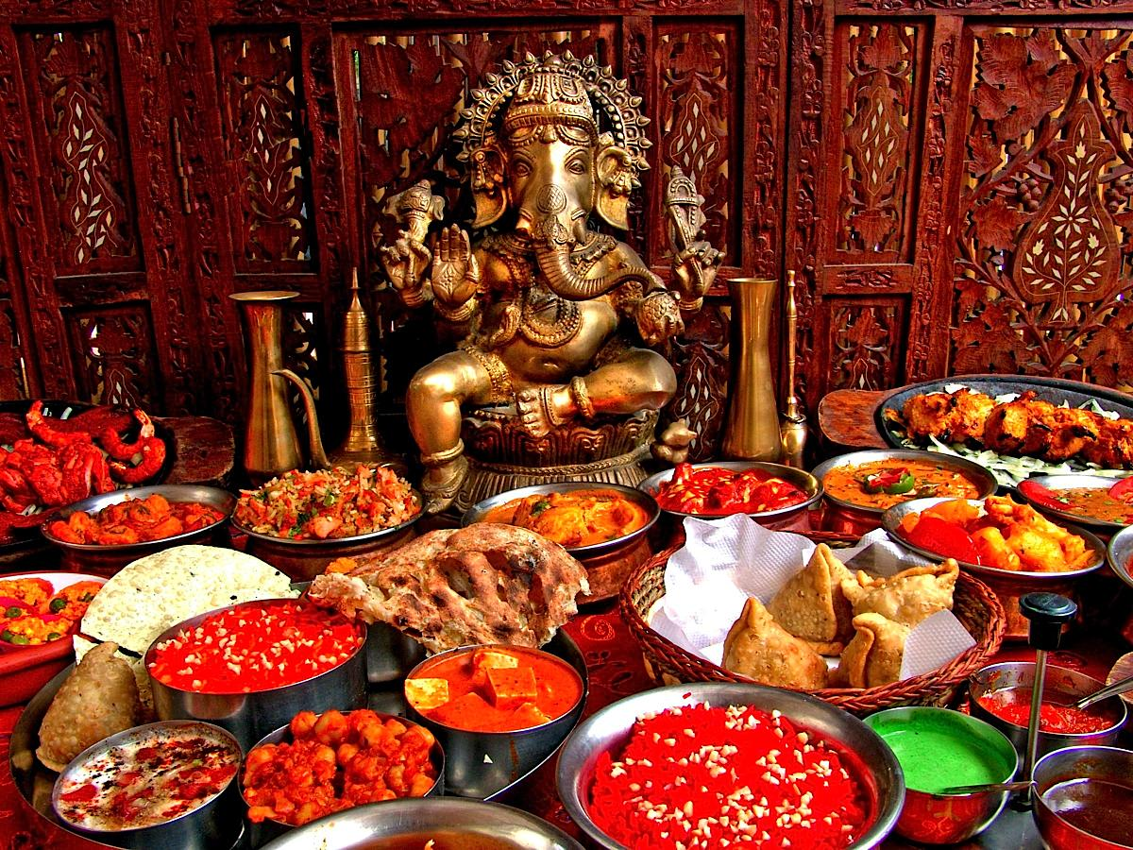

Slide 15
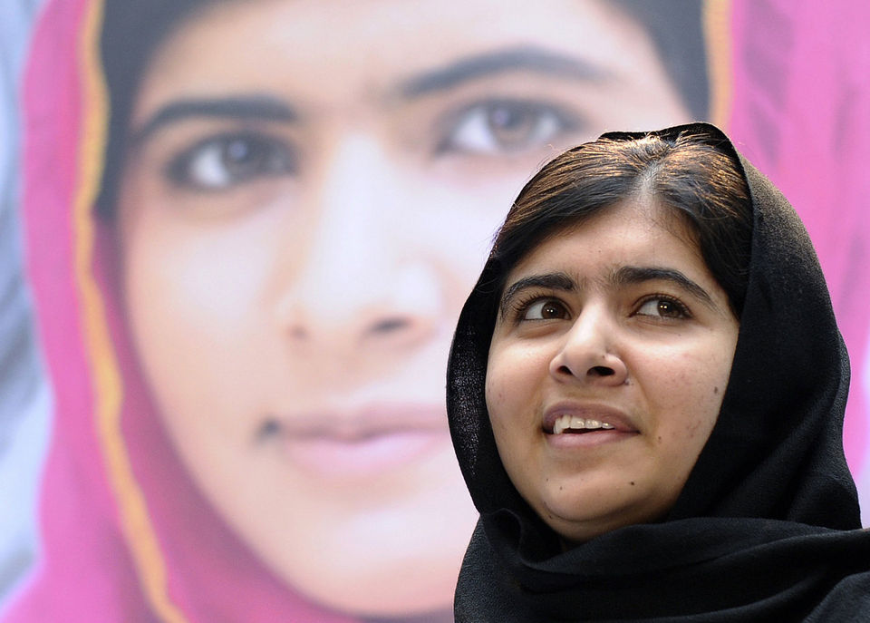

Slide 17
Autobiographical Essay
a short selection written by the author about his experience(s) and focused on a particular event or happening

Slide 18
Theme:
Respect the cultural and personal identities of others
Notes:
Lizard: © iStockphoto.com/colematt
Theme:

Slide 19
Question:
Have you ever experienced prejudice? Take five minutes and write a short paragraph about that experience.
Notes:
Lizard: © iStockphoto.com/colematt
Theme:

Slide 20
First-Person Point of View
the point of view in which the author, as one of the characters, refers to himself throughout the piece

Slide 21
School building = symbol
changing outward appearances of the culture
Notes:
School building = _______ → ___________ outward appearances of the __________
Indian building: clipart.com

Slide 22
British
Indian
→ dark
→ bright
colors = constraint & unnaturalness
colors = happiness & familiarity
Notes:
Contrasts:
British → ____________ colors = ____________ & ___________
Indian → ___________ colors = _____________ & __________

Slide 23
haughty & bigoted
British Teachers
Refuse to learn the Indian children’s real names.
Modify Indian culture to reflect their own culture.
Reject Indian culture as dishonorable.
Notes:
Continue list . . .

Slide 24
haughty & bigoted
British Teachers
Assume the ignorance of the Indian children.
Lack genuine concern for the education of the children of India.
Insult the character of their students.

Slide 25
Lesson:
True help requires true understanding!
Notes:
True ______ requires true ______________!

Slide 26
External conflict: English ways vs. Indian ways.
Internal conflict: desire to fit in vs. real identity
Notes:
External conflict: ________ ______ vs. __________ _______
Internal conflict: ________ to ____ ____ vs. _______ _________

Slide 27
Process of Prejudice :
Insensitivity
Insinuations
Insincerity
Injury

Slide 28
Process of Peace:
Sensitivity
Respect
Sincerity
Love

Slide 29
Amy Carmichael
Notes:
Photo of Amy Carmichael/Wikipedia/public domain
(website not needed in acknowledgement) http://en.wikipedia.org/wiki/File:Amy_Carmichael_with_children.jpg

Slide 30
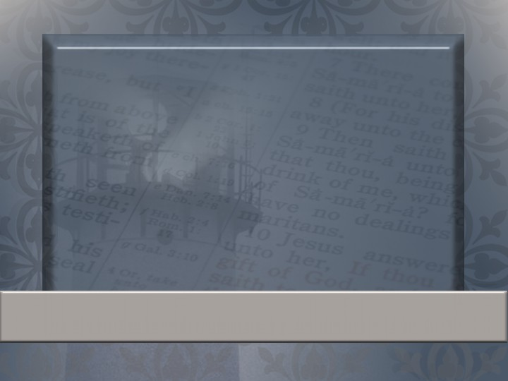
And this I pray, that your love may abound yet more and more in knowledge and in all judgment; That ye may approve things that are excellent; that ye may be sincere and without offense till the day of Christ.
Philippians 1:9–11
Notes:
Verses that show the importance of love in service:

Slide 31
The Age of Miracles
Due Monday
Notes:
Uncle Abner: guided by ___________
Randolph: guided by _____

