Slide 1
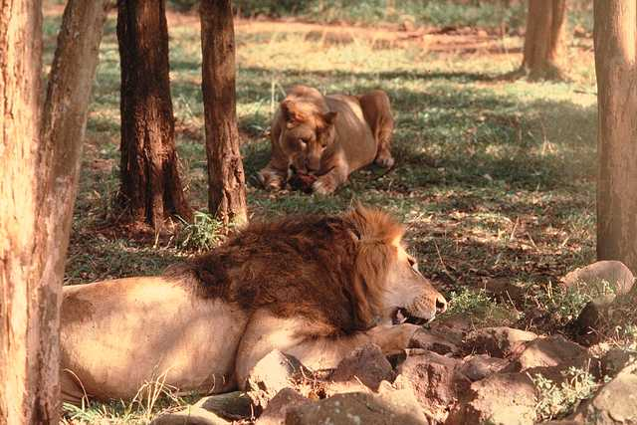
The pride is hunting for food.
The pride are arguing with each other over the kill.

Slide 2
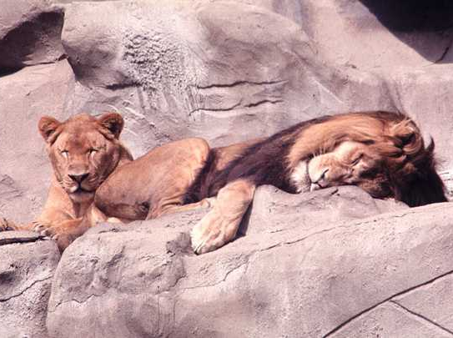
What is a group of lions called?
A tribe?
No!
a pride

Slide 3
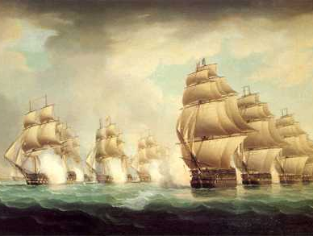
What is a group of ships called?
An armadillo?
No!
an armada or a fleet

Slide 4
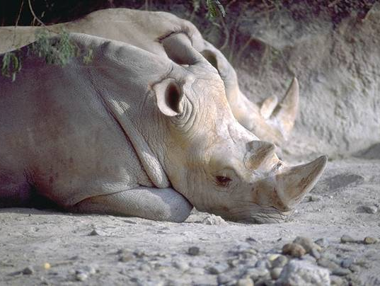
What is a group of rhinoceri called?
An accident?
No!
a crash

Slide 5
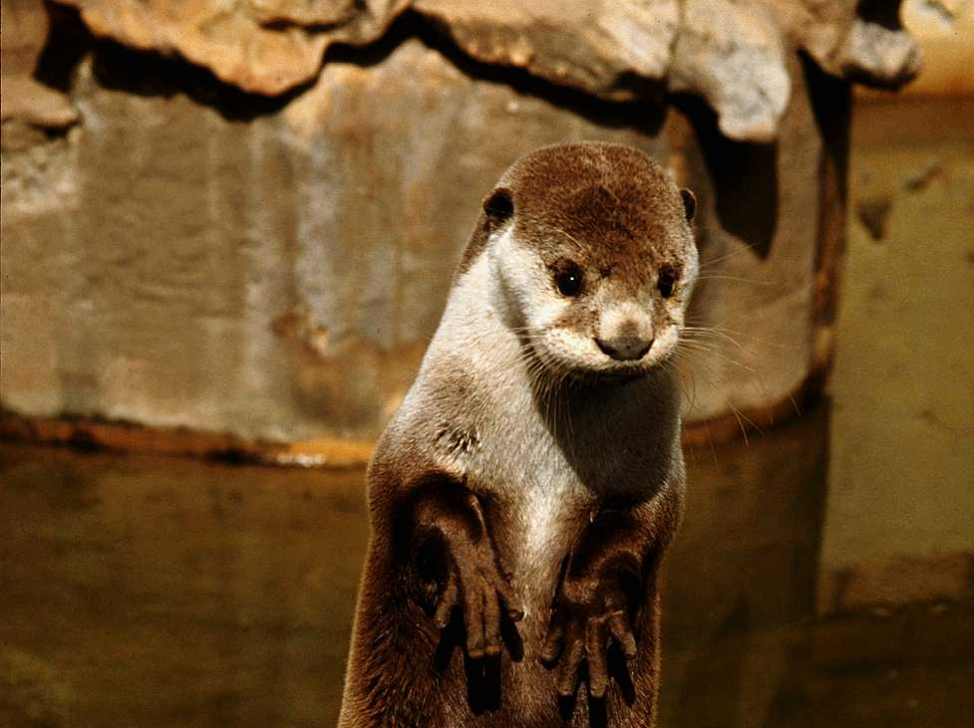
What is a group of weasels called?
A ham?
No!
a gam

Slide 6
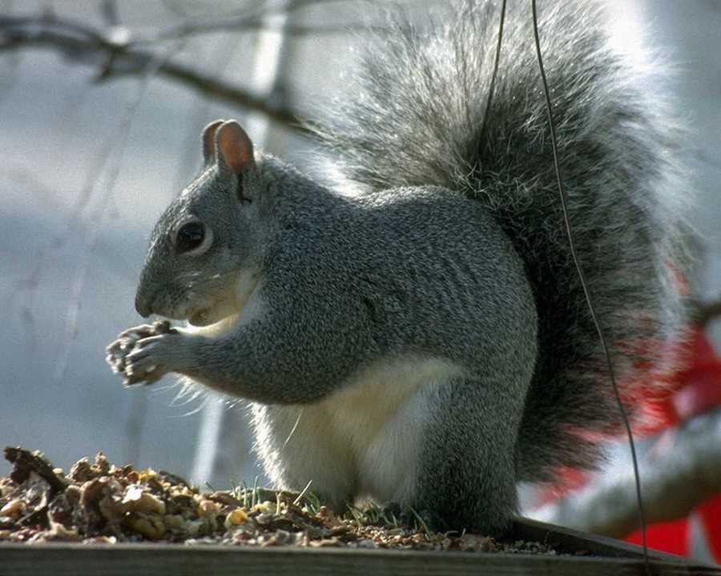
What is a group of squirrels called?
A play?
No!
a dray

Slide 7
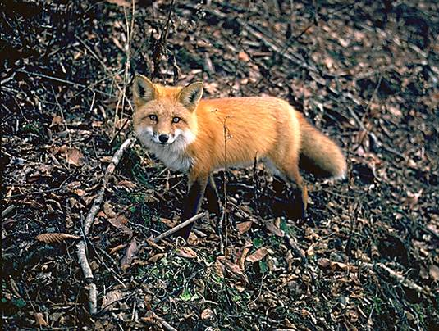
What is a group of foxes called?
A hulk?
No!
a skulk

Slide 8
Practice the Skill 2-9, p. 34

Slide 9
1. Sports: soccer, coach, team, player

Slide 10
2. Religion: Bible, congregation, Christian, belief

Slide 11
3. Government: Senate, law, judge, courtroom

Slide 12
4. Education: class, teacher, pupil, instruction

Slide 13
5. Birds: wing, flight, flock, nest

Slide 14
The pride is hunting for food.
The pride are arguing with each other over the kill.

Slide 15
Practice the Skill, pp. 34-35

Slide 16
Compound Noun
a noun formed by combining two or more words

Slide 17
Compound Noun
noun + noun:
baseball
adjective + noun: redhead
noun + verb + er: can opener
prep + verb:
upswing
prep + verb + er: undertaker

Slide 18
Compound Noun
high school
mother-in-law
babysitter
baby sitter
baby-sitter

Slide 19
Compound Noun
father-in-law
fathers-in-law
father-in-law’s car

Slide 20
Practice the Skill 2-11, p. 36

Slide 21
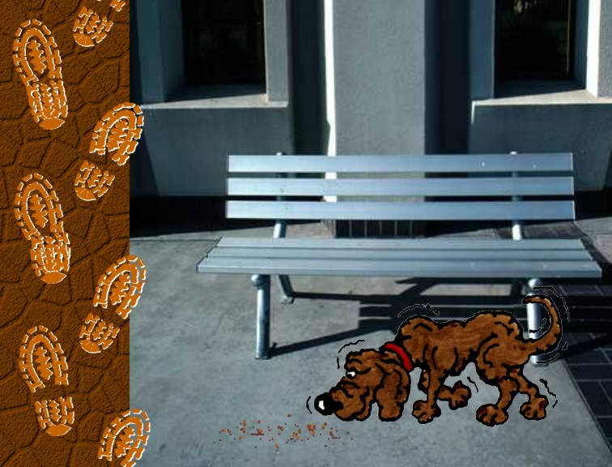
1. A dog has always been a special helpmate to man.
helpmates

Slide 22
2. Dogs have often been used for rescue; in fact, many wounded soldiers on the battlefield owe their lives to dogs.
battlefields

Slide 23
3. A bloodhound is often used by police in search and rescue because of its keen sense of smell.
bloodhounds

Slide 24
4. A policeman can also use dogs as companions to help ensure safety.
policemen

Slide 25
5. Also, adventurers have used dogs and a dogsled to deliver supplies to remote areas during winter and to save lives.
dogsleds

Slide 26
Review the Skill 2-12, p. 37

Slide 27
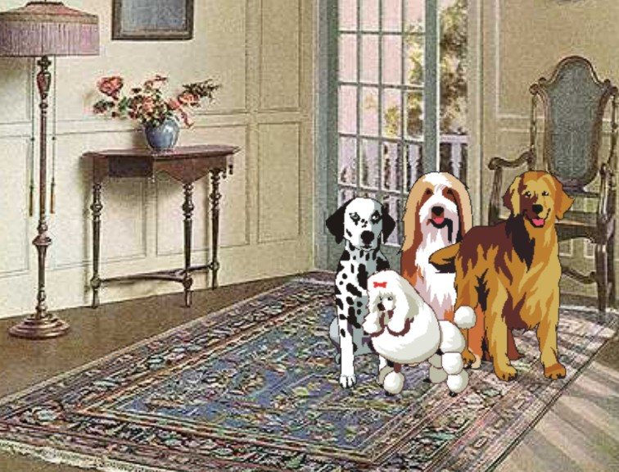
1. A pack of dogs may include dogs that vary greatly in physical appearance and in ability.
coll

Slide 28
2. Gundogs include pointers, setters, retrievers, and spaniels; they aid hunters who use guns.
cd

Slide 29
3. Although some dogs use their sense of smell to hunt, the gazehound pursues its game by sight.
cd

Slide 30
4. The collie may be used to keep a flock of sheep from straying.
coll

Slide 31
5. A bulldog and a Dalmation are examples of nonsporting dogs that are large companion dogs.
cd

Slide 32
Noun Positions
Subject
The freshman was the best athlete.

Slide 33
Noun Positions
PN
The star player was a freshman.

Slide 34
Noun Positions
DO
The freshmen beat the seniors.

Slide 35
Noun Positions
IO
The freshmen gave the seniors a challenge.

Slide 36
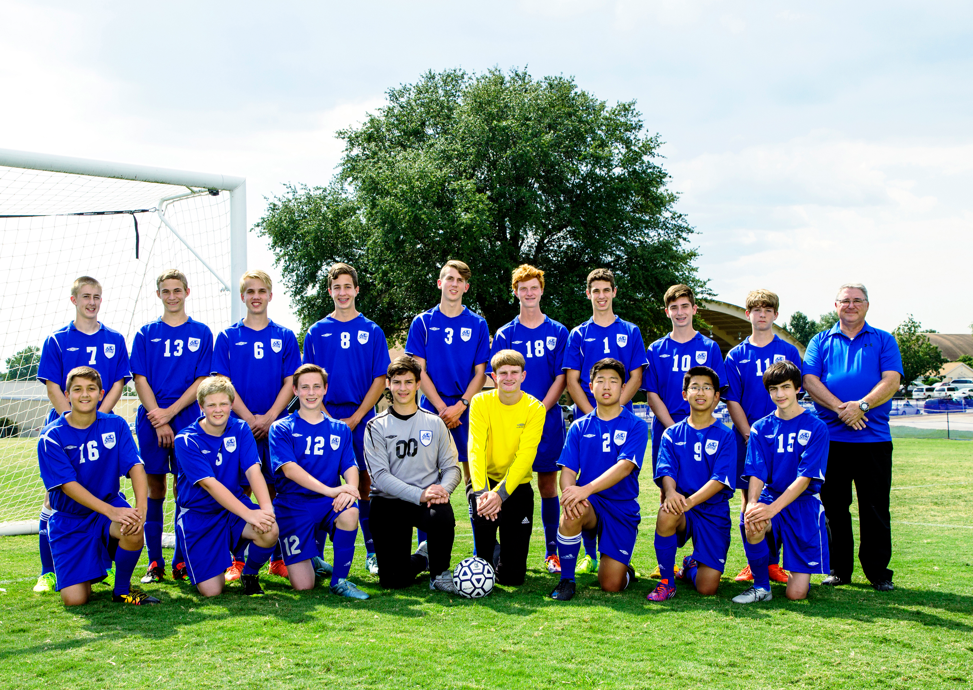
Noun Positions
OP
Applause resounded through the stands (for the freshmen).

Slide 37
Noun Positions
NA (Noun of Direct Address)
Creed, who were the Fab Five?

Slide 38
Noun Positions
App (Appositive)
My favorite team, the BJA Lions, are looking great!

Slide 39
FRAGMENTS (Frag)
Fragments=a fragment is an incomplete sentence wrongly punctuated as if it were a complete sentence.
It can be a phrase, missing a subject or a verb. Sometimes a fragment is a dependent clause that is written as a sentence.
Examples:
Mr. Tompkins the former principal.
After the game was over.

Slide 40
Comma splices (CS)
Comma Splices=two sentences incorrectly joined by only a comma.
Examples:
The senior gave his testimony, he was really on fire for the Lord.
Corrections:
The senior gave his testimony. He was really on fire for the Lord.
The senior gave his testimony; he was really on fire for the Lord.

Slide 41
Fused Sentences/Run-Ons
Fused Sentences (FS)/Run-On Sentences (RO)=two or more sentences incorrectly joined without any punctuation.
Methods for Correction:
Separate the sentence parts with a period or a semicolon.
Combine them correctly with a comma and a coordinating conjunction.
Change one of the sentences into a dependent clause.

Slide 42
Fused Sentences/Run-Ons
The freshman gave his heart to the Lord his life was never the same.
The freshman gave his heart to the Lord; his life was never the same.
The freshman gave his heart to the Lord. His life was never the same.
The freshman gave his heart to the Lord, and his life was never the same.

Slide 43
UNIT TWO TEST (50 points)
Review all types of nouns, sentence patterns, and serious errors

Slide 44
UNIT TWO Pretest (40)
Toll bridges
Tomatoes
3. m’s
4. Halves
5. Flagpoles
6. Businesses
7. children

Slide 45
UNIT TWO Pretest (40)
8. sisters-in-law
9. Countries
10. Car washes

Slide 46
UNIT TWO Pretest (40)
11. Duane’s
12. cousin’s
13. parents’
14. Louis XIV’s
15. friend’s

Slide 47
UNIT TWO Pretest (40)
16. Edict of Nantes, freedom, French Huguenots
17. Joan of Arc, heroine, Hundred Years’ War
18. king, France, Hugh Capet

Slide 48
UNIT TWO Pretest (40)
19. monarchy, French Revolution, guillotine
20. Arc de Triomphe, conquest, Napoleon

Slide 49
UNIT TWO Pretest (40)
21. Count
22. Noncount
23. Noncount
24. Count
25. Count

Slide 50
UNIT TWO Pretest (40)
26. Group
27. Army
28. Farmland
29. Family
30. Sugar beets

Slide 51
UNIT TWO Pretest (40)
31. OP 36. App.
32. App. 37. S
33. PN 38. DO
34. IO 39. PN
35. OP 40. NA

Slide 52
Proverbs
The words of a talebearer are as wounds. . . .
words
Proverbs
Proverbs 18:8
Proverbs
common
proper
count
noncount
collective
compound

Slide 53
Proverbs
The words of a talebearer are as wounds. . . .
talebearer
Proverbs
Proverbs 18:8
Proverbs
common
proper
count
noncount
collective
compound

Slide 54
Proverbs
The words of a talebearer are as wounds. . . .
Proverbs
wounds
Proverbs 18:8
Proverbs
common
proper
count
noncount
collective
compound

Slide 55
Proverbs
She looketh well to the ways of her
household. . . .
Proverbs
ways
Proverbs 31:27
Proverbs
common
proper
count
noncount
collective
compound

Slide 56
Proverbs
She looketh well to the ways of her
household. . . .
Proverbs
household
Proverbs 31:27
Proverbs
common
proper
count
noncount
collective
compound

Slide 57
Proverbs
Even a fool, when he holdeth his peace, is counted wise. . . .
fool
Proverbs
Proverbs 17:28
Proverbs
common
proper
count
noncount
collective
compound

Slide 58
Proverbs
Even a fool, when he holdeth his peace, is counted wise. . . .
Proverbs
peace
Proverbs 17:28
Proverbs
common
proper
count
noncount
collective
compound

Slide 59
Proverbs
A good man obtaineth favour of the LORD.
man
Proverbs
Proverbs 12:2
Proverbs
common
proper
count
noncount
collective
compound

Slide 60
Proverbs
A good man obtaineth favour of the LORD.
Proverbs
favour
Proverbs 12:2
Proverbs
common
proper
count
noncount
collective
compound

Slide 61
Proverbs
A good man obtaineth favour of the LORD.
Proverbs
LORD
Proverbs 12:2
Proverbs
common
proper
count
noncount
collective
compound

Slide 62
Proverbs
Whoso keepeth his mouth and his tongue keepeth his soul from trouble.
mouth
Proverbs
Proverbs 21:23
Proverbs
common
proper
count
noncount
collective
compound

Slide 63
Proverbs
Whoso keepeth his mouth and his tongue keepeth his soul from trouble.
Proverbs
tongue
Proverbs 21:23
Proverbs
common
proper
count
noncount
collective
compound

Slide 64
Proverbs
Whoso keepeth his mouth and his tongue keepeth his soul from trouble.
Proverbs
soul
Proverbs 21:23
Proverbs
common
proper
count
noncount
collective
compound

Slide 65
Proverbs
Whoso keepeth his mouth and his tongue keepeth his soul from trouble.
Proverbs
trouble
Proverbs 21:23
Proverbs
common
proper
count
noncount
collective
compound

