Slide 1
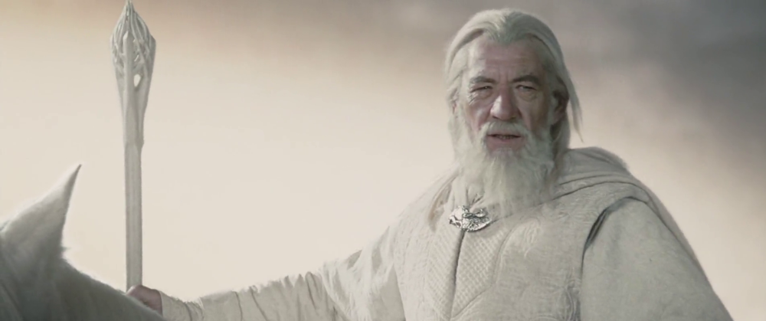
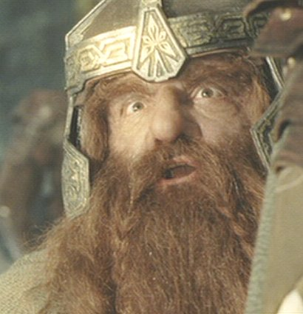
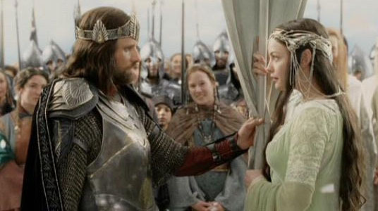
Happy Thursday! Have out your Ch. 3 notes and your homework sheets.

Slide 2
Ch. 3: Fact or Fiction

Slide 3
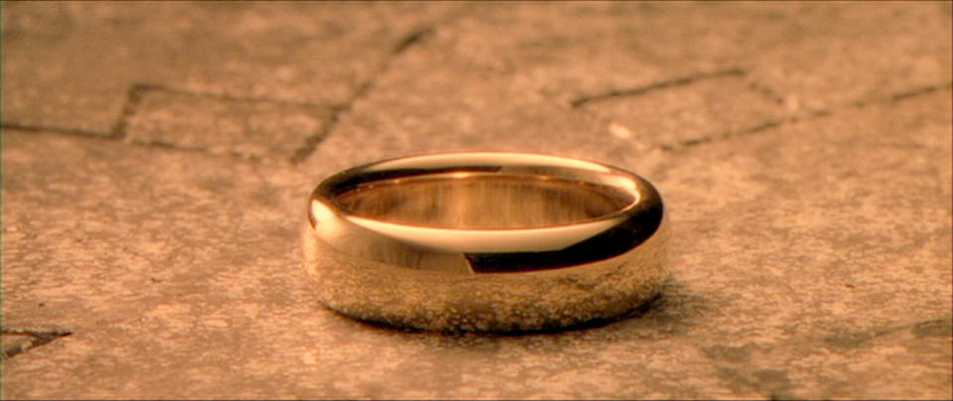
What does ante mean?
Before

Slide 4
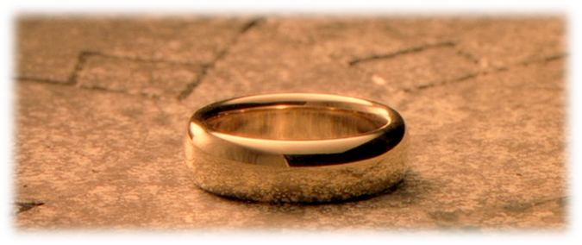
What does pro mean?
Substitute
Earlier; prior to

Slide 5
What does cedere mean?
To go

Slide 6
List two 1st person pronouns.
Me
My
Mine
I
We

Slide 7
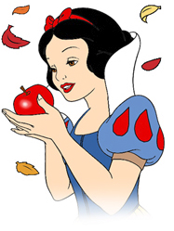
Why does Snow White fall asleep?
Ate Poison Apple
Hits her head on dwarfs pointy hat
C. Ate poison dart frog
A

Slide 8
Give an example of a 2nd person pronoun.
You

Slide 9
Give an example of a 3rd person pronoun.
He/Him/His
She/Her/Hers
They/Them
It

Slide 10
List the 4 Demonstrative Pronouns.
This
That
These
Those

Slide 11
List the 5 Interrogative Pronouns.
Who
Whom
Whose
Which
What

Slide 12
List the 5 Relative Pronouns.
Who
Whom
Whose
Which
That

Slide 13
Which indefinite pronouns are always singular? Give categories.
One
Body’s
Things
Others
Molle

Slide 14
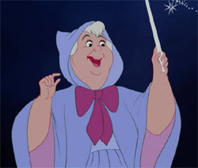
Who does the fairy godmother in Cinderella say?
Boom Shakalaka
Hickory Dickory Dock
C. Bippity Boppity Boo
C

Slide 15
What does “Molle” stand for?
Much
One
Little
Less
Each

Slide 16
Reflexive and Intensive pronouns are also known as the ____________ pronouns?
“selfish”

Slide 17
Write an example of a sentence with a intensive pronoun?
Frodo himself accepted the task of bearing the ring.

Slide 18
Write an example of a sentence with a reflexive pronoun?
Frodo gave himself the task of bearing the ring.

Slide 19
List the indefinite pronouns that can be singular OR plural?
Some
Any
More
Most
All
None

Slide 20
What must you look at to determine if these are singular OR plural?
the object of the preposition

Slide 21
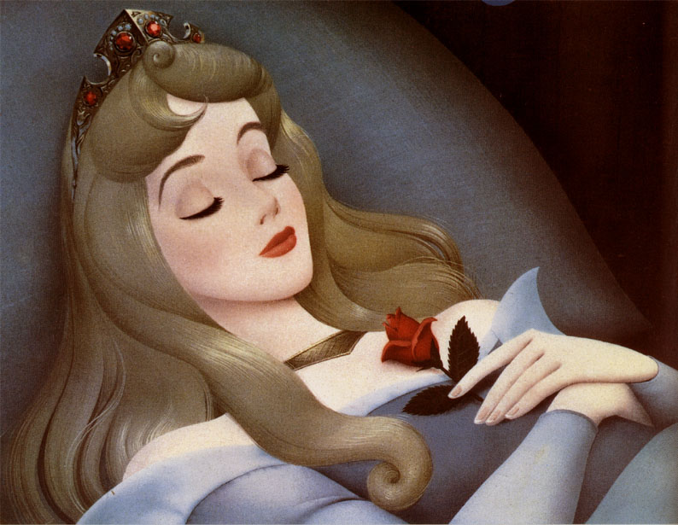
What is Sleeping Beauty’s real name?
Ariel
Aurora
C. Anastasia
B

Slide 22
Objective (O) or Subjective (S)
We

Slide 23
Objective (O) or Subjective (S)
Us

Slide 24
Objective (O) or Subjective (S)
They

Slide 25
Objective (O) or Subjective (S)
Them

Slide 26
Objective (O) or Subjective (S)
You

Slide 27
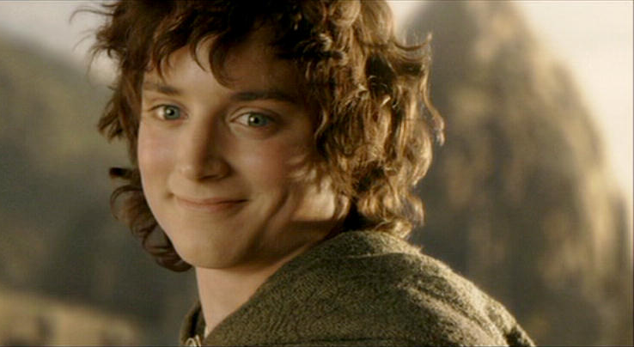
Name 4 hobbits in the Lord of the Rings.
Frodo
Sam
Merry
Pippin
Bilbo

Slide 28
Objective (O) or Subjective (S)
Me

Slide 29
Objective (O) or Subjective (S)
I

Slide 30
Objective (O) or Subjective (S)
Who

Slide 31
Objective (O) or Subjective (S)
Whom

Slide 32
Always put yourself (I, me) ________ according to courtesy order.
LAST

Slide 33
Always put the pronoun YOU ________ according to courtesy order.
FIRST

Slide 34
Singular or Plural
all
Both (look at the OP)

Slide 35
Singular or Plural
everybody
Singular

Slide 36
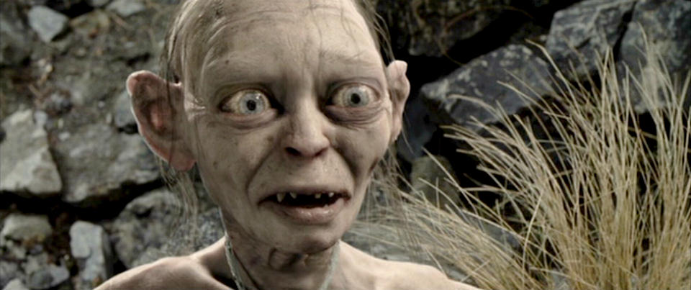
Another name for Gollum would be . . .
Smeagol

Slide 37
Singular or Plural
each
Singular

Slide 38
Singular or Plural
much
Singular

Slide 39
Singular or Plural
everything
Singular

Slide 40
Singular or Plural
many
Plural

Slide 41
Singular or Plural
Some
Both

Slide 42
Singular or Plural
Few
Plural

Slide 43
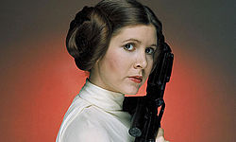
STAR WARS: Who is the twin sister of Luke Skywalker?
Princess Leia

