Slide 1
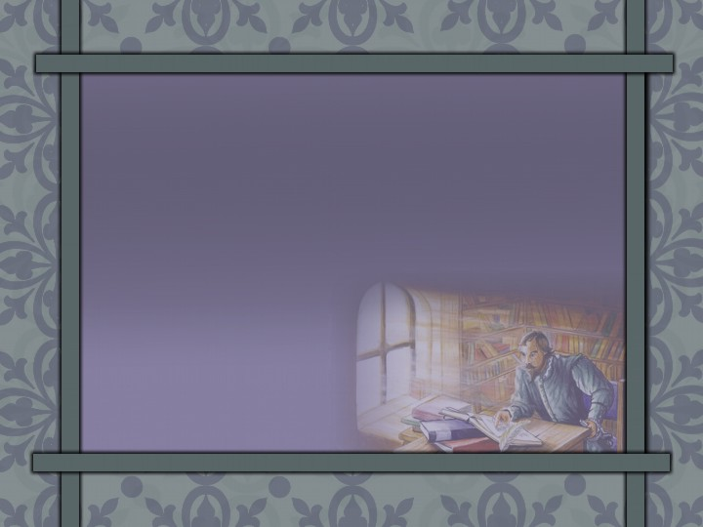
Happy Monday
Have out your take-home quiz and a grading pen.
Notes:
Make a list

Slide 2
Take Home QUIZ
Notes:
Make a list

Slide 3
1. La Mancha 11-15. TRUE
2. TRUE
3. TRUE
4. Reads books of chivalry
5. A horse, armor, great name, lady, squire, a mission, etc.
6. Dulcinea del Toboso
7. Windmills
True
False
False

Slide 4
FAIRY TALES
“If you want your children to be intelligent, read them fairy tales. If you want them to be more intelligent, read them more fairy tales.” –Albert Einstein
“When I was ten, I read fairy tales in secret and would have been ashamed if I had been found doing so. Now that I am fifty, I read them openly. When I became a man I put away childish things, including the fear of childishness and the desire to be very grown up.”—C.S. Lewis

Slide 5
Don Quixote
Notes:
Make a list

Slide 6
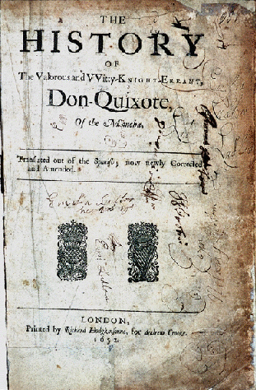
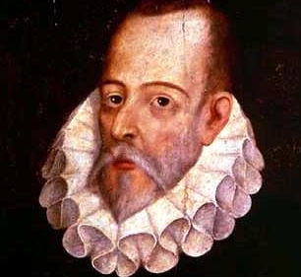
Miguel de Cervantes 1547-1616
Notes:
Make a list

Slide 7
Cervantes:
Madrid, Spain
Served in Spanish army
Captured by pirates/sold into slavery
Imprisoned for debts
1601: Don Quixote brought him great fame and stability

Slide 8
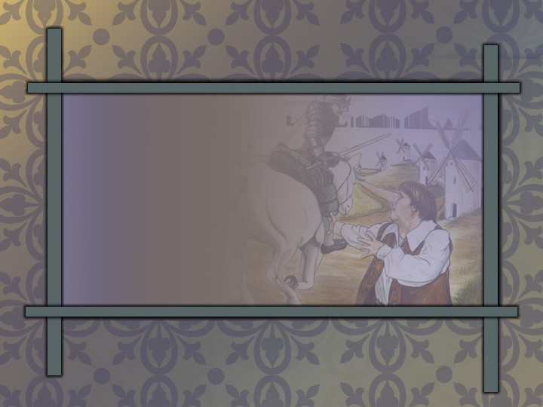
Don Quixote
1st European novel and forerunner of some of the greatest novels
Notes:
Don Quixote → __________ of some of the greatest _______

Slide 9

Cervantes’ Spain
Explorations & Discoveries: Americas & Sailing around the World
Arts: Golden Age
Notes:
Map: Map Art™ ©1996 Cartesia
Cervantes’ Spain
Explorations & Discoveries: __________ & Sailing Around the _______
Arts: _______ _____

Slide 10
Cervantes’ Spain
Government: relatively stable
Social Structure: Aristocracy,
Small Middle Class, Peasants
Religion: dominated by controlling Roman Catholics
Notes:
Map: Map Art™ ©1996 Cartesia
Government: ________ _______
Social Structure: ___________, Small _______ ______, _________
Religion: dominated by controlling ________ _________
?=What violence is attached to Spanish history?
?=What class was Don Quixote? Is it possible to have title but no money?

Slide 11

Purple Prose
unnecessarily exaggerated, flowery language
Notes:
Purple prose → unnecessarily ____________ flowery language
Read paragraph on pg. 2=What is the problem?
Many writers wrote this way.

Slide 12

Suspension of Disbelief
willingness of a reader to accept the unbelievable as true
Notes:
Suspension of Disbelief → willingness of a ________ to accept the ____________ as _____

Slide 13
Don Quixote
An obscure gentleman
Story recorded as actual history
Childish infatuation with unreality

Slide 14


Tragic Hero
the protagonist of a tragedy
Notes:
Can a tragedy be comical?
Give other examples of tragic heros?

Slide 15
Unsympathetic Character
a character with whom the reader cannot identify or for whom the reader has strong feelings of dislike
Notes:
Quixote/Panza

Slide 16
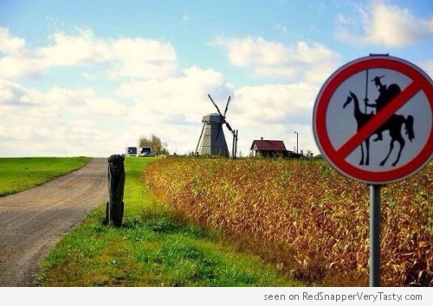

Slide 17

Sancho Panza
His name means “holy belly”
Notes:
Sanch = ______ → _______ outlook directly ______ Don Quixote’s

Slide 18
Sancho Panza
= Foil
His realistic outlook directly opposes Don Quixote’s.
Notes:
Sanch = ______ → _______ outlook directly ______ Don Quixote’s

Slide 19
Foil
a character who emphasizes another character’s opposing traits within a work

Slide 20
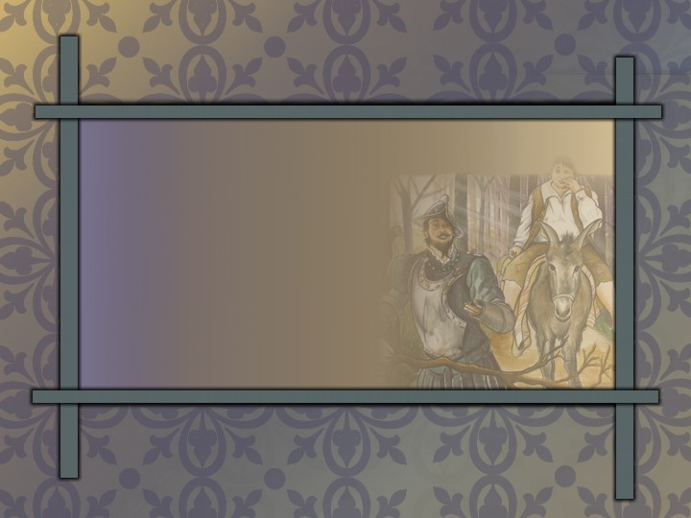
Don Quixote & Sancho
on a selfish quest
= Similarity
Notes:
List of sorts—changing element left blank

Slide 21
Don Quixote & Sancho
deluded
= Similarity

Slide 22
Don Quixote & Sancho
denial of reality
= Similarity

Slide 23
Don Quixote
vs. Sancho:
Romantic — Realistic
Notes:
_____ _________ vs. __________: __________ vs. _________

Slide 24
True nobility
idealism tempered with realism
Notes:
True _______ → __________ tempered with _________

Slide 25

Reality
God’s Word
Notes:
Bible/Cross: Clipart.com
__________ → God’s _______

Slide 26
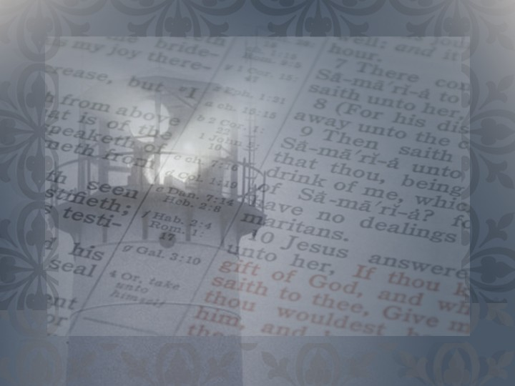
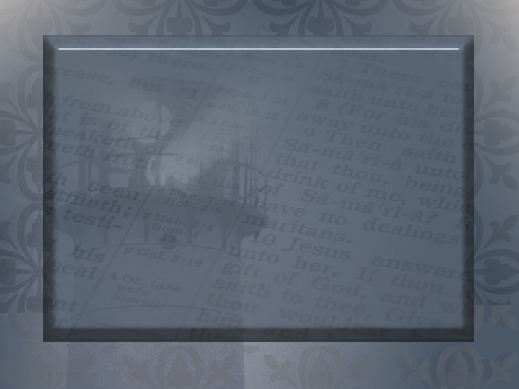
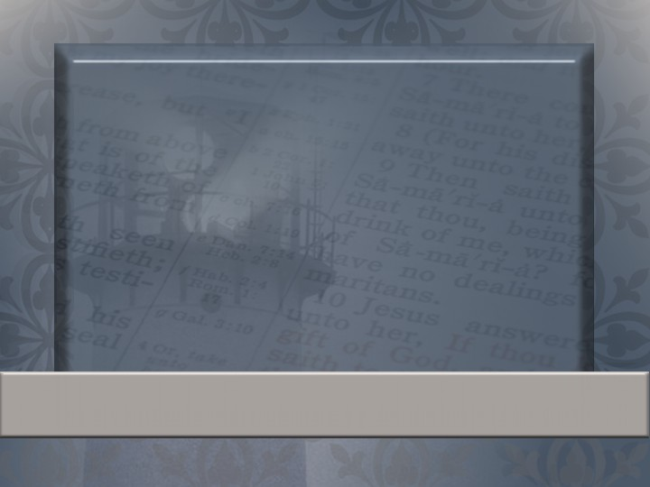
For all flesh is as grass, and all the glory of man as the flower of grass. The grass withereth, and the flower thereof falleth away: But the word of the Lord endureth for ever. And this is the word which by the gospel is preached unto you.
1 Peter 1:24–25
Notes:
Verses that teach me what endures:

Slide 27

The Impossible Dream

Slide 28
BUCKET LIST
If you haven’t heard about the term “bucket list”, it is a list of all the goals you want to achieve, dreams you want to fulfill and life experiences you desire to experience before you die.

Slide 29
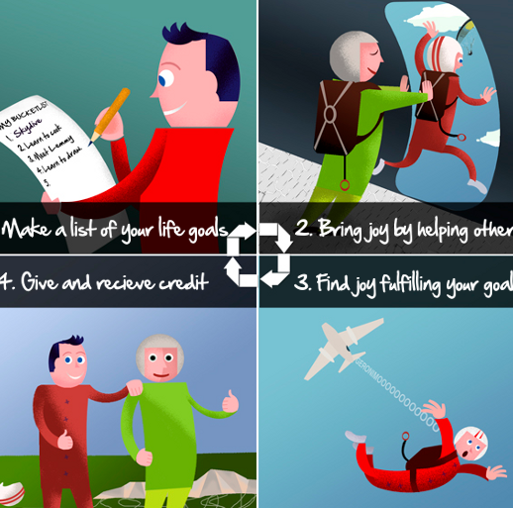
Bucket List?

Slide 30
Challenge:
Make a Bucket List.
Choose 5 goals for this year.
Choose 5 more goals for life.
Keep adding items as you go.
Post this in a place where you always see it.
Share it with others.

Slide 31
Literature Unit 2 Test
70 points (scantron)
Material:
  Intro to Characters
  Treasure Island
  Phaethon
  Walter Mitty
  Revolt of Mother
  Neighbor Rosicky
  Don Quixote
  My Last Duchess
Study:
Vocab*
Authors
Character terms
Character types
Settings
Themes
Literary terms
*MAKE A TEST FOR EACH OTHER!!!

Slide 32
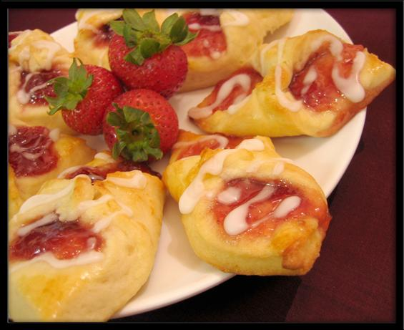
Kolaches

Slide 33
Stem List #3

Slide 34
Fer

Slide 35
Carry

Slide 36
Tomy

Slide 37
Cut

Slide 38
Pan

Slide 39
All

Slide 40
Micro

Slide 41
Small

Slide 42
Spec

Slide 43
Look

Slide 44
Hema

Slide 45
Blood

Slide 46
Mono

Slide 47
One

Slide 48
Photo

Slide 49
Light

Slide 50
Pend

Slide 51
Hang

Slide 52
Tele

Slide 53
Far

Slide 54
Vid

Slide 55
Look

Slide 56
Homo

Slide 57
Same

Slide 58
Omni

Slide 59
All

Slide 60
Phon

Slide 61
Sound

Slide 62
Ex

Slide 63
Out

Slide 64
Pseudo

Slide 65
False

Slide 66
Re

Slide 67
Again

Slide 68
Poly

Slide 69
Many

Slide 70
Neuro

Slide 71
Nerve

Slide 72
Penta

Slide 73
Five

Slide 74
Hypo

Slide 75
Under

Slide 76
Viv

Slide 77
Life

Slide 78
Hydro

Slide 79
Water

Slide 80
Proto

Slide 81
First

Slide 82
Duct

Slide 83
Lead

Slide 84
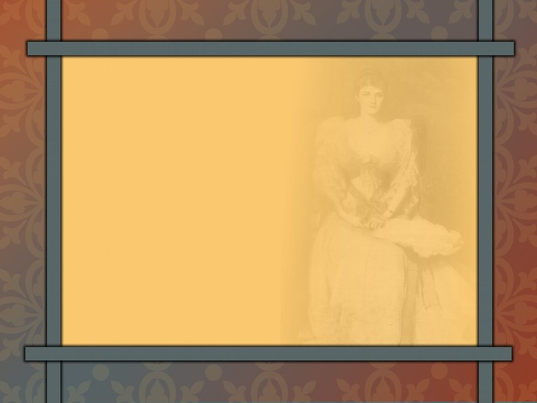
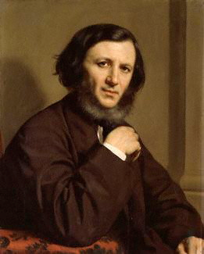
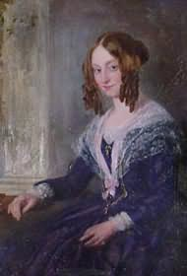
Robert Browning
London
spiritual optimist
excellent characterization
Notes:
Lady: Clipart.com
Make a list

Slide 85
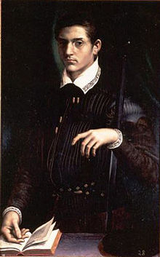
Historical Background
Alfonso II, Duke of Ferrara in Italy, is the duke in this poem.
His first wife died under mysterious circumstances in 1561.
In 1565, he married a second wife, the daughter of the Count of Tyrol.
Notes:
Lady: Clipart.com
Make a list

Slide 86
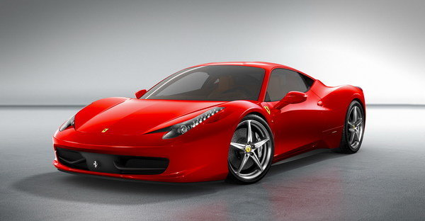
Notes:
Ferrari

Slide 87
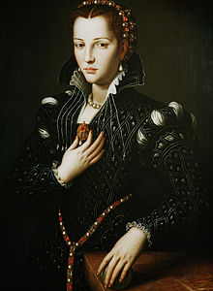
Dramatic Monologue
Notes:
Lady: Clipart.com
Make a list

Slide 88
Imaginary Dialogue
reveals his taste for fine art
his slander of his first wife
lack of appreciation for “great art” in real life
Notes:
Lady: Clipart.com
Make a list

Slide 89
Speech
Formal: impress the envoy
Informal: in unguarded moments he reveals his “true” self
Notes:
Lady: Clipart.com
Make a list

Slide 90
Duke
Italian Renaissance nobleman
Slanders his former wife
Loves fine art
Views wife as a
possession
Proud & self-centered
Jealous & cruel
Notes:
Lady: Clipart.com
Make a list

Slide 91
Duchess
Beautiful
Gracious
Kind
Love beauty
Appreciative
Pleasant
Notes:
Lady: Clipart.com
Make a list

Slide 92
Duke’s Motivations
Warn future wife
Convey expectations for next wife
Impress with his wealth
Notes:
Lady: Clipart.com
Make a list

Slide 93

Pride:
often evident to observers & hidden to possessors
Notes:
____________: often evident to __________ & hidden to _____________

Slide 94

Neptune
Notes:
Horse/Rider: Clipart.com

Slide 95
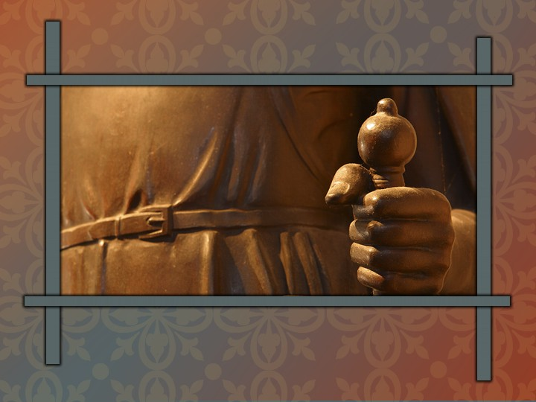
bronze
Notes:
Bronze hand: Clipart.com

Slide 96
Ye have heard that it was said of them of old time, Thou shalt not kill; and whosoever shall kill shall be in danger of the judgment: But I say unto you, That whosoever is angry with his brother without a cause shall be in danger of the judgment:
Matthew 5:21–22
Notes:
Verses that teach me about the seriousness of hateful thoughts:

Slide 97
Literature Unit 2 Test
70 points (scantron)
Material:
  Intro to Characters
  Treasure Island
  Phaethon
  Walter Mitty
  Revolt of Mother
  Neighbor Rosicky
  Don Quixote
  My Last Duchess
Study:
Authors
Character terms
Character types
Settings
Themes
Literary terms
*****MAKE A TEST FOR EACH OTHER!*****

Slide 98
Create Your Own Test….
20 ?’s minimum
A variety of question types
Answer Key included

