Slide 1
Problem Nouns as
Subjects
QUIZ TIME: S or P?

Slide 2
checkers
singular

Slide 3
clothes
plural

Slide 4
goggles
plural

Slide 5
measles
singular

Slide 6
Billiards (pool)
singular

Slide 7
molasses
singular

Slide 8
eyeglasses
plural

Slide 9
riches
plural

Slide 10
news
singular

Slide 11
United States
singular

Slide 12
scissors
plural

Slide 13
tweezers
plural

Slide 14
pants
plural

Slide 15
THE END!

Slide 16
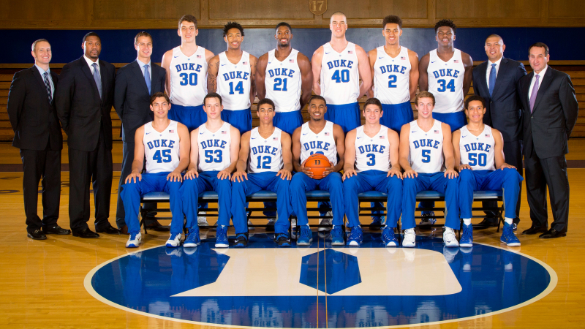
Plural

Slide 17

Plural

Slide 18
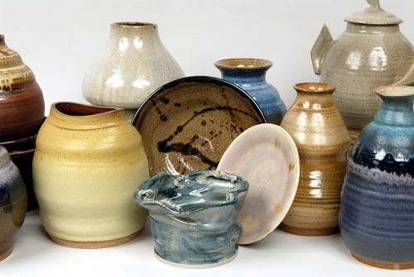
Ics=S or P

Slide 19
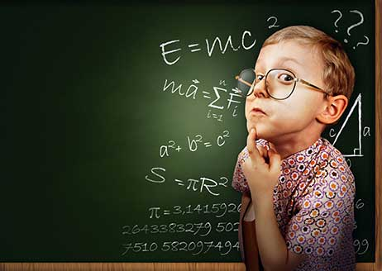
Ics=S or P

Slide 20

Collective nouns can be singular!

Slide 21
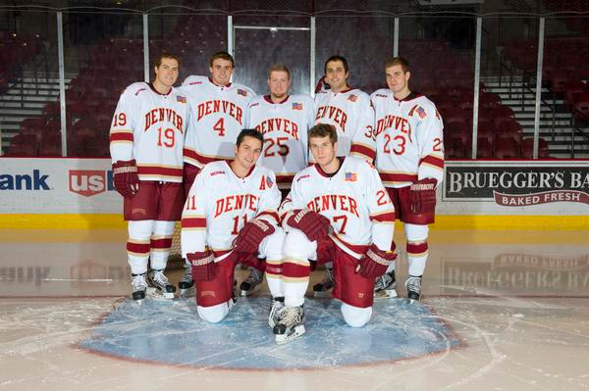

Slide 22
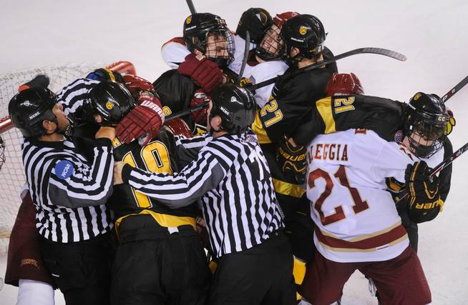

Slide 23

Collective nouns can be plural!

Slide 24
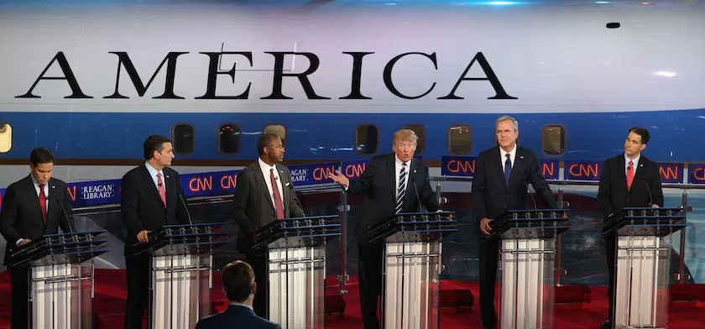
Team?

Slide 25
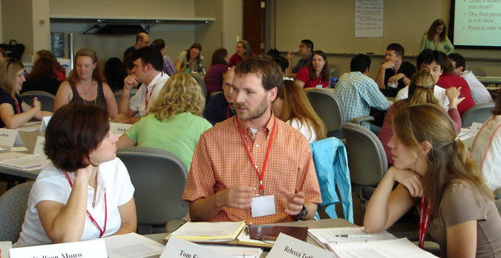
Audience?

Slide 26
Great Expectations
Subject-Verb
Agreement--
Titles
A title is always singular.

Slide 27

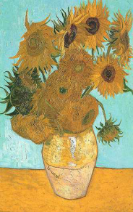
Great Expectations was
written by Charles Dickens.
G.E.
By C.D.
“Fences” is a poem about
neighbors.
Van Gogh’s Sunflowers is
a popular favorite.

Slide 28
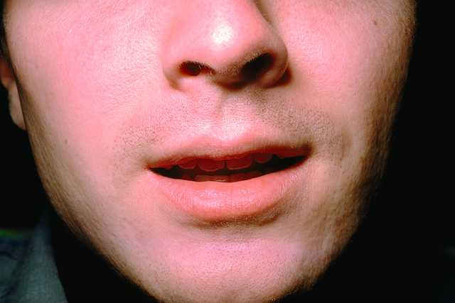
SVA--
Quoted Words
or Phrases
A quoted word or phrase is always singular.

Slide 29
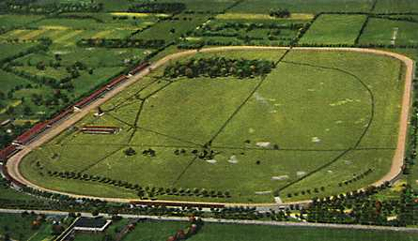
“Gentlemen, start your engines” is how the race is begun.
Hoosiers is the name for
people from Indiana.

Slide 30
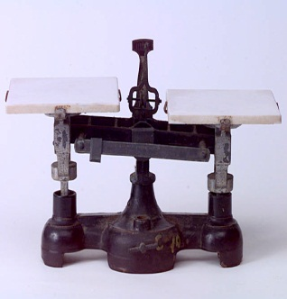
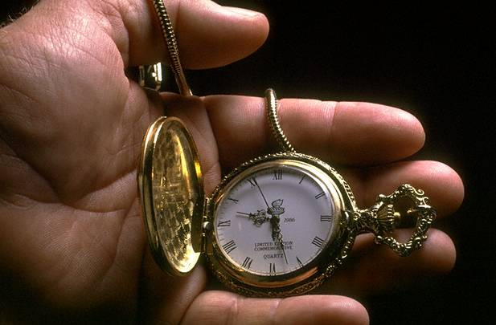
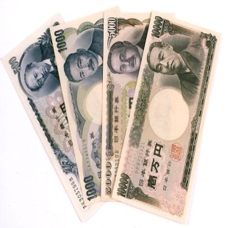
Subject-Verb
Agreement--
Amounts
An amount is always
singular.

Slide 31
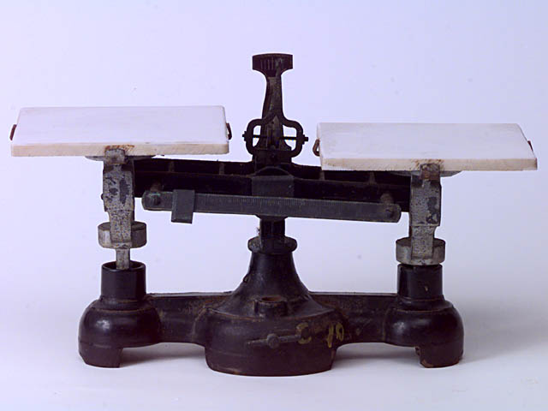
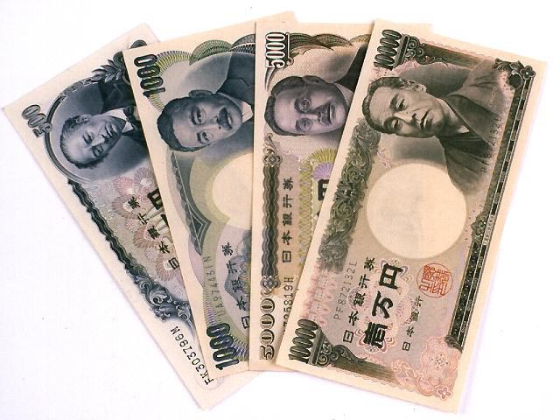
Amounts
measured amounts
amounts of money
periods of time

Slide 32
Four cups of sugar is enough to make two gallons of tea.
Twenty dollars buys a dozen
roses.
Fifty-five years is a long time
to be friends.

Slide 33
Practice the Skill 9-13, pp. 223

Slide 34
P/A Agr.

Slide 35
A pronoun must agree with its antecedent.
ante=before
cedere=to go

Slide 36
Pronoun
Characteristics
Number
Gender
Case
Person

Slide 37
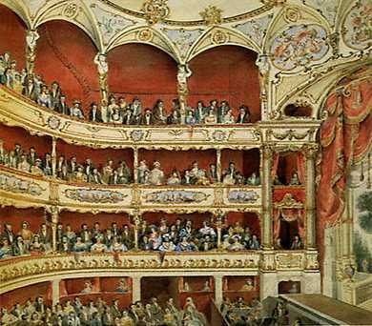
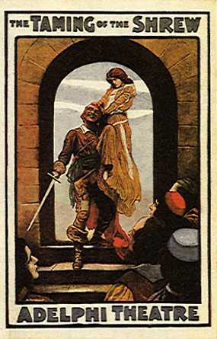
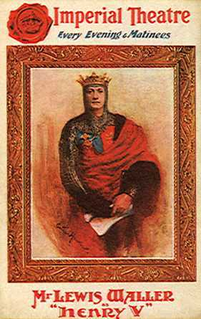
Either the producer or the actors need to express their ideas about the production of the play.

Slide 38

The police officers used their logic and intuition to track down several suspects.

Slide 39
If an antecedent referring to a person does not specify gender, use a singular masculine pronoun.

Slide 40
Investigator Young knew that he would need more evidence.

Slide 41
Neither the police officers nor the investigator could rest until he had the case solved.

Slide 42
Each of the four suspects had his alibi ready.

Slide 43
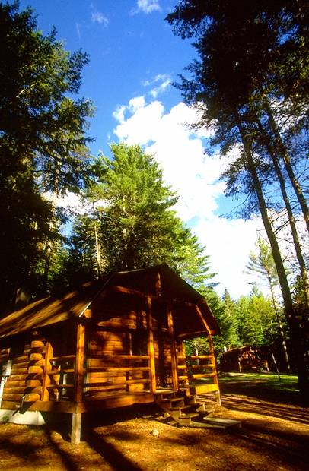
  Anybody who wants go to camp should sign his name on the list.
Someone has lost his back pack.

Slide 44
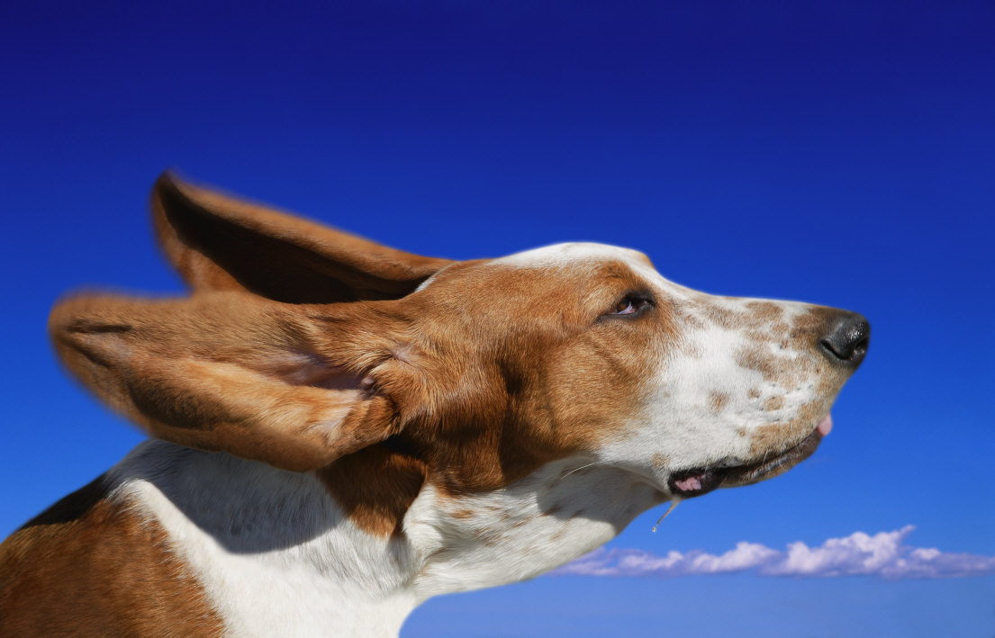
Use a neuter pronoun when referring to animals unless the context implies that the animal is masculine or feminine.

Slide 45
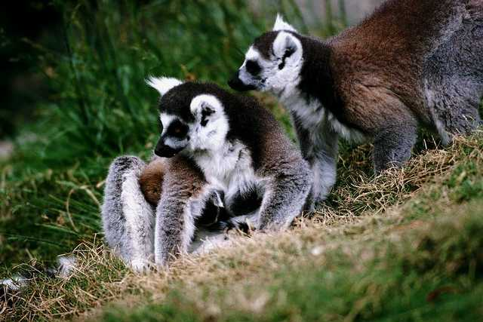
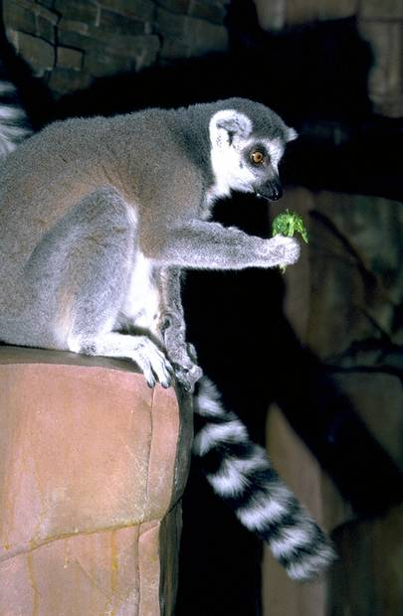
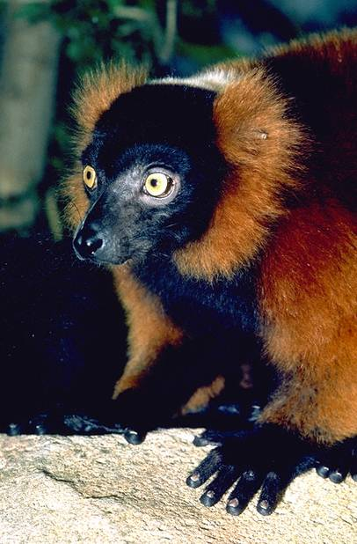
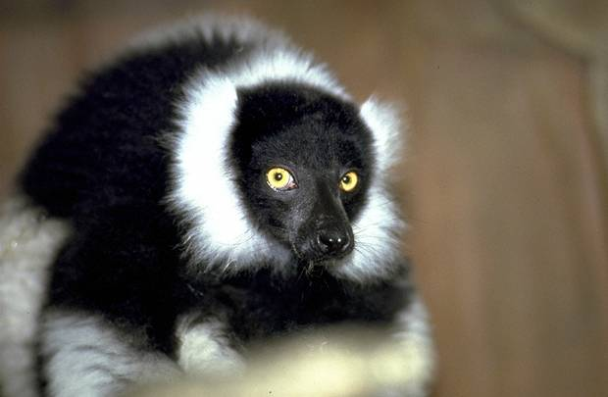
A lemur is a primate, and its home is in Madagascar.
The male lemur is a wanderer. He will live with several lemur families in his lifetime.
The female lemur carries her young in her mouth.

Slide 46
Practice the Skill 9-15, pp. 225-226

Slide 47
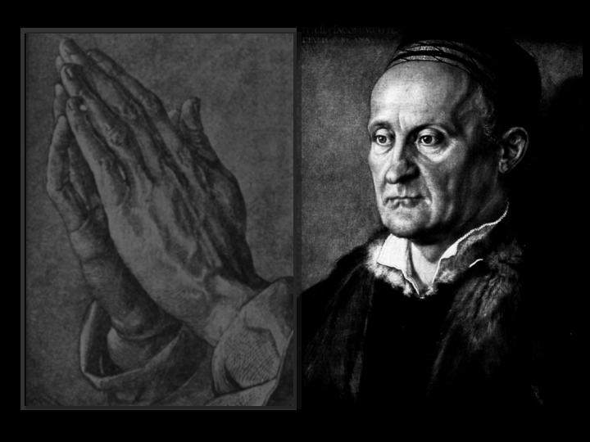
1. Miss Landry told us that German artist Albrecht Dürer’s engravings demonstrate that ___ was interested in Christian themes.
he

Slide 48
2. At which gallery in New York did Wanda Gág, an illustrator of children’s books, first display ___ woodcuts and lithographs?
her

Slide 49
3. Early in her life, Gág drew for a newspaper so that ___ could support her family.
she

Slide 50
4. Engravers cut into a flat metal plate and then use __ to print the design.
it

Slide 51
5. An artist’s slow movements dictate how good ____ cutting will be.
his

Slide 52
compound antecedents
and, both-and
plural pronoun

Slide 53
Both the Greenville drama school and the Charleston drama school are producing their versions of Shakespeare’s Henry V.

Slide 54
compound antecedents
or, nor, either-or, neither-nor
agree with nearer antecedent

Slide 55
Either the producer or the actors need to express their ideas about the production of the play.

Slide 56
Practice the Skill 9-17, pp.227-228

Slide 57
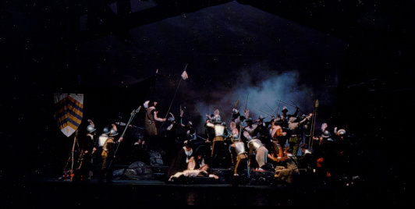
1. Both ancient philosophers and modern writers have used drama to express (his, their) philosophical ideas.

Slide 58
2. Either a tragedy or a serious drama explores questions about the meaning of life in (its, their) theme.

Slide 59
3. Often a nobleman or an admirable person comes to disaster through (his, their) tragic flaw.

Slide 60
4. Usually neither the tragic hero nor his loved ones can escape (his, their) fate in the play.

Slide 61
5. In many tragedies, one or more characters are faced with dilemmas, and (he, they) must make difficult moral decisions.

Slide 62
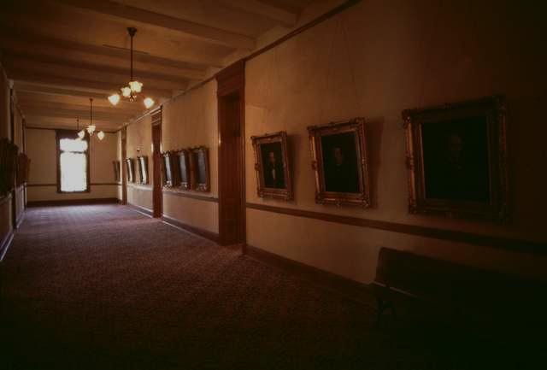
More brought their antiques to the exhibit than was expected.
Each of the antiques has its own unique beauty.

Slide 63
All of the antique dealers had their eyes on the most expensive pieces.
Most of the picture frame had its paint scratched from being moved too often.

Slide 64
Someone bought the eighteenth-century pitcher for his wife.
Someone sold her husband pieces of antique costume jewelry.

Slide 65
Practice the Skill 9-19, p. 230.

Slide 66
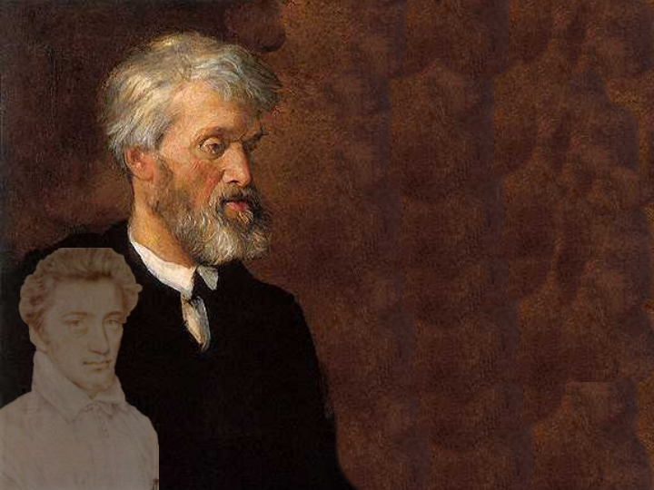
1. Each of the art students enjoyed working on ___ drawing project.
his

Slide 67
2. Everyone in art class was given ___ own subject.
his

Slide 68
3. Several of the girls drew _____ pictures to use in a later painting.
their

Slide 69
4. One of the girls used chalk for ___ drawing.
her

Slide 70
5. Another used pencil for ___ entry.
her

Slide 71
Review the Skill 9-20, p. 230.

Slide 72

1. Most of my classmates enjoyed their decoupage assignment.
C

Slide 73
2. However, not everybody enjoyed their task of cutting out paper to decorate items.
his

Slide 74
3. All of the girls disliked taking her time to cut out the intricate designs.
their

Slide 75
4. Neither of the boys enjoyed decorating his box.
C

Slide 76
5. However, both of them enjoyed sanding and staining his boxes.
their

