Slide 1
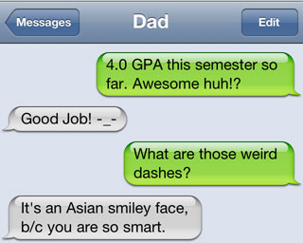
Happy Monday!
Bring your grammar book.
2. Have out your pretest.

Slide 2
Novel 2 Project
How is your reading going?

Slide 3
Ch. 12 Pretest
Quotation Marks, Italics, and Ellipses
26. B
27. A
28. C
29. A
30. A
31. B
32. C
33. B
34. A
35. B
Apostrophes, Hyphens, etc.
36. B
37. D
38. C.
39. A
40. A

Slide 4


Slide 5
Hyphens
Hyphens: (-)
Join parts of words & separate words
Omission of a Connecting Word: Used in place of a connecting word.
  Acts I-V
  6:00-7:00
(Not needed with conjunctions: from 5 to 6; between 6 and 7)

Slide 6
Hyphens
Word Di-vision/End of a Line:
Goes at the end of a line, not at the beginning of the next line.
2+ letters and the hyphen must re-
main on first line.
3+ letters must appear on se-
cond line
If in doubt, look up the word division.

Slide 7
Hyphens
Numbers and Fractions:
Twenty-one through ninety-nine (21-99) are hyphenated, even when they are part of larger numbers.
Hyphens go between the numerator-demoninator.
  One-fourth
  Two-thirds
  Exception: thirty-five hundredths

Slide 8
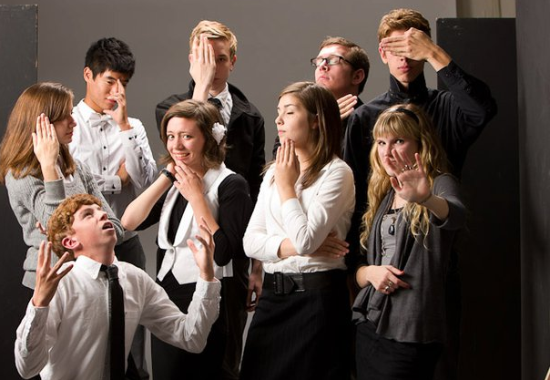
Hyphens
Compounds:
sister-in-law
Multiword Modifiers:
Long-legged
Funny-looking

Slide 9
Dashes—
Dashes—TWICE as long
Use sparingly.
Example: interrupting clauses
Faltering speech/Change of thought
  “I think I—what was that?”
Abrupt endings
  “But you said—”

Slide 10
(Parentheses)
Parentheses-(enclose extra info)
Words, phrases, clauses, sometime whole sentences
Punctuation:
  Punctuation stays OUTSIDE parentheses unless a whole sentence is enclosed.
  Bible References (Romans 8:28)
  Numbers (1) or letters (A) within sentences

Slide 11
Worksheet Challenge

Slide 12
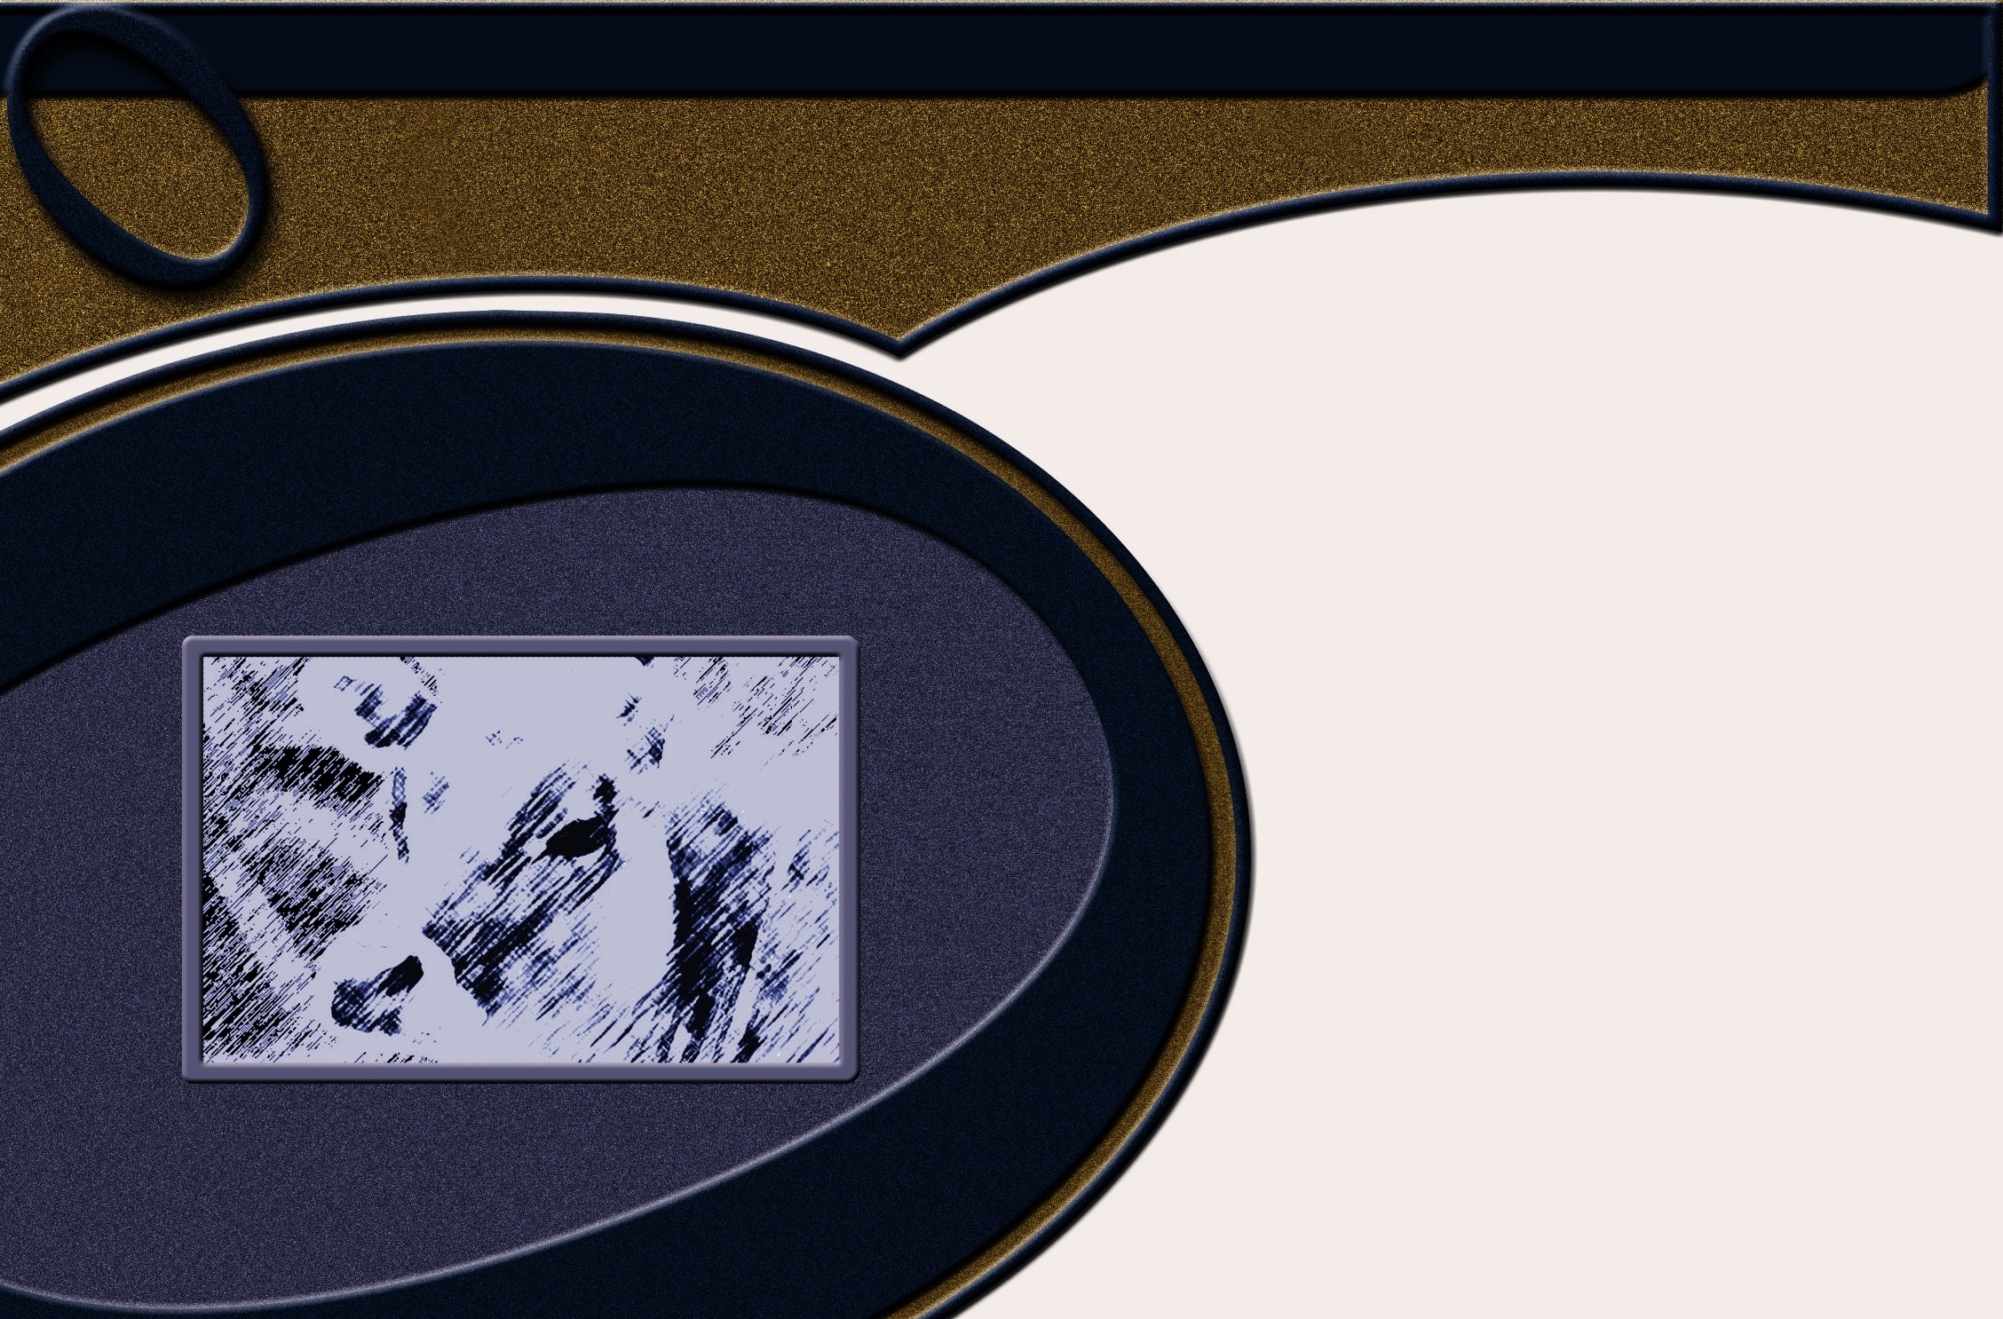
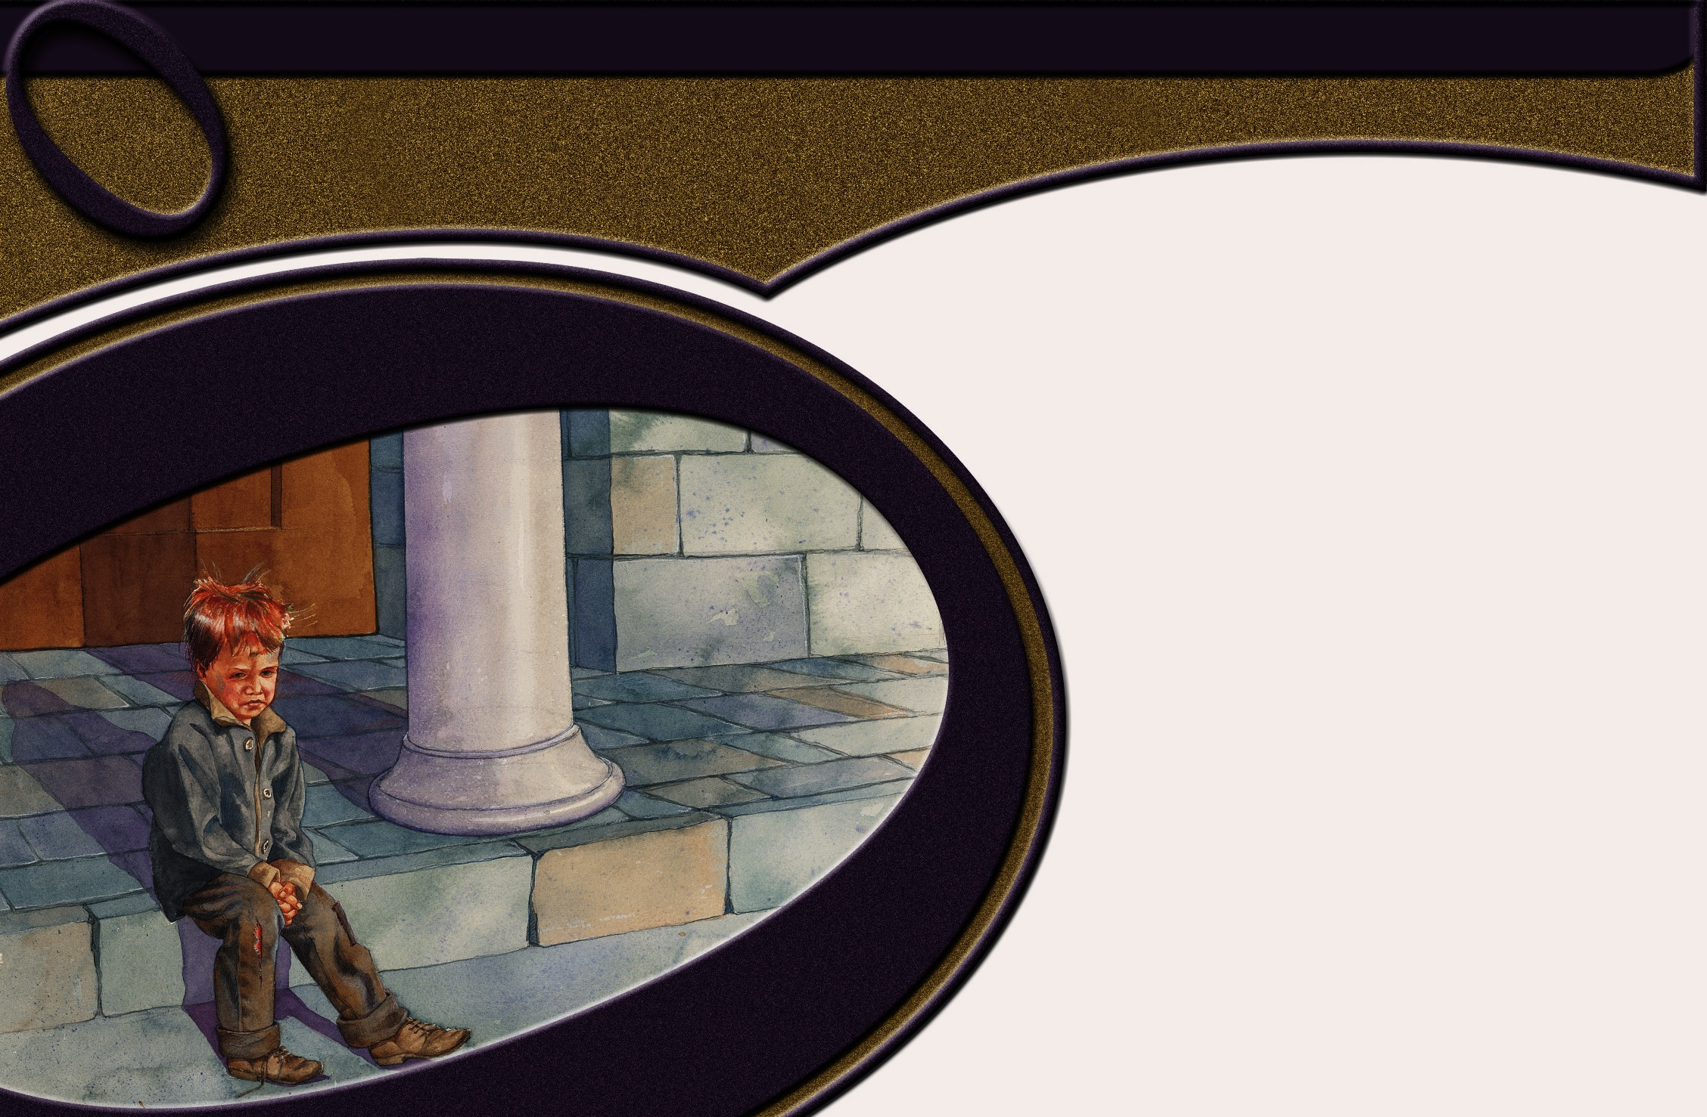
Chapter 12
Punctuation

Slide 13


*Write the word before the comma and the comma in the following examples. Write C if correct.

Slide 14
Introductory Elements
Having finished the laundry Mom and I took a short break.

Slide 15
Introductory Elements
participial phrases
Having finished the laundry, Mom and I took a short break.

Slide 16
Introductory Elements
With a list of jobs in her hand Mom decided what we should do next.

Slide 17
Introductory Elements
With a list of jobs in her hand, Mom decided what we should do next.

Slide 18
Introductory Elements
First I would wash the sliding glass door while Mom vacuumed.

Slide 19
Introductory Elements
numbering words
First, I would wash the sliding glass door while Mom vacuumed.

Slide 20
Introductory Elements
After we finished those jobs we dusted the shelves and cleaned the bathroom.

Slide 21
Introductory Elements
adverb clauses
After we finished those jobs, we dusted the shelves and cleaned the bathroom.

Slide 22
Introductory Elements
Before quitting we had made every square inch of the house spotless.

Slide 23
Introductory Elements
other elements
Before quitting, we had made every square inch of the house spotless.

Slide 24


Slide 25

Interjections
Well I prefer cherries rather than strawberries.
Will you hand me some more please?

Slide 26
Interjections
Well, I prefer cherries rather than strawberries.
Will you hand me some more, please?

Slide 27
Parenthetical
Expressions
The rose by the way is my mom’s favorite flower.

Slide 28
Parenthetical
Expressions
The rose, by the way, is my mom’s favorite flower.

Slide 29
Appositives
The word plant comes from a Latin word referring to the bottom of the foot.

Slide 30
Appositives
The word plant comes from a Latin word referring to the bottom of the foot.

Slide 31
Restrictive Clause
The plant which has become most familiar to me is poison ivy.

Slide 32
Restrictive Clause
The plant which has become most familiar to me is poison ivy.

Slide 33
Restrictive Clause
Poison ivy which grows near my house causes a rash on my skin.

Slide 34
Restrictive Clause
Poison ivy, which grows near my house, causes a rash on my skin.

Slide 35
Nonrestrictive
Element
Soccer which is my favorite hobby is an intense sport.

Slide 36
Nonrestrictive
Element
Soccer, which is my favorite hobby, is an intense sport.

Slide 37


Commas
With dates
On April 22, 2011 your paper is due.

Slide 38
Commas
With dates
On April 22, 2011, your paper is due.

Slide 39

Semicolons
While watching television and eating popcorn with my girlfriend, I did my homework I don’t know why I didn’t do well.

Slide 40
Semicolons
1. Join equal elements
2. fairly strong mark
3. Used between two independent clauses
While watching television and eating popcorn with my girlfriend, I did my homework; I don’t know why I didn’t do well.

Slide 41
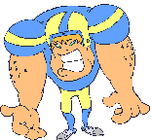

Slide 42

Colons
We will discuss the following topics at today’s meeting a new principal, time off, and extended vacations.
We would like to welcome our most important guest Dr. Jones.

Slide 43
Colons
Before a series at the end of a sentence
We will discuss the following topics at today’s meeting: a new principal, time off, and extended vacations.
Emphasizes a single appositive
We would like to welcome our most important guest: Dr. Jones.

Slide 44
Colons
Hazel forgot the following things her keys, her driver’s license, and her money.

Slide 45
Colons
Not before a series that is part of the sentence pattern or after the words such as or including
Hazel forgot the following things: her keys, her driver’s license, and her money.

Slide 46

Colons
Dr. Williams began his speech to the student body by quoting John Donne’s famous statement “No man is an island.”

Slide 47
Colons
Before a formal quotation
Dr. Williams began his speech to the student body by quoting John Donne’s famous statement: “No man is an island.”
(The introduction to the quotation must be a complete sentence, and the quotation must be the last element in the sentence.)

Slide 48
Editing Paragraph

Slide 50
He thought it was something more than a blown transformer. People were crying. Some were throwing up not because they had just run a marathon.
“They were freaking out ” he said.
They stopped to talk to a bus driver. That’s when they found out what really happened.
By then barricades were in place and fifteen blocks of downtown Boston was evacuated and the trains were shut down.
A fraternity at Massachusetts Institute of Technology offered the victims food water snacks and a restroom.
Many long hours after this, my family members made it to Newton where they had parked.
Zeke later called and described this dramatic experience running with so many others in one of the world’s premier marathons. By the end of Patriot’s Day the marathon was just a memory. He wanted to talk about his little niece his graduation next month from Norwich University in Vermont, and his upcoming officer’s commissioning service into the Marines.
After an afternoon filled with questions it was just good to hear his voice.

