Slide 1
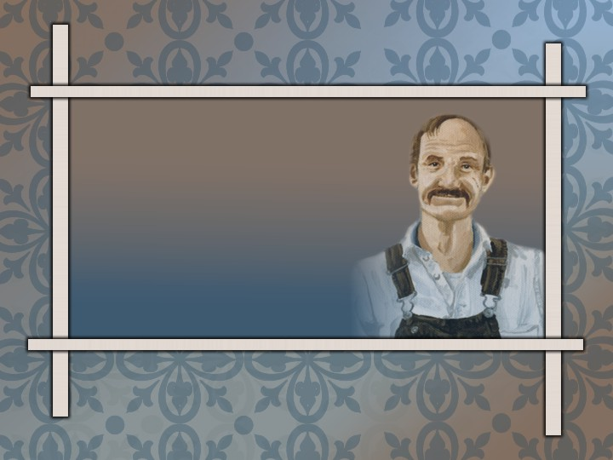
Happy Friday!
Have out your bio project and a grading pen.
Notes:
Title → reveals ______ ____________ and his ______ _____________

Slide 2
Any interesting stories?
Notes:
Title → reveals ______ ____________ and his ______ _____________

Slide 3
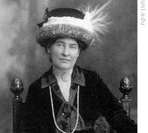
AUTHOR
I. Willa Cather
A. Nebraska
B. realistic fiction
C. famous for O Pioneers and My Antonia
D. Pulitzer Prize (1923) for her WWI novel called One of Ours.

Slide 4
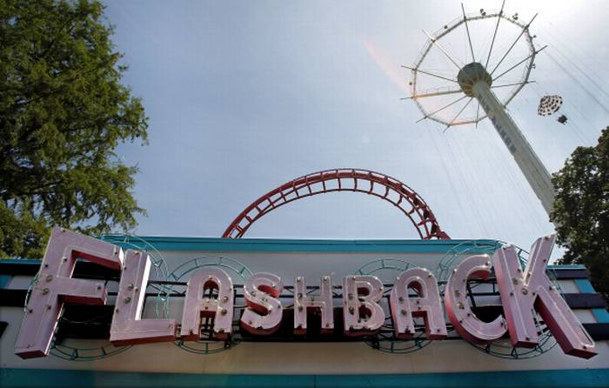
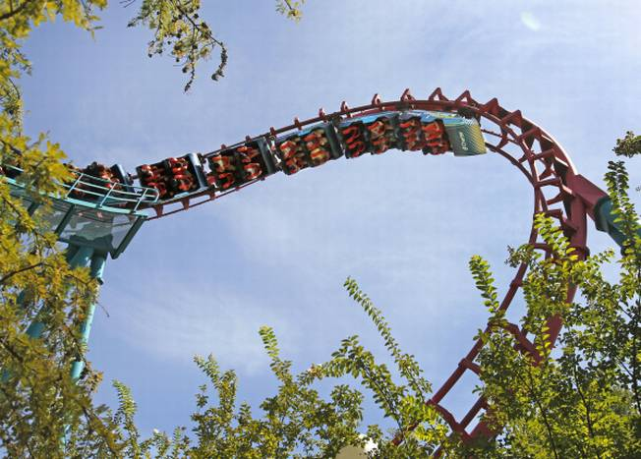
WRITING TECHNIQUES
II. Writing Techniques:
A. flashback—a previous event that interrupts the story
B. local color—features particular to a specific region (dialect, customs, characters, etc.)
Notes:
Flashback=Famous Texas Six Flags ride

Slide 5
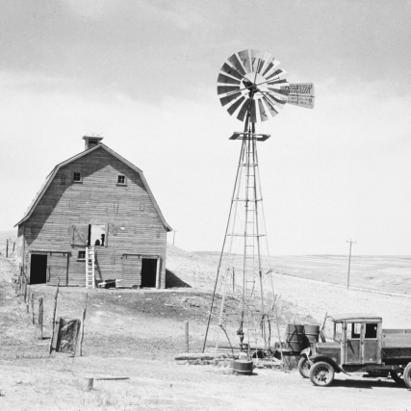
SETTINGS
III. Settings:
Dr. Burleigh’s office—heart problem revealed
B. Rosicky’s house—welcoming environment

Slide 6
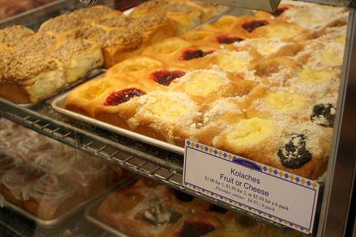

Slide 7
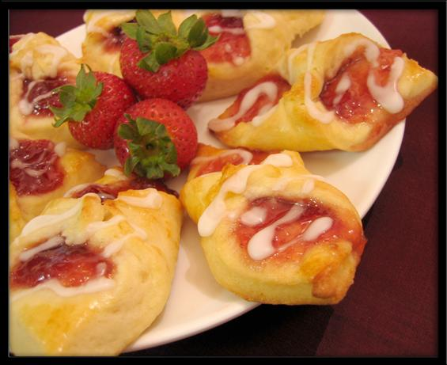

Slide 8
CHARACTERS
IV. Main Characters:
Rosicky—65, Czechoslovakian (Bohemian) bad heart (antagonist), contented, happy, generous, industrious
Mary—50, American country girl, good wife, talkative, strong, hospitable
C. Dr. Ed Burleigh—loves the Rosickys and understands them
D. Polly—American daughter-in-law, city girl, sensitive, lonely, stylish, dynamic

Slide 9
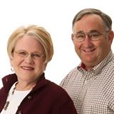
Hug your Mama!
Courtesy of Mr. Weathers

Slide 10
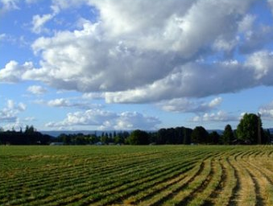
Rosicky’s philosophy
“To be a landless man was to . . . have nothing, to be nothing.”

Slide 11
Rosicky’s Best Qualities
  Patience
  Kindness
  Unselfishness
"never under any circumstances raised his voice or spoke roughly.“
“Yes, she's [Polly] a fine girl. Dat widder woman [Polly's mother] bring her daughters up very nice. Polly got lots of spunk, an' she got some style, too."

Slide 12
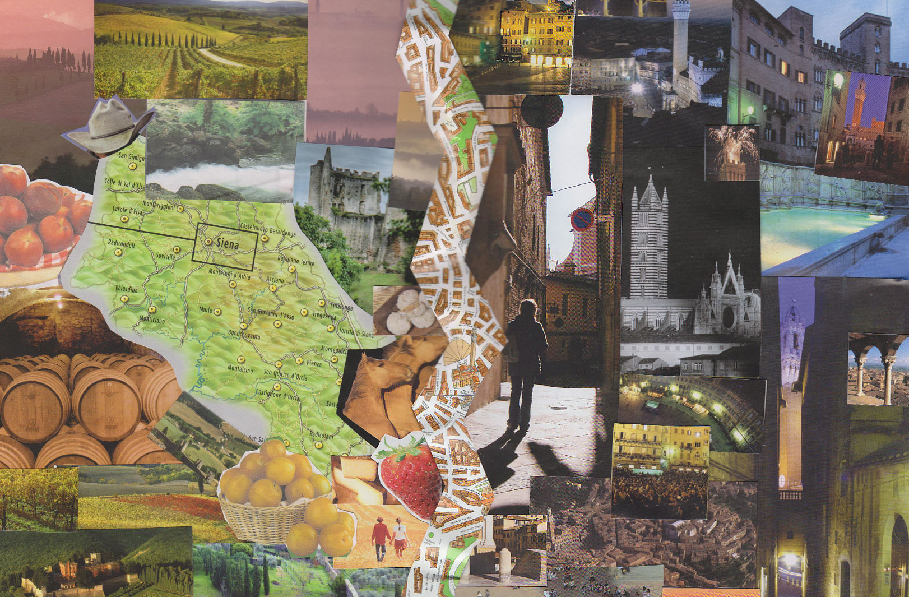
Rosicky’s Preferences
  country
    watch sun rise and set
    plant things/watch growth
    own your land
    people are not as mean
    graveyards are beautiful
city
walled in with stone and asphalt
easy on the rich; hard on the poor
c. harder to own land
d. people are unfriendly
e. graveyards are lonely

Slide 13
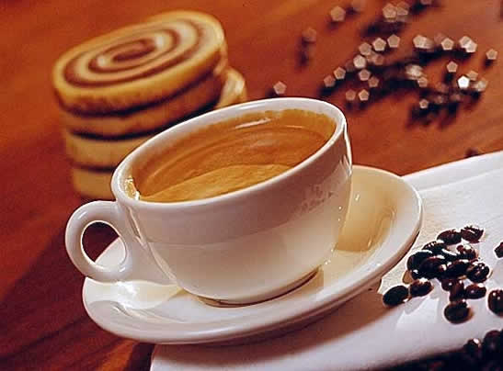
Rosicky’s Old Fashioned Ideas
Preferring sons marry Czech girls
Drinking rich coffee
Excessive work ethic

Slide 14
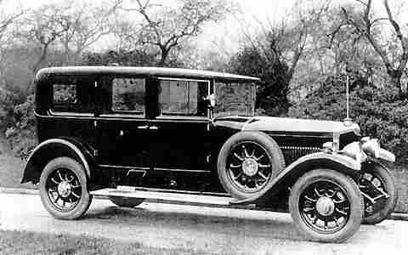
Rosicky’s Most Important values=people
people vs. belongings
children’s happiness vs. his bank account
a night out for Polly vs. his own leisure and comfort

Slide 15
Rosicky’s Lesson (Theme)
?????

Slide 16
Hardship reveals what is important. Value the things that are eternal.
Notes:
Title → reveals ______ ____________ and his ______ _____________

Slide 17
FAIRY TALES
“If you want your children to be intelligent, read them fairy tales. If you want them to be more intelligent, read them more fairy tales.” –Albert Einstein
“When I was ten, I read fairy tales in secret and would have been ashamed if I had been found doing so. Now that I am fifty, I read them openly. When I became a man I put away childish things, including the fear of childishness and the desire to be very grown up.”—C.S. Lewis

Slide 18
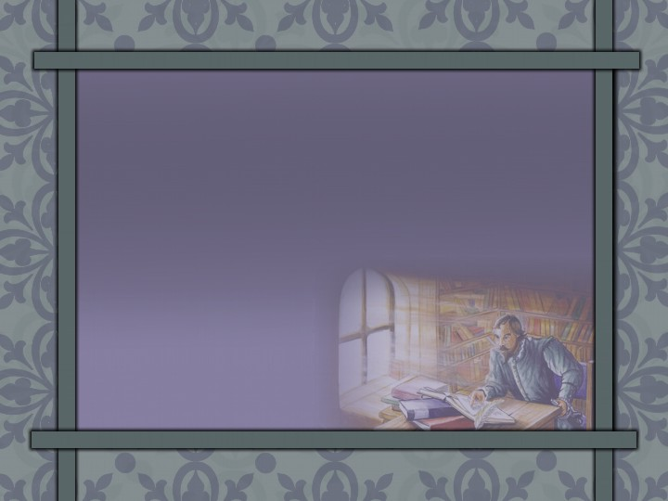
Don Quixote
take-home quiz
Notes:
Make a list

Slide 19
Don Quixote
Notes:
Make a list

Slide 20
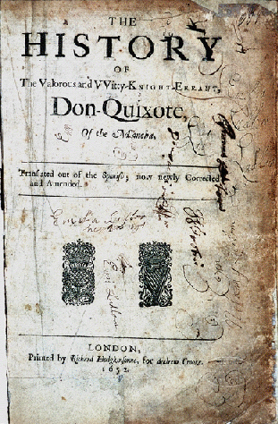
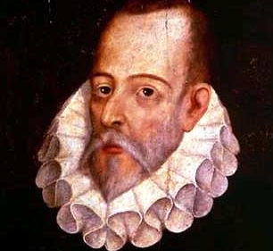
Miguel de Cervantes 1547-1616
Notes:
Make a list

Slide 21
Cervantes:
Madrid, Spain
Served in Spanish army
Captured by pirates/sold into slavery
Imprisoned for debts
1601: Don Quixote brought him great fame and stability

Slide 22
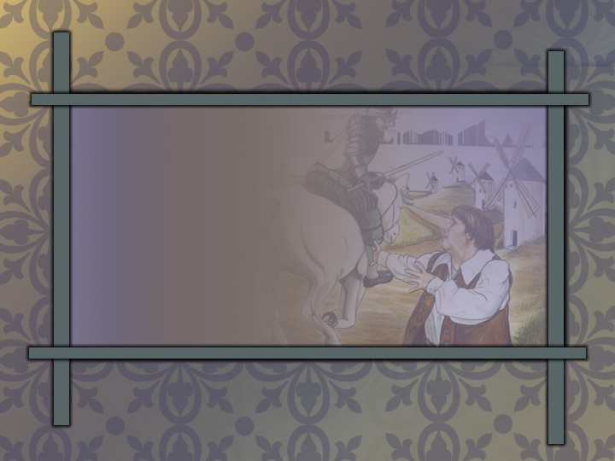
Don Quixote
1st European novel and forerunner of some of the greatest novels
Notes:
Don Quixote → __________ of some of the greatest _______

Slide 23
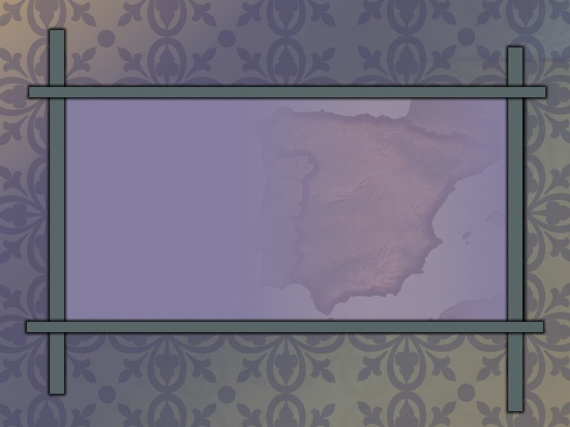
Cervantes’ Spain
Explorations & Discoveries: Americas & Sailing around the World
Arts: Golden Age
Notes:
Map: Map Art™ ©1996 Cartesia
Cervantes’ Spain
Explorations & Discoveries: __________ & Sailing Around the _______
Arts: _______ _____

Slide 24
Cervantes’ Spain
Government: relatively stable
Social Structure: Aristocracy,
Small Middle Class, Peasants
Religion: dominated by controlling Roman Catholics
Notes:
Map: Map Art™ ©1996 Cartesia
Government: ________ _______
Social Structure: ___________, Small _______ ______, _________
Religion: dominated by controlling ________ _________
?=What violence is attached to Spanish history?
?=What class was Don Quixote? Is it possible to have title but no money?

Slide 25

Purple Prose
unnecessarily exaggerated, flowery language
Notes:
Purple prose → unnecessarily ____________ flowery language
Read paragraph on pg. 2=What is the problem?
Many writers wrote this way.

Slide 26

Suspension of Disbelief
willingness of a reader to accept the unbelievable as true
Notes:
Suspension of Disbelief → willingness of a ________ to accept the ____________ as _____

Slide 27
Don Quixote
An obscure gentleman
Story recorded as actual history
Childish infatuation with unreality

Slide 28


Tragic Hero
the protagonist of a tragedy
Notes:
Can a tragedy be comical?
Give other examples of tragic heros?

Slide 29
Unsympathetic Character
a character with whom the reader cannot identify or for whom the reader has strong feelings of dislike
Notes:
Quixote/Panza

Slide 30
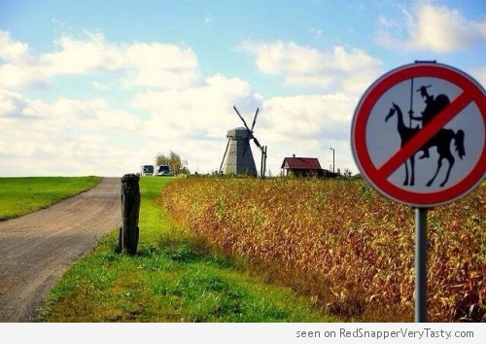

Slide 31

Sancho Panza
His name means “holy belly”
Notes:
Sanch = ______ → _______ outlook directly ______ Don Quixote’s

Slide 32
Sancho Panza
= Foil
His realistic outlook directly opposes Don Quixote’s.
Notes:
Sanch = ______ → _______ outlook directly ______ Don Quixote’s

Slide 33
Foil
a character who emphasizes another character’s opposing traits within a work

Slide 34
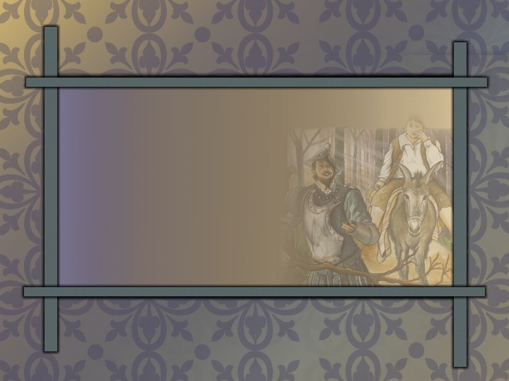
Don Quixote & Sancho
on a selfish quest
= Similarity
Notes:
List of sorts—changing element left blank

Slide 35
Don Quixote & Sancho
deluded
= Similarity

Slide 36
Don Quixote & Sancho
denial of reality
= Similarity

Slide 37
Don Quixote
vs. Sancho:
Romantic — Realistic
Notes:
_____ _________ vs. __________: __________ vs. _________

Slide 38
True nobility
idealism tempered with realism
Notes:
True _______ → __________ tempered with _________

Slide 39

Reality
God’s Word
Notes:
Bible/Cross: Clipart.com
__________ → God’s _______

Slide 40
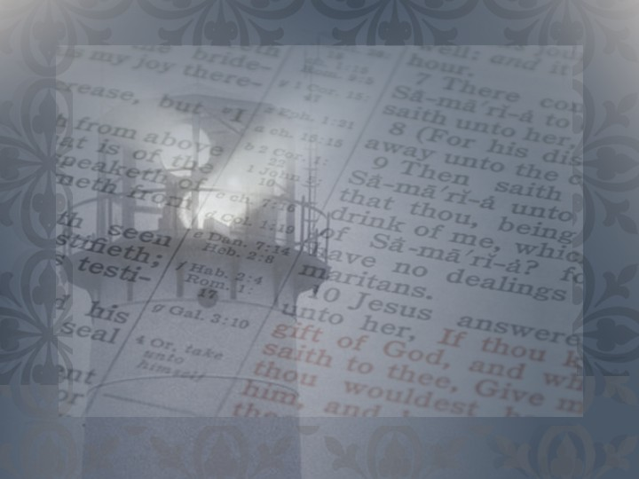
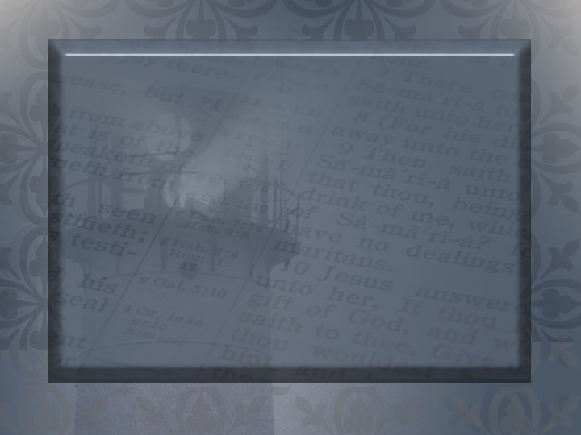
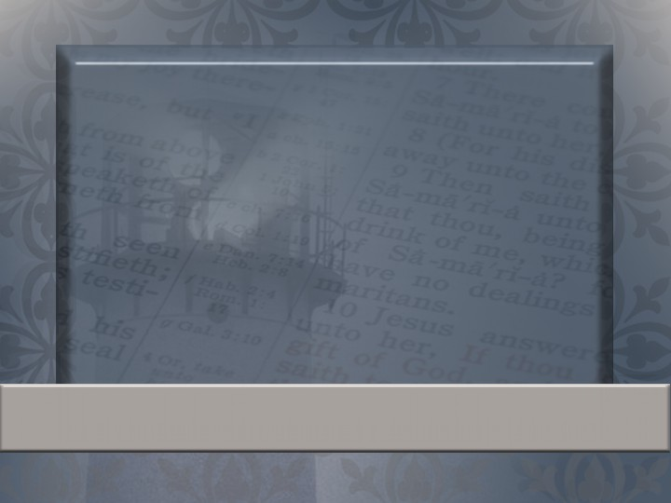
For all flesh is as grass, and all the glory of man as the flower of grass. The grass withereth, and the flower thereof falleth away: But the word of the Lord endureth for ever. And this is the word which by the gospel is preached unto you.
1 Peter 1:24–25
Notes:
Verses that teach me what endures:

Slide 41

The Impossible Dream

Slide 42
BUCKET LIST
If you haven’t heard about the term “bucket list”, it is a list of all the goals you want to achieve, dreams you want to fulfill and life experiences you desire to experience before you die.

Slide 43
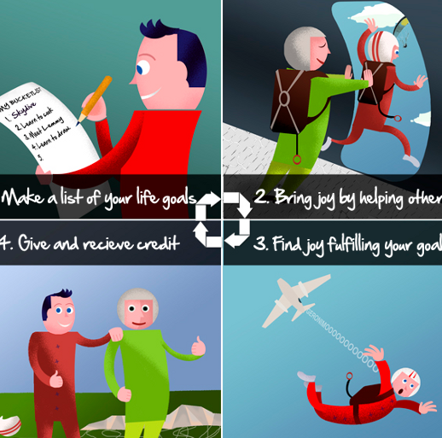
Bucket List?

Slide 44
Challenge:
Make a Bucket List.
Choose 5 goals for this year.
Choose 5 more goals for life.
Keep adding items as you go.
Post this in a place where you always see it.
Share it with others.

Slide 45
Literature Unit 2 Test
70 points (scantron)
Material:
  Intro to Characters
  Treasure Island
  Phaethon
  Walter Mitty
  Revolt of Mother
  Neighbor Rosicky
  Don Quixote
  My Last Duchess
Study:
Vocab*
Authors
Character terms
Character types
Settings
Themes
Literary terms
*MAKE A TEST FOR EACH OTHER!!!

Slide 46
Kolaches

Slide 47
Stem List #3

Slide 48
Fer

Slide 49
Carry

Slide 50
Tomy

Slide 51
Cut

Slide 52
Pan

Slide 53
All

Slide 54
Micro

Slide 55
Small

Slide 56
Spec

Slide 57
Look

Slide 58
Hema

Slide 59
Blood

Slide 60
Mono

Slide 61
One

Slide 62
Photo

Slide 63
Light

Slide 64
Pend

Slide 65
Hang

Slide 66
Tele

Slide 67
Far

Slide 68
Vid

Slide 69
Look

Slide 70
Homo

Slide 71
Same

Slide 72
Omni

Slide 73
All

Slide 74
Phon

Slide 75
Sound

Slide 76
Ex

Slide 77
Out

Slide 78
Pseudo

Slide 79
False

Slide 80
Re

Slide 81
Again

Slide 82
Poly

Slide 83
Many

Slide 84
Neuro

Slide 85
Nerve

Slide 86
Penta

Slide 87
Five

Slide 88
Hypo

Slide 89
Under

Slide 90
Viv

Slide 91
Life

Slide 92
Hydro

Slide 93
Water

Slide 94
Proto

Slide 95
First

Slide 96
Duct

Slide 97
Lead

Slide 98
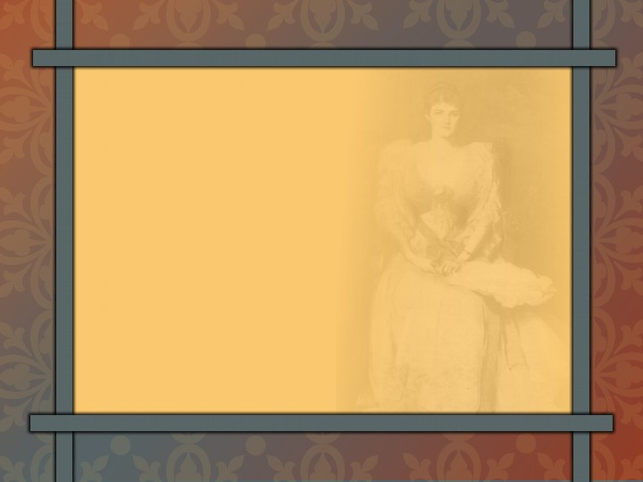
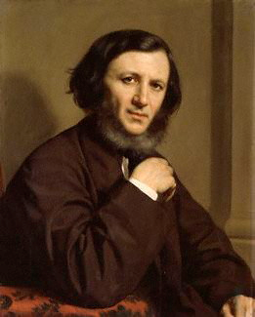
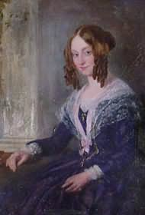
Robert Browning
London
spiritual optimist
excellent characterization
Notes:
Lady: Clipart.com
Make a list

Slide 99
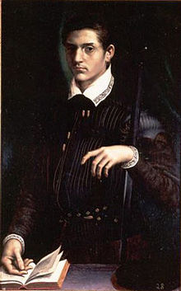
Historical Background
Alfonso II, Duke of Ferrara in Italy, is the duke in this poem.
His first wife died under mysterious circumstances in 1561.
In 1565, he married a second wife, the daughter of the Count of Tyrol.
Notes:
Lady: Clipart.com
Make a list

Slide 100
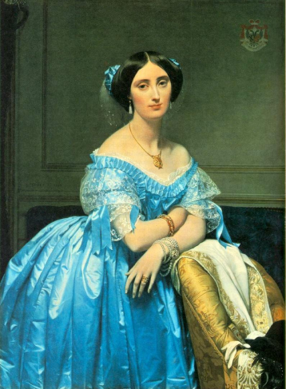
Dramatic Monologue
Notes:
Lady: Clipart.com
Make a list

Slide 101
Imaginary Dialogue
reveals his taste for fine art
his slander of his first wife
lack of appreciation for “great art” in real life
Notes:
Lady: Clipart.com
Make a list

Slide 102
Speech
Formal: impress the envoy
Informal: in unguarded moments he reveals his “true” self
Notes:
Lady: Clipart.com
Make a list

