Slide 1

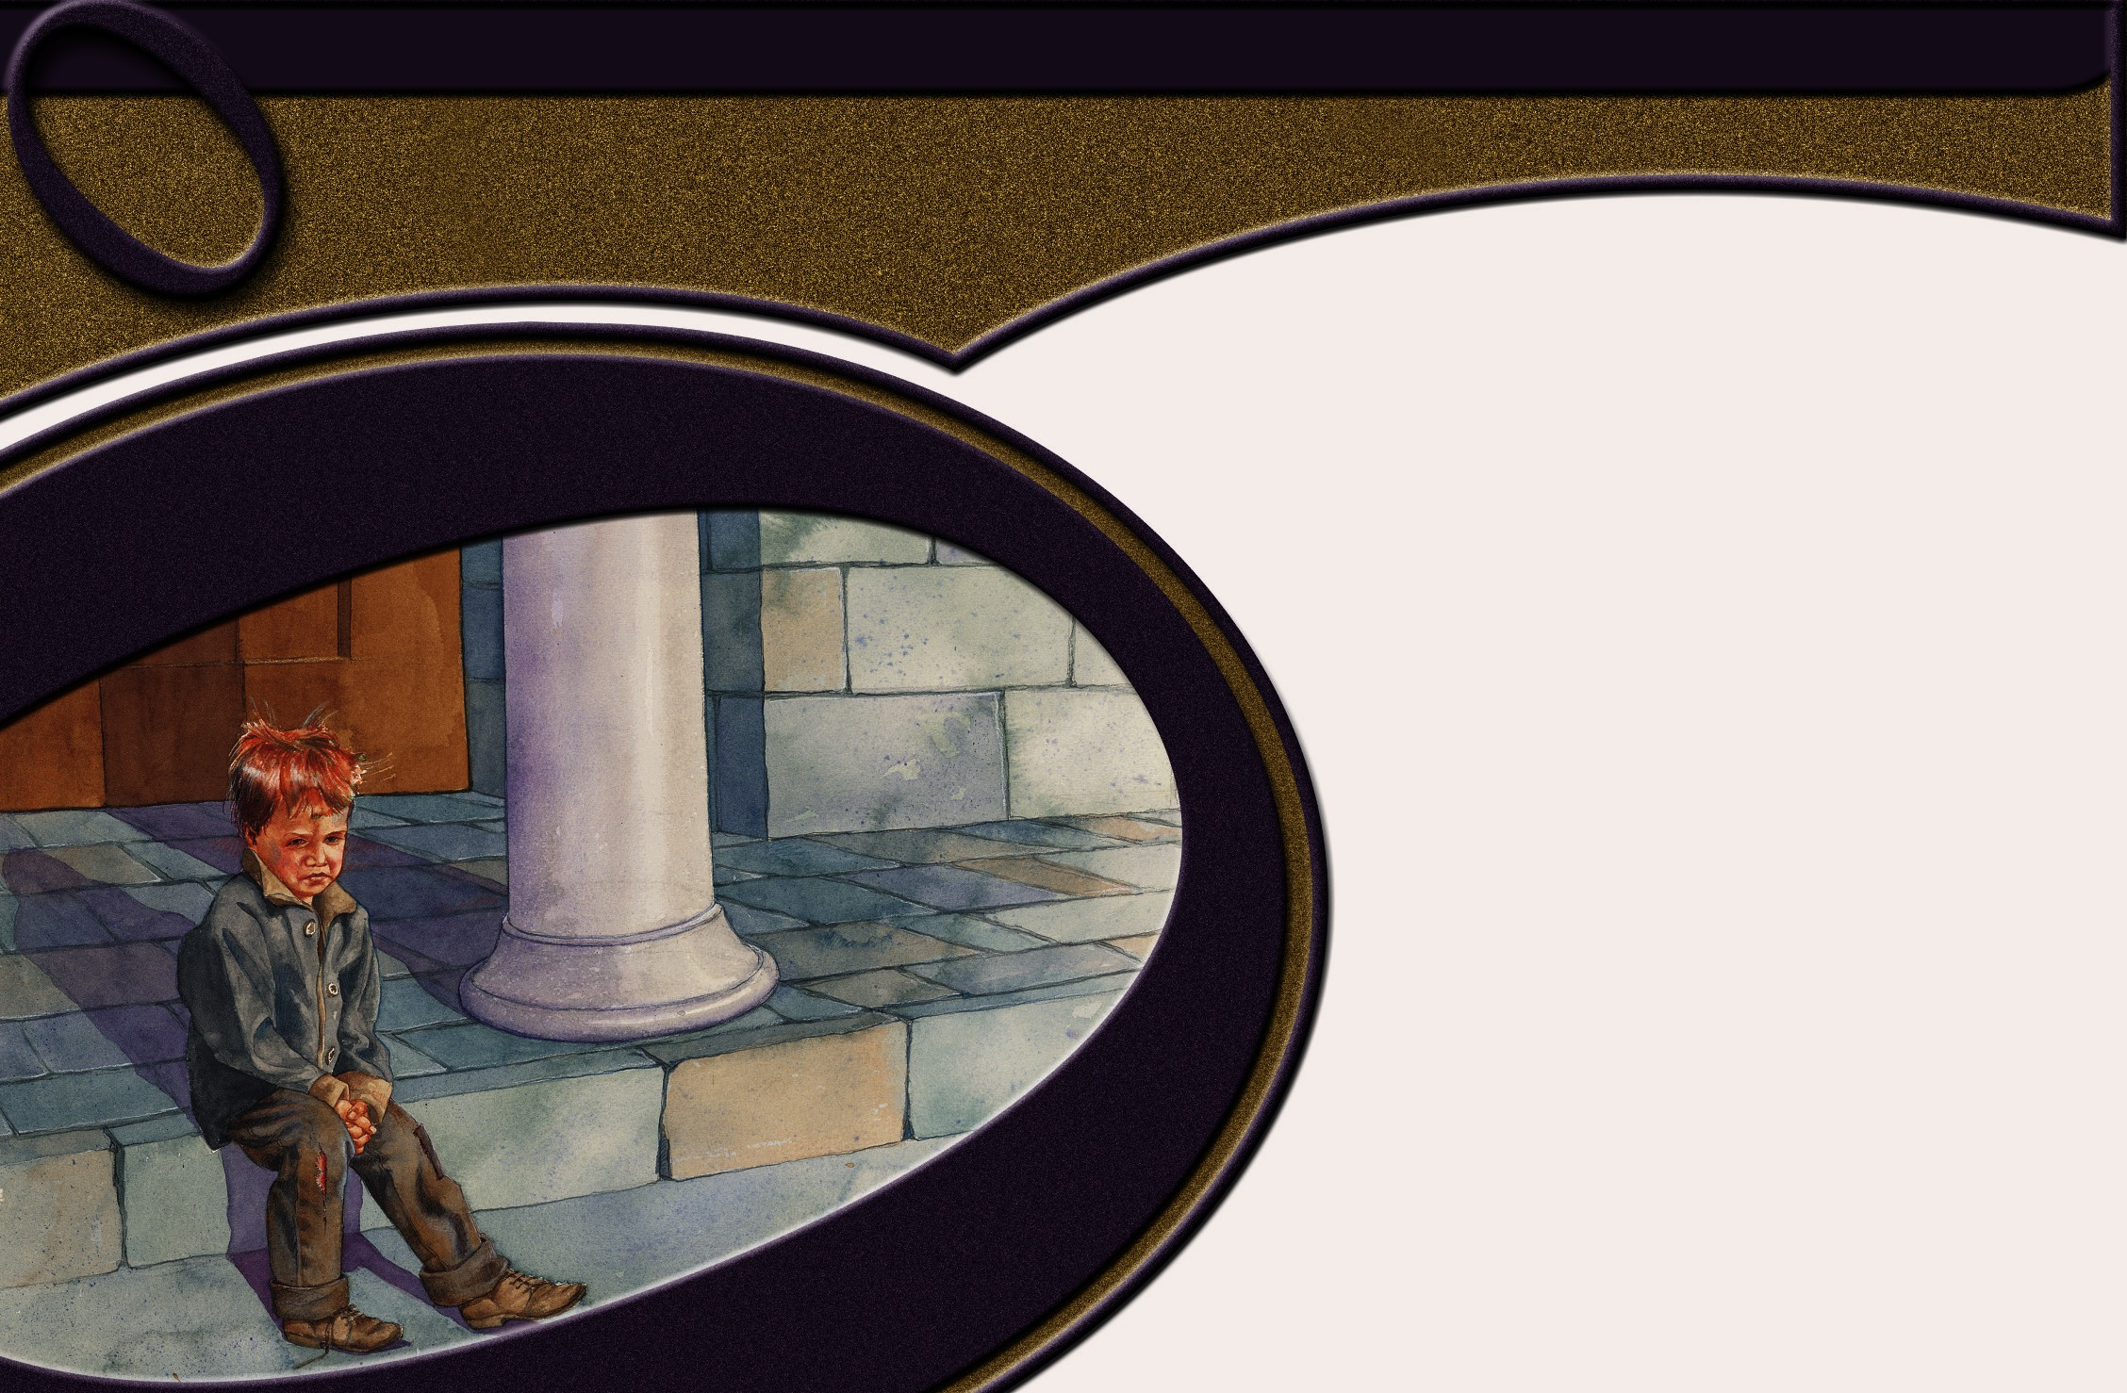
Chapter 4
Verbs

Slide 2




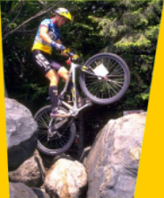
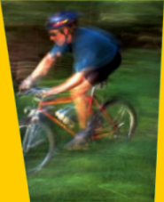

Action
Action
Verbs
Verbs

Slide 3

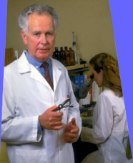
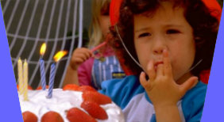

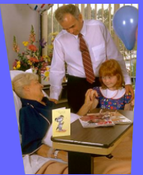

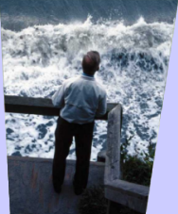
State of Being
State of Being
Verbs
Verbs

Slide 4

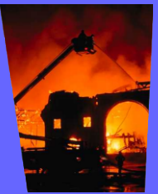
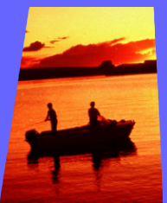
Auxiliaries
Auxiliaries
Join other verbs to make up the complete verb
helping verbs

Slide 5
BE VERBS
am
is
are
was
were
be
being
been
have
has
had
do
does
did

Slide 6
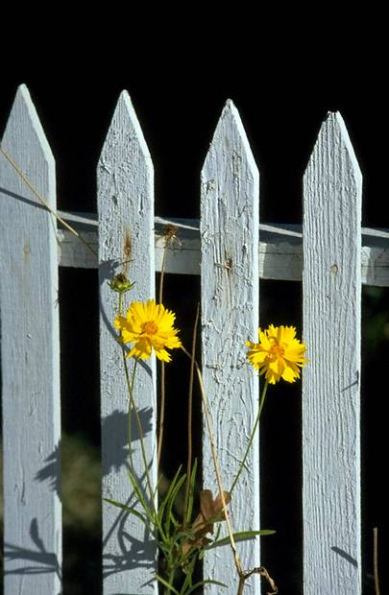
Linking Verbs= state of being (forms of be)

Slide 7
Our neighbor is
friendly.

Slide 8
Our neighbor is
a teacher.

Slide 9
A teacher is our neighbor.
SCARY!!!

Slide 10

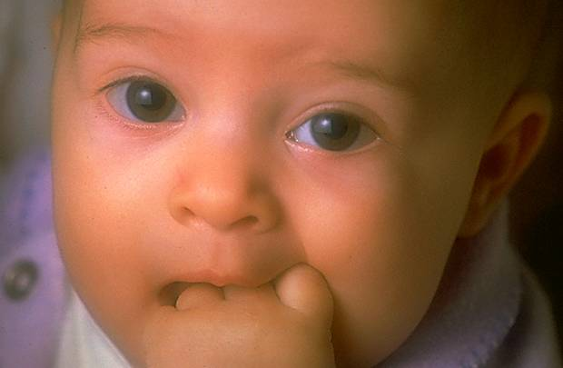
Linking Verbs
look
smell
taste
sound
feel

Slide 11
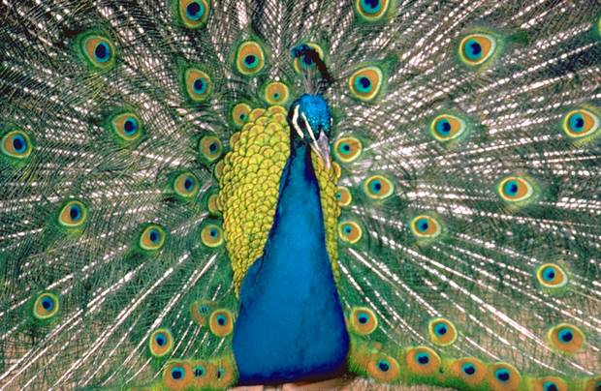
Linking
Verbs
B
R
A
G
S
S
ecome
emain
ppear
row
eem
tay

Slide 12
Practice the Skill 4-3, p. 85

Slide 13
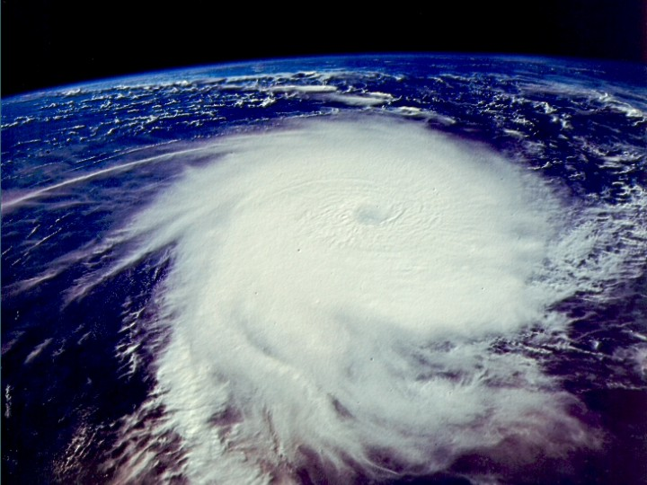
PA
1. The tools of a weather forecaster are interesting and diverse.

Slide 14
PA
2. A thermometer is important in the measurement of temperature.

Slide 15
PN
3. A falling barometer is a sign of stormy weather.

Slide 16
PA
4. Weather satellites have also grown increasingly useful to meteorologists.

Slide 17
PN
5. These satellites have become an especially valuable tool for a worldwide view of weather conditions.

Slide 18
transitive
transitive
intransitive
intransitive

Slide 19
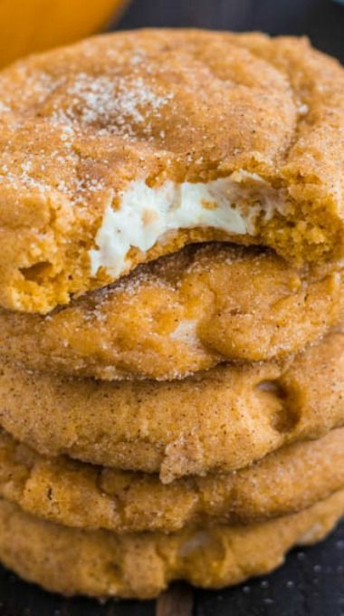
My friend gives me ______.

Slide 20

transitive verb
  has an object that receives the action of the verb

Slide 21
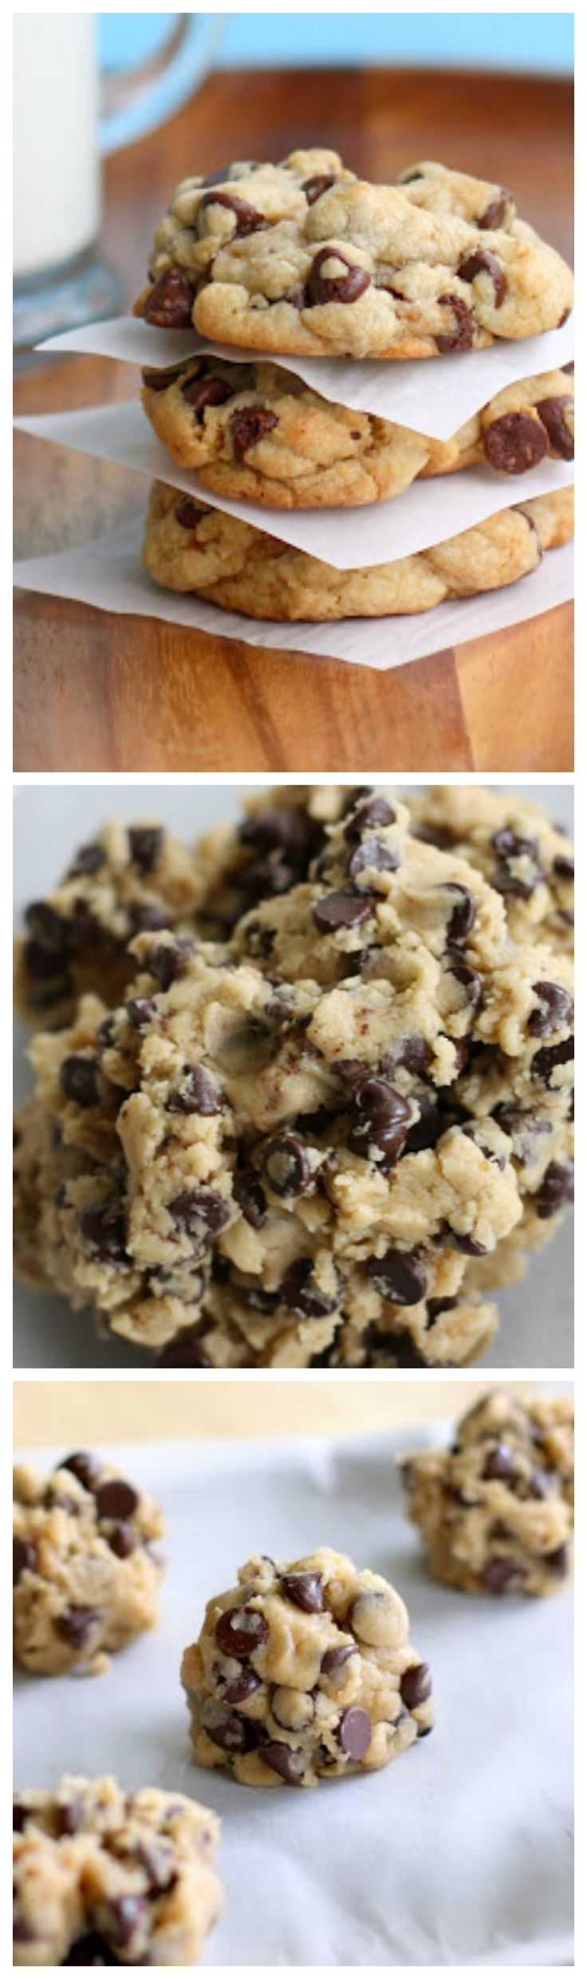
Dad loves chocolate chip cookies.

Slide 22

This time Mom made him snickerdoodles.

Slide 23

intransitive verb
does not need a complement or object

Slide 24
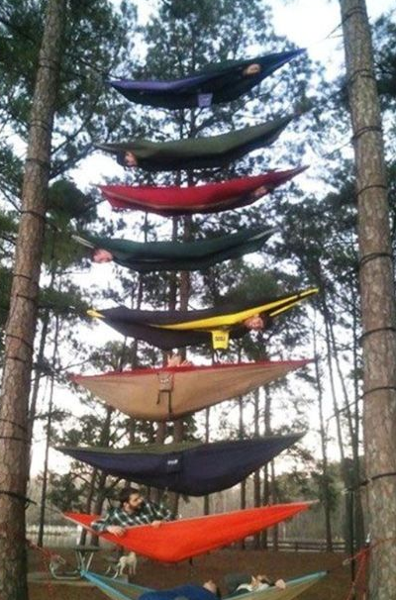
Allen was
napping in the
hammock.
The hammock
tipped over.

Slide 25

Participle
the third principal part of the verb; used to form the perfect tenses and adjectives

Slide 26
Principal
main
present past
past participle

Slide 27
Regular Verbs
Regular verbs form the second and third principal parts by adding -ed to the first principal part.
walk, walked, (have) walked

Slide 28
Regular Verbs
climb
climbed
climbed
drag
dragged
dragged
drown
drowned
drowned
hang
hanged
hanged
raise
raised
raised
shine
shined
shined
sneak
sneaked
sneaked

Slide 29
Irregular Verbs
Irregular verbs form the past and past participle in some other way than by adding -ed to the first principal part.
give, gave, (have) given

Slide 30
Irregular Verbs
All three principal parts are the same.
cost, cost, (have) cost
hit, hit, (have) hit
bid, bid, (have) bid

Slide 31
Irregular Verbs
Two principal parts are the same.
hear, heard, (have) heard
hold, held, (have) held
creep, crept, (have) crept

Slide 32
Irregular Verbs
All three principal parts of the verb are different.
forego, forewent, foregone
mistake, mistook, mistaken
forget, forgot, forgotten

Slide 33
Practice the Skill 4-7, pp. 91-92

Slide 34
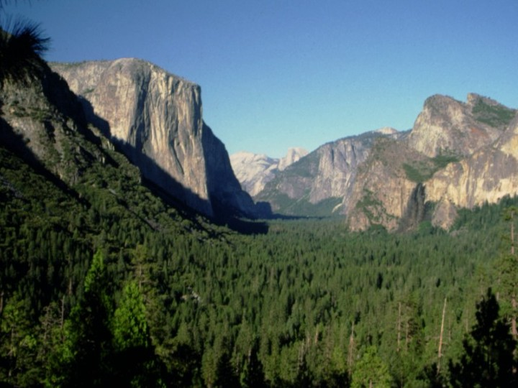
1. What are some of the best things you ever (did, done) outside?
did

Slide 35
2. I love ice skating on a lake that has (froze, frozen).
frozen

Slide 36
lay
3. Today I just (laid, lay) out in the sun and read a book.

Slide 37
4. I have also (swam, swum) in the ocean recently.
swum

Slide 38
5. I love hearing birds sing, like the robin that just (sang, sung) a beautiful song outside my window.
sang

Slide 39
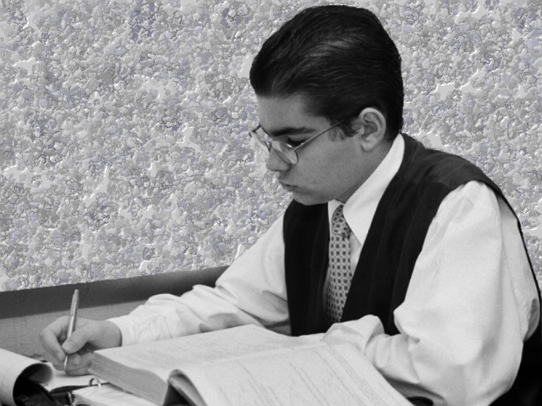
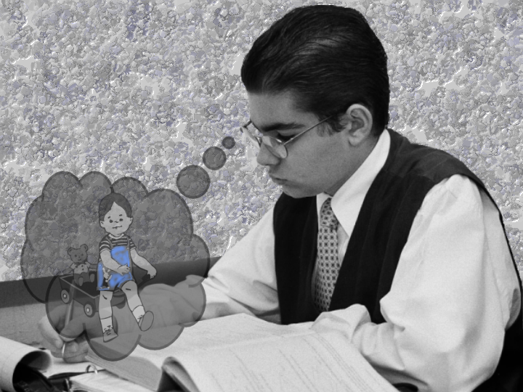
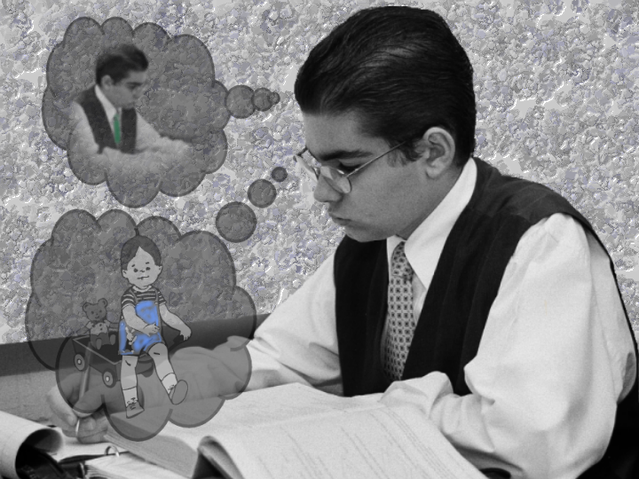
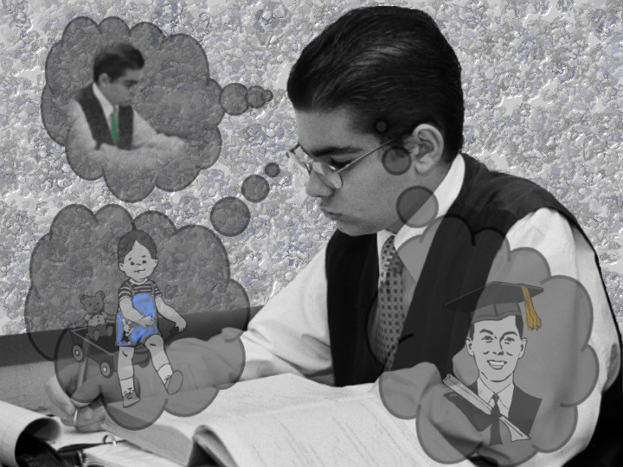
present
past
future

Slide 40
Present Tense
expresses a state that is true now or an action that occurs habitually
I do well in math classes.

Slide 41
Past Tense (ed, t, en)
shows action that occurred in the past
Grandma made lunch for me.

Slide 42
Future Tense (will/shall)
shows action that will occur later
I shall finish my schooling.

Slide 43
Gospels?
Past=“In the beginning was the Word, and the Word was with God, and the Word was God.” John 1:1
Present=the words of Jesus
“Verily, verily, I say unto you, He that heareth my word, and believeth on him that sent me, hath everlasting life, and shall not come into condemnation; but is passed from death unto life.” John 5:24

Slide 44
Epistles?
Present=makes the passages personal, timeless, and immediate
Revelation?
Past, Present, and Future
Much of it is recorded in past tense in the form of a dream
From God’s perspective, these future events have already occurred.

Slide 45
Perfect Tenses
Perfect=Complete/Completed
Form of have + 3rd Principal Part of the verb

Slide 46
Perfect Tenses
Present=have/has finished
Past=had finished
Future=will have finished

Slide 47
Progressive Tenses
Continuous/ongoing action….
Form of the be verb + ing

Slide 48
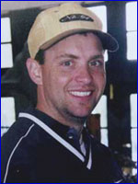
Tenses:
The Flight 93 heroes__________ the hijackers. (attack)
Simple:
Present:
attack
Past:
attacked
Future:
will attack
Perfect:
Present Perfect:
have attacked
Past Perfect:
had attacked
Future Perfect:
will have attacked

Slide 49
Tenses:
The Flight 93 heroes__________ the hijackers. (attack)
Progressive:
Present Progressive:
are attacking
Past Progressive:
were attacking
Future Progressive:
will be attacking
Perfect Progressive:
Present Perfect Prog:
have been attacking
Past Perfect Prog:
had been attacking
Future Perfect Prog:
will have been attacking

Slide 50

1. Ella’s friends gave her a party.
2. Ella was given a party by her friends.

Slide 51
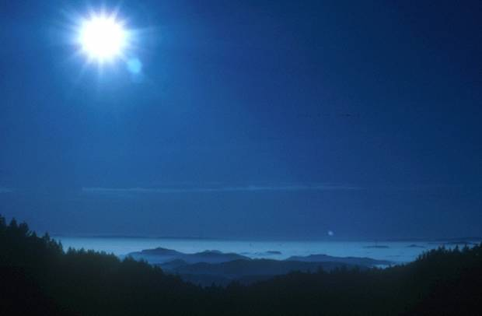
Intransitive
and
Linking Verbs
active

Slide 52
Transitive
can be either

Slide 53

Advantages of
Active Sentences
livelier and stronger writing if you mention
1. the doer (S)
2. the action (V)
3. the receiver (O)
shorter writing

Slide 54
Advantages of
Active Sentences
Last night’s sermon was preached by your uncle.
Your uncle preached last night’s sermon.

Slide 55
Passive sentences= form of be + past partciple form of transitive verb

Slide 56
Advantages of
Passive Sentences
You can avoid mentioning the doer of the action.
The money was kept in the store’s safe overnight.

Slide 57
Advantages of
Passive Sentences
You can save important information for the end of a sentence.
Evidence can be obtained by DNA testing.

