Slide 1
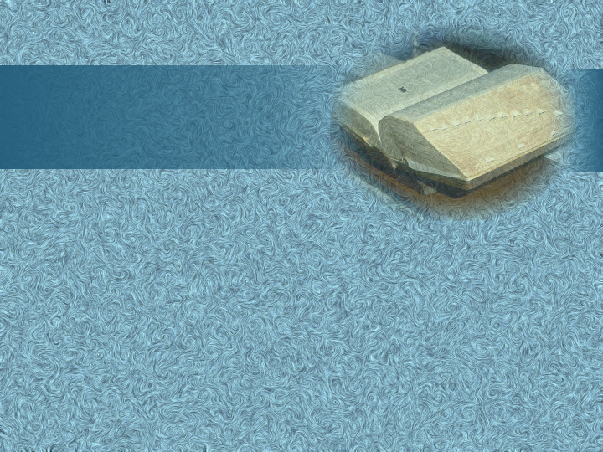
Happy Thursday!
Have out…
your pen, Stem List 10, and “Sonnet 116”.
your literature book.

Slide 2
Sonnet 116

Slide 3
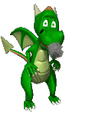
Valentine’s Day Poetry Contest
Directions:
Write a 14 line poem by TOMORROW.
It must have traditional rhyme and meter.
Your theme is “love” but it may be silly, serious, or spiritual.
Prizes will be awarded for 1st ($10),
2nd ($7), and 3rd place ($5) winners. Also, 5 extra credit points will be given.
*I will announce the V-Day Poetry Contest winners on Tuesday.

Slide 4
Stem List #10

Slide 5
cor

Slide 6
heart

Slide 7
ethno

Slide 8
race or culture

Slide 9
fug

Slide 10
flee

Slide 11
alt

Slide 12
high

Slide 13
iso

Slide 14
equal

Slide 15
mort

Slide 16
death

Slide 17
carn

Slide 18
flesh

Slide 19
paleo

Slide 20
old

Slide 21
nat

Slide 22
born

Slide 23
uni

Slide 24
one

Slide 25
ics

Slide 26
art

Slide 27
gen

Slide 28
origin

Slide 29
ped

Slide 30
foot or child

Slide 31
psych

Slide 32
soul

Slide 33
capit

Slide 34
head

Slide 35
ness

Slide 36
quality

Slide 37
muta

Slide 38
change

Slide 39
cad

Slide 40
fall

Slide 41
curs

Slide 42
run

Slide 43
loqu

Slide 44
talk

Slide 45
ate

Slide 46
cause

Slide 47
vert

Slide 48
turn

Slide 49
ess

Slide 50
female

Slide 51
sacro

Slide 52
holy

Slide 53
crypt

Slide 54
hidden

Slide 55
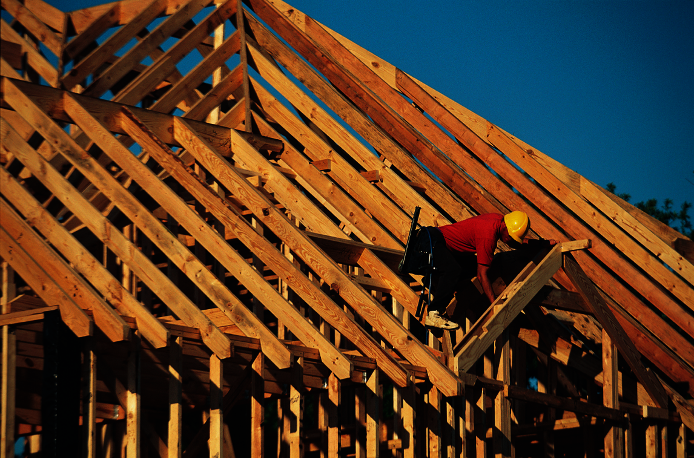
Structure

Slide 56
Betty Botter's Biting Beaver
Betty Botter bought a beaver. But the beastly beaver bit her. So she bought a biting badger. And the badger bit the beaver. Since the badger bit the beaver, now the beaver will not bite her. So 'twas better Betty Botter bought a beaver-biting badger.
*10 seconds or less: Excellent. You can out talk anyone around.
*5 seconds or less: You are a tongue tying champion! `

Slide 57
Famous First Lines/ Punctured Poems:
Marlowe: “Was this the face that launched a thousand ships?
Student: No wonder there are keel marks on her lips.
Shakespeare: “Full fathom five thy father lies.”
Student: I pushed him. I apologize.

Slide 58
You can try to finish these:
Wordsworth: “My heart leaps up when I behold...
Kilmer: “I think that I shall never see…
Poe: “Once upon a midnight dreary…

Slide 59
definition
poetry
c
’
words arranged into a rhythmical pattern with regular accents

Slide 60
Poetry
appeals to reason
appeals to emotions

Slide 61
Structure
rhyme/ meter
verse forms
stanza forms
shape

Slide 62
Rhyme
= powerful tool
Notes:
Rhyme = _____ _____

Slide 63
Rhyme
identical sounds in the last stressed vowel and all of the sounds following that vowel in two or more words

Slide 64
End Rhyme
rhyme that occurs at the ends of corresponding lines of poetry (lord / word)

Slide 65
Mary, Mary, quite contrary,
How does your garden grow?
With silver bells and cockleshells,
And pretty maids all in a row.
Notes:
Clipart.com

Slide 66
Rhyme Scheme
the pattern of rhyme sounds in a poem or in a stanza

Slide 67
a
Mary, Mary, quite contrary,
How does your garden grow?
b
c
With silver bells and cockleshells,
b
And pretty maids all in a row.
Notes:
Clipart.com

Slide 68
Eye Rhyme
rhyme that occurs when word pairs are spelled alike but pronounced differently (cough / bough)

Slide 69
Slant Rhyme
Two words with similar but slightly mismatched sounds are paired together (door / star)

Slide 70
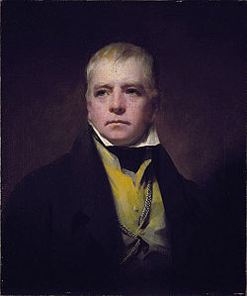
Sir Walter Scott
(1771-1832)
Scotsman
Romantic poet (feelings/imagination)
Common life themes
Famous for his novel Ivanhoe

Slide 71
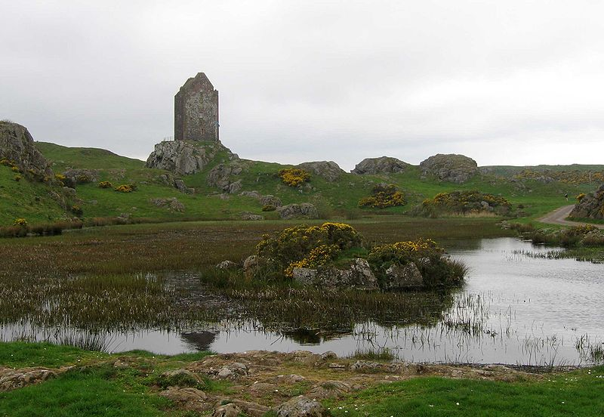

Slide 72
History of “Allen-a-Dale”
Similar to Robin Hood ballads
Legend says Allen-a-Dale was one
of Robin Hood’s men—a minstrel.
Stanza Form: sestet ballad
Rhyme Scheme: aabbcc
Notes:
Lists

Slide 73
Theme:
Nobility of character and deeds trumps nobility of lineage and possessions.
Notes:
Theme: nobility of character and deeds _____ _____ of _____ and _______.

Slide 74
Winning a girl without her parents’ blessing
= admirable
Notes:
Winning a girl without her parents’ blessing = ________

Slide 75
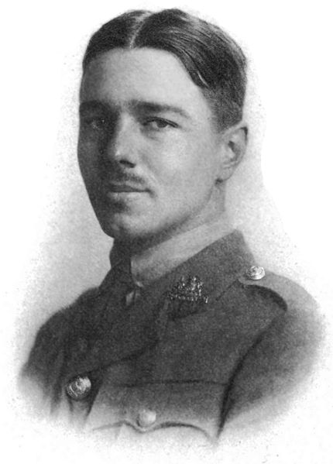
“Futility”
Author: Wilfred Owen (1893-1918)
Context: World War I
Notes:
Tree/snow: iStockphoto.com/Ekspansio
“Futility” Context: ____ ____ __

Slide 77
Notes:
Soldiers: clipart.com

Slide 78
Notes:
Soldiers: clipart.com

Slide 79
“Futility”
Purpose: Presentation of reality
Style: Lament & Protest
Notes:
Tree/snow: iStockphoto.com/Ekspansio
“Futility” Context: ____ ____ __ Purpose: ______ of ____ Style: _____ & _____

Slide 80
Assonance
the repetition of similar vowel sounds in a series of words

Slide 81
Consonance
the repetition of terminal consonant sounds and, more rarely, of internal consonants that creates extra emphasis on the words involved

Slide 82
Rhyme Scheme of “Futility”
ababccc
efefggg
Notes:
Pic: PressArt
Rhyme Scheme of “Futility” ___________ _________

Slide 83
Slant Rhyme
rhyme between two words with similar but slightly mismatched sounds

Slide 84
Owen’s Conclusion:
Life is futile.
Notes:
Pic: PressArt
Owen’s Conclusion: _____ is _____

Slide 85
Trusting God
= cure for despair!
Notes:
Tree/snow: iStockphoto.com/Ekspansio
Trusting God = _____ for ______!

Slide 86
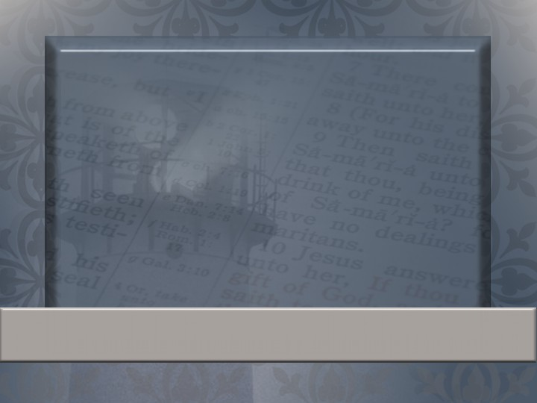
But unto you that fear my name shall the Sun of righteousness arise with healing in his wings.
Malachi 4:2a
Notes:
Verse about fearing God and healing:

Slide 87
Why art thou cast down, O my soul? and why art thou disquieted within me? hope thou in God: for I shall yet praise him, who is the health of my countenance, and my God.
Psalm 42:11
Notes:
Verse about God comforting people’s hearts:

Slide 88
Grammar Test Grading Scale
A=36-40
B=32-35
C=28-31
D=24-27
F= 0-23

