Slide 1
Italics

Slide 2
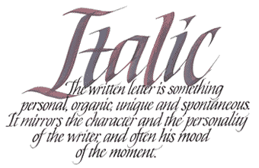
When to use italics?
Only use them when typing
Ex: Do you like the long story A Tale of Two Cities?
Underline when expressing italics in handwritten form

Slide 3
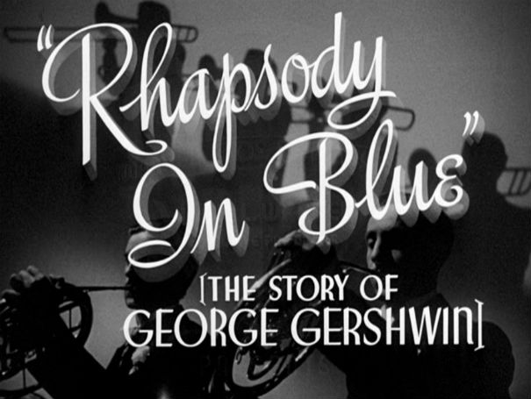
Uses for italics
Books
Ex: The Magician's Nephew
Exception: the Bible
Periodicals
Ex: Science News
Newspapers
Ex: The Greenville News
Epic poems
Ex: Homer's Illiad
Musical compositions
Ex: Rhapsody In Blue
Plays
My Fair Lady

Slide 4
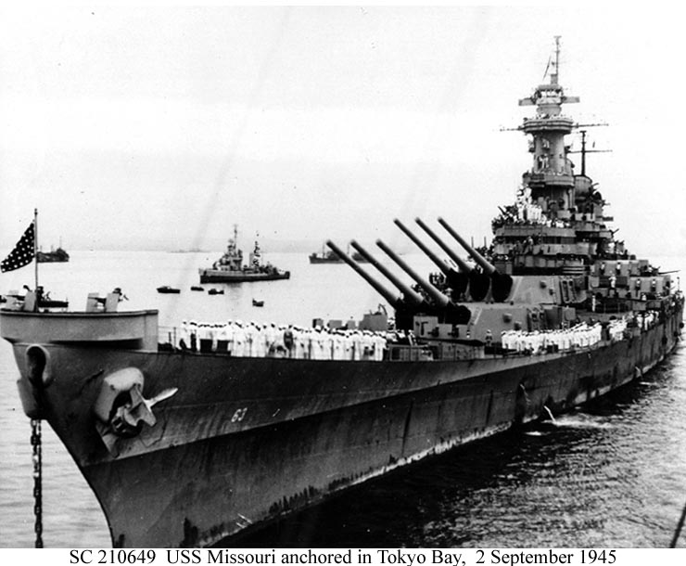
More Uses
Movies and TV shows
Ex: Courageous
Works of visual art
Ex: Mona Lisa
Ships
Ex: USS Missouri
Aircraft
Ex: Spirit of St. Louis
Trains
Ex: Tom Thumb
Spacecraft
Ex: Apollo 13
Emphasis
For letters, words, and numerals that are referred to as words
Ex: There are three cow's in that sentense.

Slide 5
Review Game!

Slide 6
Question 1
A
A favorite poem in this English class is If.
B
A favorite poem in this English class is "If".

Slide 7
Answer
A
A favorite poem in this English class is If.
B
A favorite poem in this English class is "If".

Slide 8
Question 2
A
His favorite TV show is Andy Griffith.
B
His favorite TV show is Andy Griffith.

Slide 9
Answer
A
His favorite TV show is Andy Griffith.
B
His favorite TV show is Andy Griffith.

Slide 10
Question 3
A
We listened to The Four Seasons last year.
B
We listened to The Four Seasons last year.

Slide 11
Answer
A
We listened to The Four Seasons last year.
B
We listened to The Four Seasons last year.

Slide 12
Question 4
A
Last semester we did a project on "The Hound of the Baskervilles".
B
Last semester we did a project on The Hound of the Baskervilles.

Slide 13
Answer
A
Last semester we did a project on "The Hound of the Baskervilles".
B
Last semester we did a project on The Hound of the Baskervilles.

Slide 14
Question 5
A
Hope's favorite TV show is Say Yes to the Dress.
B
Hope's favorite TV show is Say Yes to the Dress.

Slide 15
Answer
A
Hope's favorite TV show is Say Yes to the Dress.
B
Hope's favorite TV show is Say Yes to the Dress.

Slide 16
Question 6
A
The Boston Pops have performed the beloved composition Rhapsody in Blue.
B
The Boston Pops have performed the beloved composition "Rhapsody in Blue".

Slide 17
Answer
A
The Boston Pops have performed the beloved composition Rhapsody in Blue.
B
The Boston Pops have performed the beloved composition "Rhapsody in Blue".

Slide 18
Question 7
A
Where did you see The Ponderer statue?
B
Where did you see The Ponderer statue?

Slide 19
Answer
A
Where did you see The Ponderer statue?
B
Where did you see The Ponderer statue?

Slide 20
Question 8
A
The "New York Times" is a popular newspaper.
B
The New York Times is a popular newspaper.

Slide 21
Answer
A
The "New York Times" is a popular newspaper.
B
The New York Times is a popular newspaper.

Slide 22
Question 9
A
The Titanic seemed indestructible.
B
The Titanic seemed indestructible.

Slide 23
Answer
A
The Titanic seemed indestructible.
B
The Titanic seemed indestructible.

Slide 24
Question 10
A
There are seven were's in that paragraph.
B
There are seven were's in that paragraph.

Slide 25
Answer
A
There are seven were's in that paragraph.
B
There are seven were's in that paragraph.

Slide 26
Question 11
A
Have you ever seen the Gemini spaceship before?
B
Have you ever seen the Gemini spaceship before?

Slide 27
Answer
A
Have you ever seen the Gemini spaceship before?
B
Have you ever seen the Gemini spaceship before?

Slide 28
Question 12
A
The Printing is a movie put on by Bob Jones University.
B
"The Printing" is a movie put on by Bob Jones University.

Slide 29
Answer
A
The Printing is a movie put on by Bob Jones University.
B
"The Printing" is a movie put on by Bob Jones University.

Slide 30
Question 13
A
Rachel reads the Bible every morning.
B
Rachel reads the Bible every morning.

Slide 31
Answer
A
Rachel reads the Bible every morning.
B
Rachel reads the Bible every morning.

Slide 32
Question 14
A
One of my mom's favorite movies is "The Princess Bride".
B
One of my mom's favorite movies is The Princess Bride.

Slide 33
Answer
A
One of my mom's favorite movies is "The Princess Bride".
B
One of my mom's favorite movies is The Princess Bride.

Slide 34
Question 15
A
He performed the hymn "I Am Resolved".
B
He performed the hymn I Am Resolved.

Slide 35
Answer
A
He performed the hymn "I Am Resolved".
B
He performed the hymn I Am Resolved.

Slide 36
Picture Links:
http://avi2obrunsden.blogspot.com/2014_04_01_archive.html
http://cinema-fanatic.com/2012/02/25/from-the-warner-archive-rhapsody-in-blue-1945-dir-irving-rapper/
http://www.ibiblio.org/hyperwar/OnlineLibrary/photos/events/wwii-pac/japansur/js-8.htm

