Slide 1
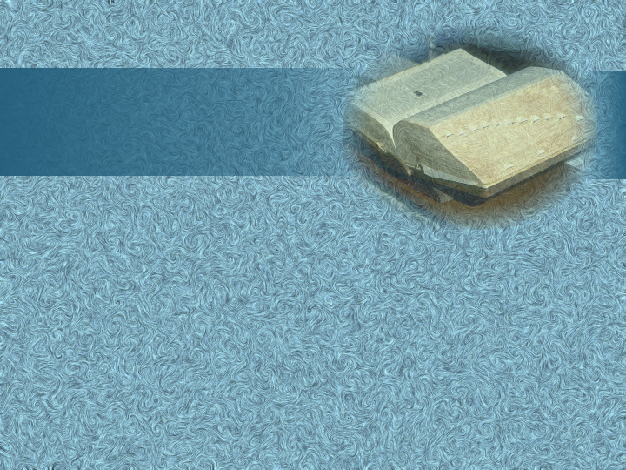
Happy Tuesday!
Have out your acrostic poem and bring your literature book.
Notes:
Tuesday:
Share synechdoche poems
Shape Poems
Poetry Test Details/cards to “sit on”—may look at for one minute at end of test
Review Game
Meter Poem Challenge

Slide 2
Poetry Worksheet #2

Slide 3
Shaped Poem
a poem that rarely follows any specific stanza or verse form but is shaped in an image that supports the subject of the poem
Notes:
Show poems on board

Slide 4
“400-Meter Freestyle”
= Pun
Notes:
Rope: Clipart.com
Water: © iStockphoto.com/LordRunar (all slides
Background: Digital Juice
“400-Meter Freestyle” = ______

Slide 5
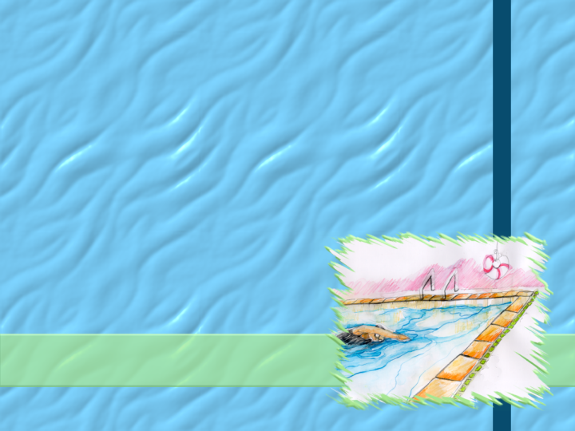
“Thrift is his wonderful secret; he has schooled out all extravagance.”

Slide 6
“that plum red heart pumps hard cries hurt how soon its near one more and makes its final surge”

Slide 7
Features
Loss of grammatical clues and some punctuation→ less clarity
More emphasis on visual effect
Abundance of sound devices → create and reinforce atmosphere
Example: “catapults and cracks”
4. Goal=respect/admiration for the swimmer
Notes:
Features:
List with subpoints
Rope: Clipart.com
Water: © iStockphoto.com/LordRunar (all slides
Background: Digital Juice
Features
Loss of grammatical clues and some punctuation → _______ clarity
But more emphasis
visual _______
simultaneous ___________
pace of _________
Abundance of ______ devices → create and reinforce ____________
Meaning → __________ of the poem & _______ for the disciplined athlete

Slide 8
Eye Rhyme
word pairs that are spelled alike but pronounced differently
“gone all in one”

Slide 9
“Broken Altar”
literal level: Herbert’s poem
figurative level: Herbert’s heart
fallen
& repentant
Notes:
“Broken Altar”
Literal level: Herbert’s __________
Figurative level:
→ __________ & __________

Slide 10
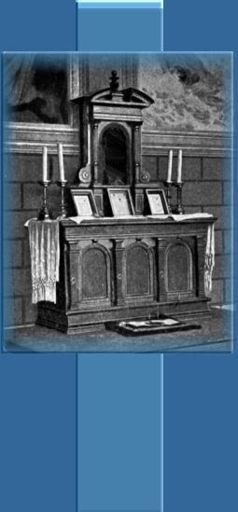
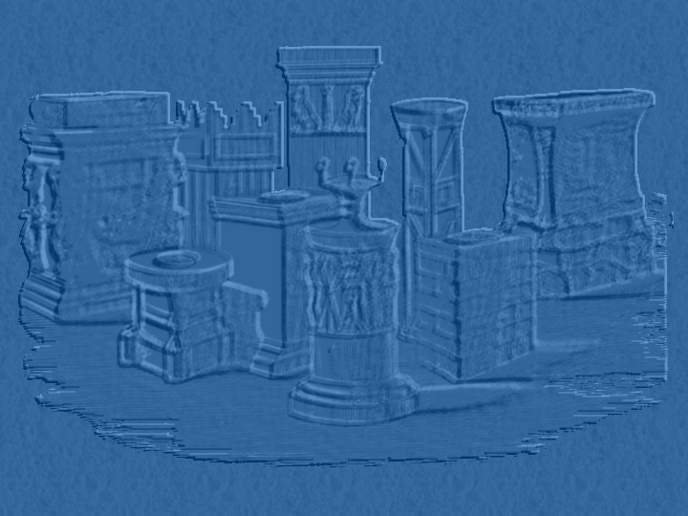
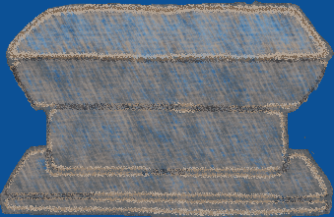
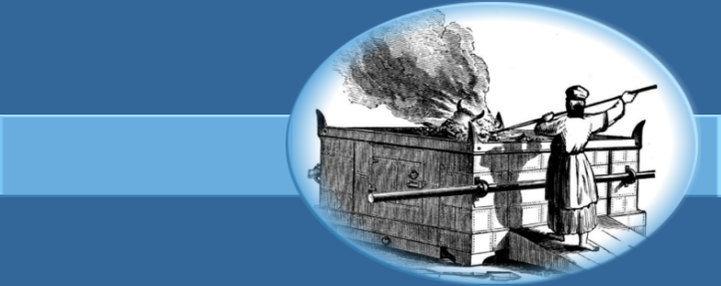
A broken altar, Lord, thy servant rears,
Made of a heart and cemented with tears;
Whose parts are as thy hand did frame;
No workman's tool hath touched the same.
A heart alone
Is such a stone
As nothing but
Thy power doth cut.
Wherefore each part
Of my hard heart
Meets in this frame
To praise thy name;
That if I chance to hold my peace,
These stones to praise thee may not cease.
Oh, let thy blessed sacrifice be mine,
And sanctify this altar to be thine.

Slide 11
Herbert’s Theme:
Believing responses to God’s power and love through God’s enabling bring God praise.
Notes:
Herbert’s Theme: Believing responses to God’s ________ and ________ through God’s enabling bring God __________.

Slide 12
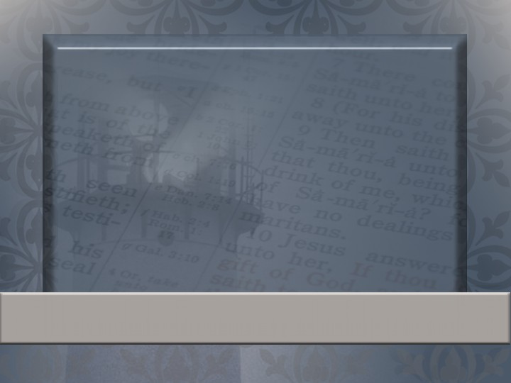
And he answered and said unto them, I tell you that, if these should hold their peace, the stones would immediately cry out.
Luke 19:40=biblical allusion
Notes:
Verse about the stones crying out:

Slide 13
1st Couplet: Man’s Response
2nd Couplet: God’s Work
Octave: Man’s Complete Dependence on God
3rd Couplet: Creation will praise God if man doesn’t.
4th Couplet: Man’s heart was made to worship God.
Notes:
“Broken Altar”
1st Couplet: Man’s ____________
2nd Couplet: God’s __________
Octave: Man’s Complete ____________ on _______
3rd Couplet: Praise from _________ _________

Slide 14
Poetry Test (50 points)
All scantron

Slide 15
Study:
Rhyme—”Allen-a-Dale”, “Futility”
Meter—”Charge of the Light Brigade”, “The Destruction of Sennacherib”
Verse Forms—rhymed, blank, free (3 examples)
Limericks/Haiku
Stanza Forms—ballad/sonnets
Shape poem

Slide 16
Tips:
Make a study card for each section (rhyme, meter, etc.)
A few ?’s over meter—straight from notes
*SPECIAL PRIVILEGE: You may bring a 3x5 card with any notes on it to the test tomorrow. (1 minute help)

