Slide 1
Unit 3 Test Focus
Pronouns
Antecedents (ante, cedere, pro)
person, number, gender, case
Interrogative (list them/use them correctly)
Demonstrative (list them/use them)
intensive/reflexive (nickname?/difference?)
Indefinite (singular, plural, both=SAMMAN)
Relative (list them/combine sentences)
pronoun agreement (tomorrow’s focus)

Slide 2
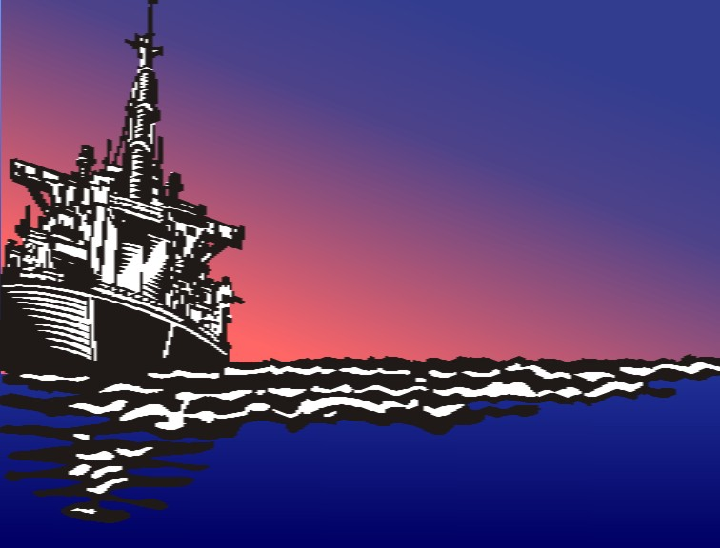
1. ______ was one of the worst environmental disasters in history?
What
who whom whose
which what
interrogative

Slide 3
2. One of the worst was the Exxon Valdez oil spill, _____ happened on March 24, 1989.
which
who whom whose
which that
relative

Slide 4
3. A ship carried a cargo of 1,264,155 barrels of oil; about one-fifth of ____ spilled into Prince William Sound along the coast of Alaska.
that
this that these those
demonstrative

Slide 5
4. Much oil turned into a substance called mousse, _____ will not burn and can be difficult to clean up.
which
who whom whose
which that
relative

Slide 6
Some
5. _____ of the other results of the spill were that wildlife was lost and that the economy of the area was devastated.
any some most one fewer none
indefinite

Slide 7
6. Several hundred thousand air and sea creatures died, but birds __________ totaled more than 250,000 deaths.
themselves
itself herself himself themselves
intensive

Slide 8
7. An alarming result of the spill is more than one thousand miles of coastline ____ was damaged by oil.
that
who whom whose
which that
relative

Slide 9
One
8. ____ of the most disturbing facts about the disaster was the fact that it was caused by
human error.
any some most one fewer none
indefinite

Slide 10
9. ____ was to blame?
Who
who whom whose
which what
interrogative

Slide 11
10. Many people contrib-uted to the accident, but the person most at fault was the captain, ____ was impaired because of alcohol.
who
who whom whose
which that
relative

Slide 12
11. Because of the impairment, __ had left his duty.
he
I you he she it me him her my our your his her its
personal

Slide 13
12. Also, the captain allowed an inexperienced officer to run the ship by _______.
himself
myself yourself itself herself himself themselves
reflexive

Slide 14
13. Finally, many sources say that the company _____ could have provided better training and a better crew.
itself
itself herself himself themselves
intensive

Slide 15
14. Many years later, the coastline was checked, and __ still contained many evidences of oil damage.
it
I he she it me him her my his her its
personal

Slide 16
15. The far-reaching damages exemplify that we need to learn to watch _________ and our decisions carefully.
ourselves
myself yourself ourselves themselves
reflexive

