Slide 1
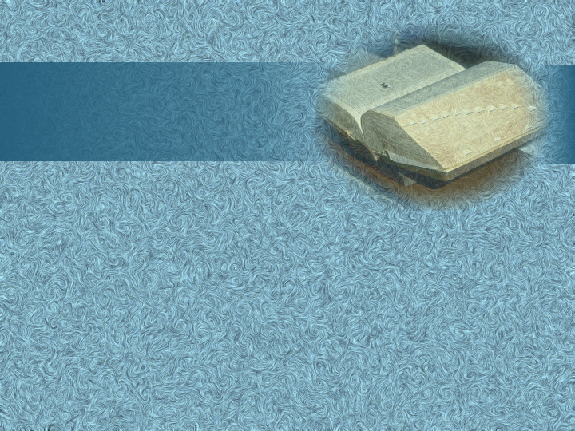
Happy Thursday!
Open Seating Today!
Have out your novel project and bring your literature book.
Notes:
Tuesday:
Share synechdoche poems
Shape Poems
Poetry Test Details/cards to “sit on”—may look at for one minute at end of test
Review Game
Meter Poem Challenge

Slide 2
Shaped Poem
a poem that rarely follows any specific stanza or verse form but is shaped in an image that supports the subject of the poem

Slide 3
“400-Meter Freestyle”
= Pun
Notes:
Rope: Clipart.com
Water: © iStockphoto.com/LordRunar (all slides
Background: Digital Juice
“400-Meter Freestyle” = ______

Slide 4
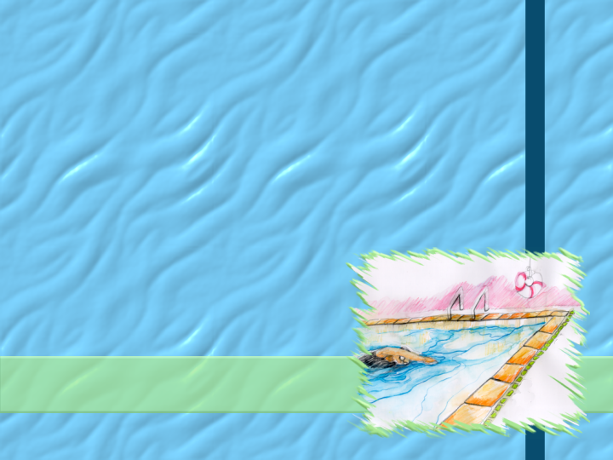
“Thrift is his wonderful secret; he has schooled out all extravagance.”

Slide 5
“that plum red heart pumps hard cries hurt how soon its near one more and makes its final surge”

Slide 6
Features
Loss of grammatical clues and some punctuation→ less clarity
More emphasis on visual effect
Abundance of sound devices → create and reinforce atmosphere
Example: “catapults and cracks”
4. Goal=respect/admiration for the swimmer
Notes:
Features:
List with subpoints
Rope: Clipart.com
Water: © iStockphoto.com/LordRunar (all slides
Background: Digital Juice
Features
Loss of grammatical clues and some punctuation → _______ clarity
But more emphasis
visual _______
simultaneous ___________
pace of _________
Abundance of ______ devices → create and reinforce ____________
Meaning → __________ of the poem & _______ for the disciplined athlete

Slide 7
Eye Rhyme
word pairs that are spelled alike but pronounced differently
“gone all in one”

Slide 9
“Broken Altar”
literal level: Herbert’s poem
figurative level: Herbert’s heart
fallen
& repentant
Notes:
“Broken Altar”
Literal level: Herbert’s __________
Figurative level:
→ __________ & __________

Slide 10
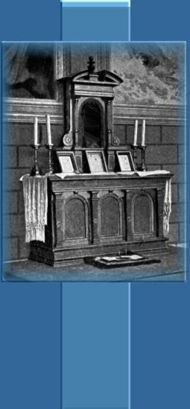
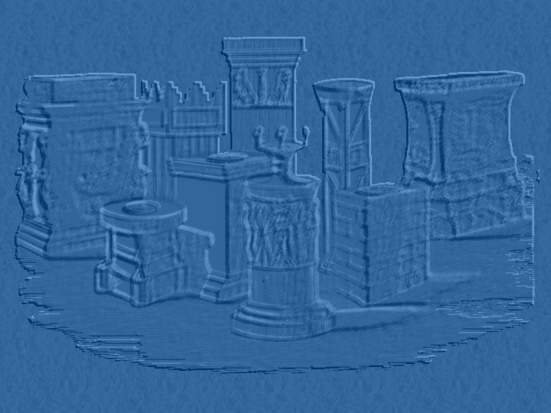
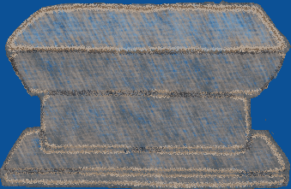
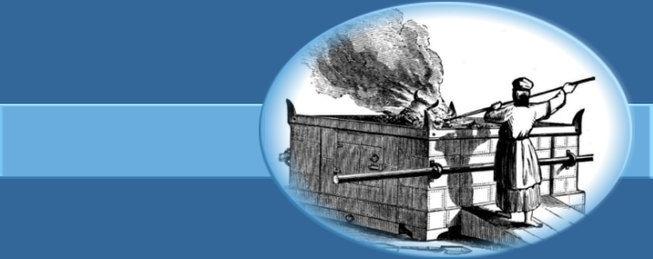
A broken altar, Lord, thy servant rears,
Made of a heart and cemented with tears;
Whose parts are as thy hand did frame;
No workman's tool hath touched the same.
A heart alone
Is such a stone
As nothing but
Thy power doth cut.
Wherefore each part
Of my hard heart
Meets in this frame
To praise thy name;
That if I chance to hold my peace,
These stones to praise thee may not cease.
Oh, let thy blessed sacrifice be mine,
And sanctify this altar to be thine.

Slide 11
Herbert’s Theme:
Believing responses to God’s power and love through God’s enabling bring God praise.
Notes:
Herbert’s Theme: Believing responses to God’s ________ and ________ through God’s enabling bring God __________.

Slide 12
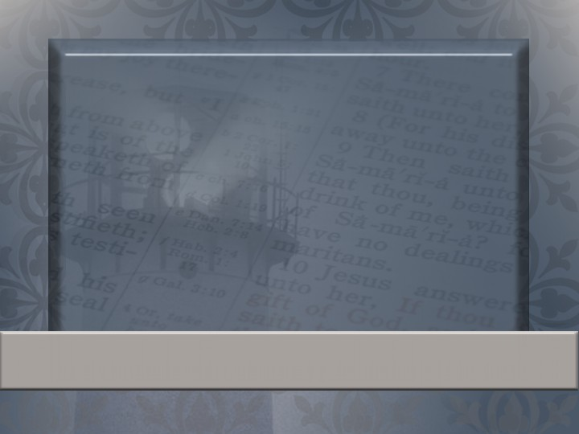
The sacrifices of God are a broken spirit: a broken and a contrite heart, O God, thou wilt not despise.
Psalm 51:17

Slide 13
And he answered and said unto them, I tell you that, if these should hold their peace, the stones would immediately cry out.
Luke 19:40=biblical allusion
Notes:
Verse about the stones crying out:

Slide 14
1st Couplet: Man’s Response
2nd Couplet: God’s Work
Octave: Man’s Complete Dependence on God
3rd Couplet: Creation will praise God if man doesn’t.
4th Couplet: Man’s heart was made to worship God.
Notes:
“Broken Altar”
1st Couplet: Man’s ____________
2nd Couplet: God’s __________
Octave: Man’s Complete ____________ on _______
3rd Couplet: Praise from _________ _________

Slide 15
“Freedom to Breathe”
=
Prose Poetry
Notes:
Woman: clipart.com
“freedom to breathe” = freedom to ________ → freedom = ________

Slide 16
Aleksandr Solzhenitsyn
*Most famous Russian author of the 20th Century
*Nobel Prize Winner in 1970
Notes:
Clipart.com

Slide 17
“Freedom to Breathe”
= freedom to live
= freedom of speech
Notes:
Woman: clipart.com
“freedom to breathe” = freedom to ________ → freedom = ________

Slide 18
Poetic Features
Stanzas
Repetition
Sensory images
Message with universal appeal
Notes:
Flowers: PhotoDisc/GettyImages
Poetic Features
1.
2.
3.
4.

Slide 19
Parallelism
similarity in the structure of two or more phrases, clauses, or sentences

Slide 20
And ye shall know the truth, and the truth shall make you free. If the Son therefore shall make you free, ye shall be free indeed.
John 8:32, 36
Notes:
Verse about Christ setting people free:

Slide 21
Theme:
Freedom allows people to experience real living.
Notes:
Flowers: PhotoDisc/GettyImages
Theme: Freedom allows people to ________________ real _________.

Slide 22
Notes:
Clipart.com

Slide 23
Poetry Test (50 points)
All scantron

Slide 24
Study:
Rhyme—”Allen-a-Dale”, “Futility”
Meter—”Charge of the Light Brigade”, “The Destruction of Sennacherib”
Verse Forms—rhymed, blank, free (3 examples)
Stanza Forms—ballad/sonnets
Shape Poetry/Prose Poetry

Slide 25
Tips:
Make a study card for each section (rhyme, meter, etc.)
A few ?’s over meter—straight from the notes
*SPECIAL PRIVILEGE: You may bring a 3x5 card with any notes on it to the test tomorrow. (1 minute help)

