Slide 1
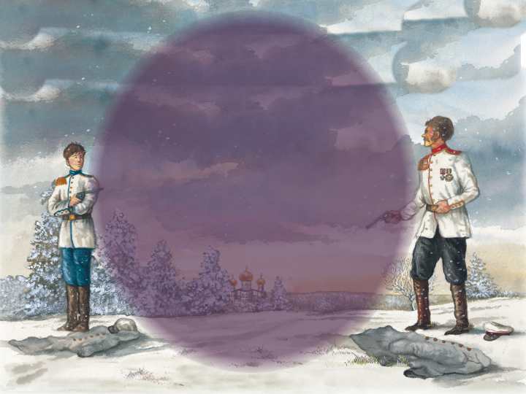
Happy Thursday!
Have out your “Road Not Taken” poem.
Make sure you have your literature book in class today.
Notes:
Prayer Requests
Reminder: Reading tomorrow
Robert Frost History/poem recitation
Award winners from yesterday
History of Dueling
Class duel—award winners
Read Aloud!
Notes

Slide 2
Freshman Tip
Yearbook (Academian) & Triangle

Slide 3
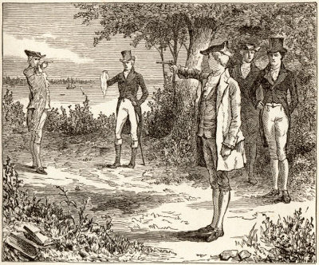
Notes:
“In our early years a man’s political opinions were inseparable from the self, from personal character and reputation, and as central to his honor as a seventeenth-century Frenchman’s courage was to his. He called his opinions “principles,” and he was willing, almost eager, to die or to kill for them. Joanne B. Freeman, in Affairs of Honor, writes that dueling politcos ‘were men of public duty and private ambition who identified so closely with their public roles that they often could not distinguish between their identity as gentlemen and their status as political leaders. Longtime political opponents almost expected duels, for there was no way that constant opposition to a man’s political career could leave his personal identity unaffected.’” -GB
Refusing a challenge to duel would effectively end a man’s political career. Dueling proved to a man’s constituents that he had the requisite honor, courage, and leadership to represent them in Washington.

Slide 4
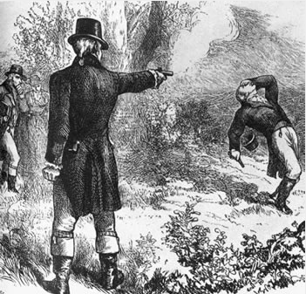
Notes:
Burr & Hamilton Duel
The most famous duel in American history is unquestionably that which occurred between Vice President Aaron Burr and Alexander Hamilton, who greatly influenced the founding of America’s economy and was possibly on track to become President himself. Burr and Hamilton had long been political enemies by the time they met on the field of honor. Hamilton had been instrumental in preventing Burr from winning the Presidency when Burr tied Thomas Jefferson’s vote count, leading to Burr’s eventual appointment as VP. The two men continued to square off politically until rumors that Hamilton had been saying “despicable” things about Burr led the slandered veep to issue a formal challenge to duel.
The two men met on the field of honor in Weehawken, New Jersey on the morning of July 11, 1804. Interestingly enough, Hamilton’s son had fallen to a mortal blow in a duel at the very same place just two years before. The same guns used in his duel were also used in his father’s.
The accounts of precisely what happened are conflicting, but it is generally thought that Hamilton fired first, aiming high and missing Burr completely. Burr then aimed squarely at Hamilton’s torso and returned fire. Hamilton fell, the bullet lodged in his spine, and he died the following morning.
Whether Hamilton’s miss was intentional or not is debatable. Hamilton had recorded in a letter the previous night that he intended to purposefully miss Burr in an effort to end the confrontation without bloodshed. Still, other believe that Hamilton so detested Burr that he shared this sentiment simply to paint Burr as the villainous shedder of innocent blood, thus forever besmirching his character.
If that truly was his wish, it was certainly granted. Though murder charges were levied against Burr, he was never brought to trial. But the ensuing political fallout undermined Burr’s political clout and brought a swift end to his career.

Slide 5
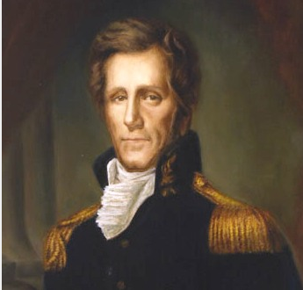
Notes:
Prior to his presidential career, Andrew Jackson was known for his inclination to invoke violence in defense of his honor; he was the veteran of at least 13 duels. These showdowns left his body so filled with lead that people said he “rattled like a bag of marbles.”
The most famous of Jackson’s affairs of honor was his confrontation with prominent duelist Charles Dickinson. Dickinson, rumored to be the best shot in the country, had insulted the future President by alleging that he cheated in a horse racing bet between Jackson and Dickinson’s father-in-law. Insults were exchanged, culminating with Dickinson insulting Jackson’s wife. Slandering Jackson’s wife was “like sinning against the Holy Ghost: unpardonable.” Biographer James Parton claimed that Jackson “kept pistols in perfect condition for thirty-seven years” to use whenever someone “dared breathe her name except in honor.” Jackson had no choice but to issue a challenge to duel.
Jackson and Dickinson met at Harrison’s Mill on the Red River in Kentucky on May 30, 1806. The men were to stand at eight paces and then turn and fire. Dickinson was a well-known sharpshooter and Jackson felt his only chance to kill him would be to allow himself enough time to take an accurate shot. Thus he calmly allowed Dickinson to fire into his chest. The bullet lodged in his ribs, but Jackson hardly quivered, calmly leveling his pistol at Dickinson. But when the trigger was pulled the hammer of his gun only fell to the half-cocked position and did not fire. According to dueling etiquette, this should have been the end of the duel. Jackson, however, was not finished with Dickinson. Re-cocking his pistol, he aimed and fired, striking Dickinson dead.
It was only then that Jackson took heed of the fact that blood was dripping into his boot. Dickinson’s musket ball was too close to his heart to be removed and forever remained lodged in Jackson’s chest. The wound would lend him a perpetual hacking cough, cause him persistent pain, and compound the many health problems that would beleaguer him throughout life. But Jackson never regretted the decision

Slide 6
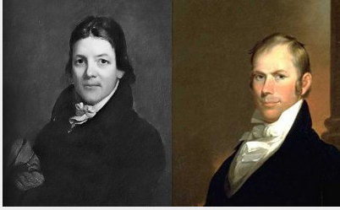
Notes:
Clay vs. Randolph
John Randolph was quite a character. He fought his first duel at 18, seriously wounding a fellow student over his mispronunciation of a word. His volatility continued as a Congressman; “he called Daniel Webster “a vile slanderer,” President Adams a “traitor,” and Edward Livingston “the most contemptible and degraded of beings, whom no man ought to touch, unless with a pair of tongs.” When he wasn’t hurling insults at his associates, he was challenging them to duels.
Following a slanderous speech on the Senate floor in which he accused sitting Secretary of State Henry Clay of “crucifying the Constitution and cheating at cards,” Senator John Randolph found himself the recipient of a formal challenge to duel. While comfortable with assailing the man’s character, Randolph, an experienced marksman, had no intention of robbing Clay’s family of their patriarch (and suffering the political fallout of slaying the Secretary of State). Several days before the duel took place, Randolph confided in Senator Thomas Hart Benton that he was unwilling to kill Clay, but did not want to sacrifice his personal honor either, so he would instead purposefully aim high when the time came to fire.
When the day of the duel arrived on April 8, 1826, both men met on the field of honor. As preparations for the start of the duel were still being made, Randolph accidentally fired his gun, which was pointed at the ground. Clay accepted that the misfire was an accident and allowed the duel to proceed. Marching the agreed upon number of steps in opposite directions, both men turned and fired. Randolph, apparently motivated by the humiliation of his misfire (and his missed chance to come off as the magnanimous one), made no effort to aim high, although he still just missed his intended target, the bullet perforating Clay’s coat. Clay also missed, and having gained no satisfaction, demanded another go around. This time Clay missed again, and Randolph followed through on his promise to Benton by firing into the air. Moved by the sentiment, Randolph met Clay at midfield for a handshake to end the duel, noting to his opponent that he owed him a new coat. Clay simply replied “I am glad the debt is no greater.”

Slide 7
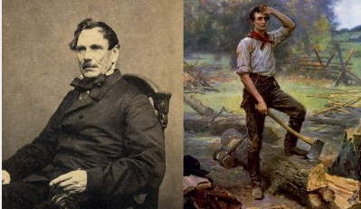
Notes:
As an elected official in the Illinois State Legislature, future President Abraham Lincoln was sharply critical of James Shields’ performance as Illinois State Auditor. Lincoln even resorted to adopting various pseudonyms and publishing many satirical letters criticizing Shields (a common tactic at the time). In an unfortunate twist of fate, Lincoln’s future wife Mary Todd and a friend also wrote several letters. But the women got carried away, changing the tone from satirical criticism to insult. Shields, upon discovering that Lincoln was behind the letters in one form or another, issued an immediate challenge. Lincoln, unwilling to accept the public disgrace that came with refusing a duel, and eager to impress his future wife Mary, accepted.
As the challenged party, Lincoln set the parameters for the duel. It was to be fought with large cavalry broadswords in a deep pit divided by a board which no man could step over. In creating such parameters, Lincoln aimed to disarm his opponent using his superior reach advantage and avoid bloodshed on either side. Furthermore, Lincoln hoped that such ridiculous conditions would force Shields’ withdrawal. But initially, they did not.
On September 22, 1842, the two men met on the field of honor. As the seconds desperately tried to sway Shields’ determination, he looked over and saw Lincoln chopping at the branches of a nearby tree that would be far out of his own reach. Realizing that he was outmatched, Shields agreed to attempt to talk it out with Lincoln. Lincoln’s second convinced Shields that Lincoln had not written the letters, and Lincoln offered an apology for the misunderstanding, which Shields fortunately accepted. Shields went on to become a prominent United States Senator, and Abraham Lincoln went on to become, well, Abraham Lincoln.

Slide 8
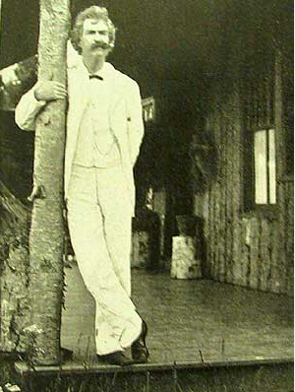
Notes:
While living in Virginia City, Nevada, sharp-witted satirist Mark Twain was up to his usual pot stirring, writing such outrageous editorials for The Territorial Enterprise that locals dubbed him “The Incorrigible.” When Twain wrote a piece erroneously accusing a rival paper, The Virginia City Union, of reneging on a promised pledge to charity, the publisher of the paper, James Laird, made such a stink over the false accusation that Twain challenged him to a duel. Twain’s second, Steve Gillis, took Twain to practice his shooting, only to find that the man’s pen was truly mightier than his pistol; Twain couldn’t hit the side of a barn. Filled with fear, Twain collapsed. As Laird and his men were making their way over, Gillis grabbed a bird, shot his head off, and stood admiring the corpse. Laird’s second asked, “Who did that?” and Gillis responded that Twain had shot the bird’s head off from a good distance and was capable of doing it with every shot. Then he gravely intoned, “You don’t want to fight that man. It’s just like suicide. You better settle this thing, now.” The creative ploy worked, and the men reconciled. Tom Sawyer would have been proud.

Slide 9
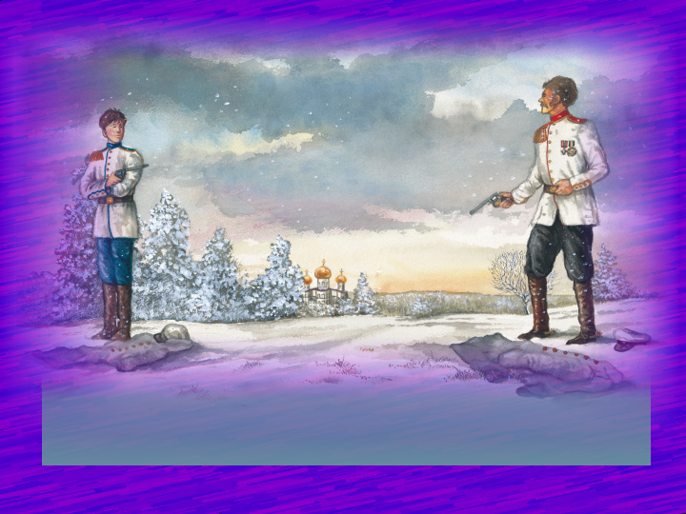
"The Duel"
pp. 31-34
by Nikolai Dmitrievitch Teleshov

Slide 10
Teleshov
Russian
writing reflects a violent culture

Slide 11
Secondary
Conflict
man vs. man
Vladimir vs. his opponent
Resolution: Vladimir’s death

Slide 12
Central
Conflict
man vs. himself
Ivan vs. his decision to tell the truth

Slide 13
Evidences of Ivan’s Struggle

Slide 14
Ivan’s gloomy, confused manner
the twirling of his mustache
the wringing of his hands
the watering of his eyes

Slide 15
Factors in Ivan’s Failure

Slide 16
Fear
Selfishness
Guilt

Slide 17
Theme:
Fear is never an acceptable reason to flee responsibility.

Slide 18
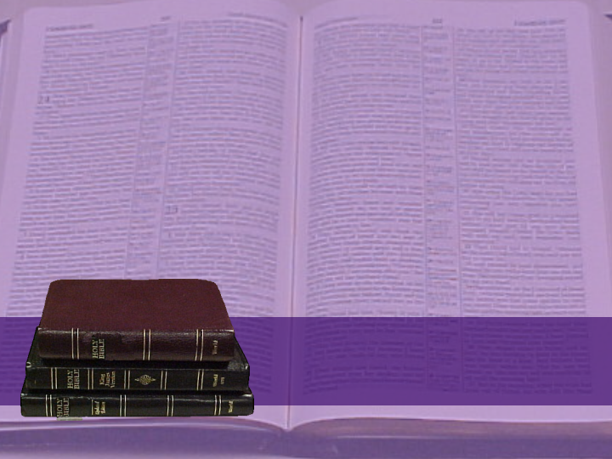
For God hath not given us the spirit of fear; but of power, and of love, and of a sound mind.
II Timothy 1:7

Slide 19
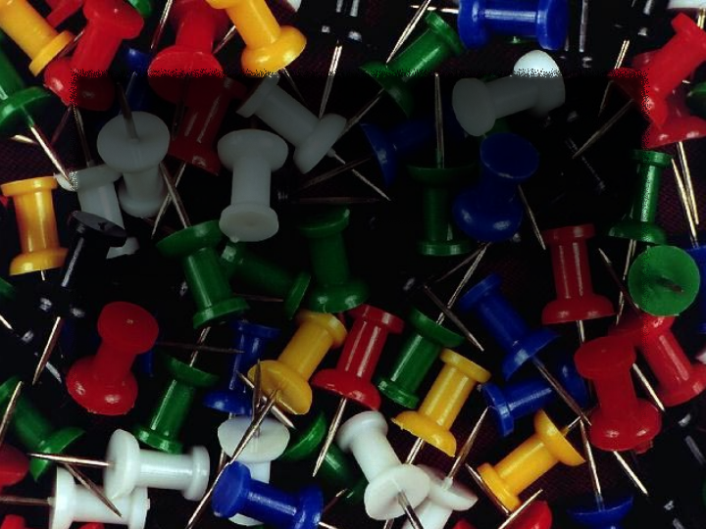
deconss
official attendants of a contestant in a duel
seconds

Slide 20
mronytroop
projecting cliff
promontory

Slide 21
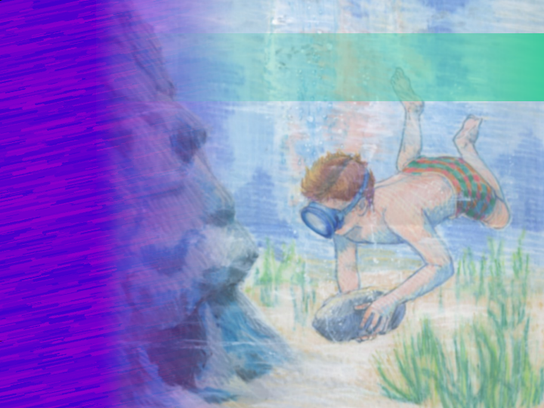
"Through the Tunnel"
pp. 22-30
by Doris Lessing

Slide 22
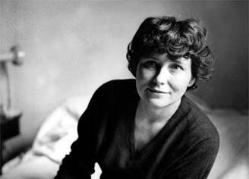
Doris
Lessing

Slide 23
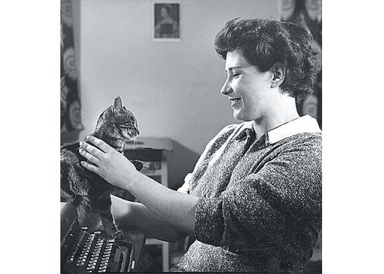

Slide 24
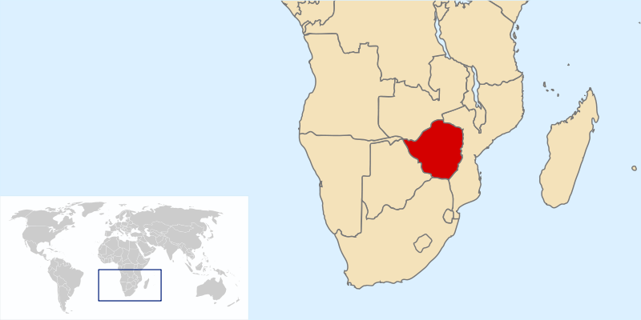
Southern Rhodesia/Zimbabwe

Slide 25
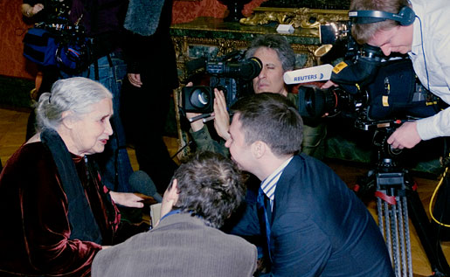
Nobel Peace Prize Winner 2007

Slide 26
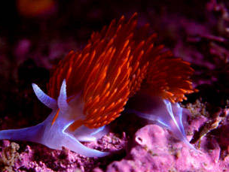

Slide 27
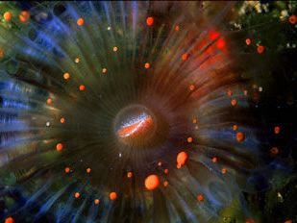

Slide 28
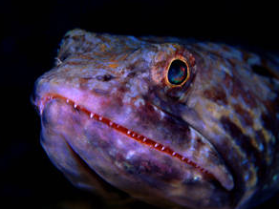


Slide 29
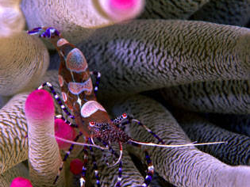

Slide 30
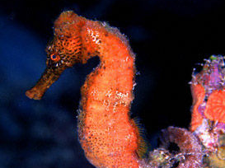

Slide 31

Interpretive Literature:
Coming-of-Age Story
Notes:
Interpretive Key: _______-___-_____ _______

Slide 32
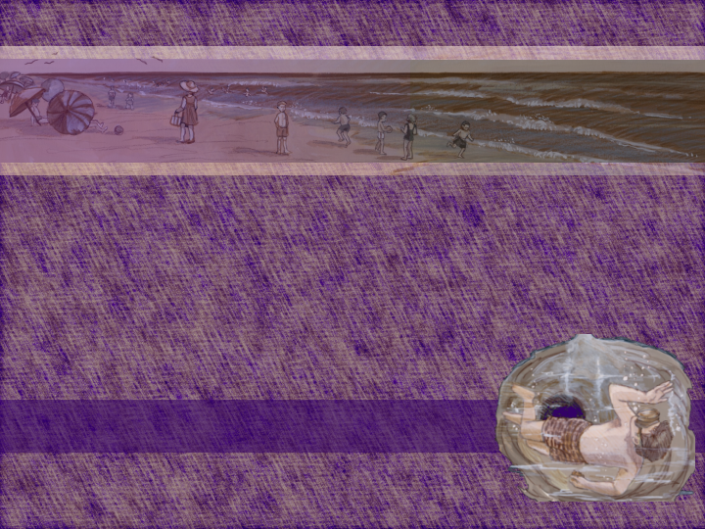
Main Character: Jerry
11 year old
English boy
only child
good swimmer

Slide 33
Minor Characters
his mother—a widow; anxious that she should neither push Jerry away nor smother him
native boys

Slide 34
Color Imagery

Slide 42
Say the colors brain teaser:
Yellow Orange Blue
Black Green Red
Yellow Purple Red
Orange Green Yellow

Slide 43
Mother
the whiteness of her skin (innocence, vulnerability)
a yellow spot under an orange umbrella (safety)

Slide 44
Native Boys
dark brown (unknown)
dark eyes

Slide 45
Bay
bluish green water
solid, heavy blue
deep purple
dark black wall of rock

Slide 46


Slide 47


Slide 48
Conflicts
man vs. nature—Jerry vs. fear of the ocean.
man vs. himself—
Jerry wants to prove himself

Slide 49
Conflict
man vs. man--Jerry and his mother experience emotional growing pains

Slide 50
“It was no longer of the least importance to go to the bay.”

Slide 51
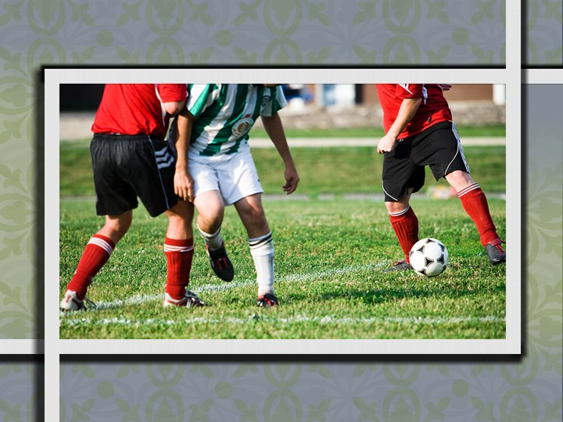
Notes:
Soccer: Clipart.com

Slide 52
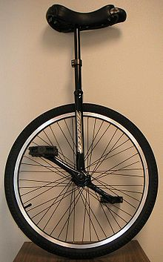
Notes:
Soccer: Clipart.com

Slide 53

Impact of
response
intellectual
Jerry's
knowledge
MIND
emotional
Discovery
HEART
change in
behavior
discovers the older boys’ ability
WILL
disciplines himself
discontent with his inability

Slide 54
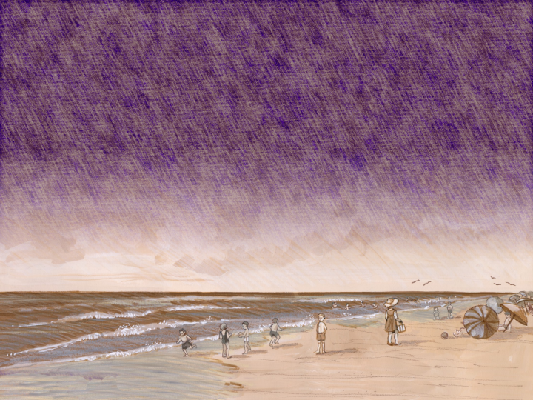
Jerry’s Character Traits:
devotion, love
immaturity
foolishness
impatience
maturity

Slide 55
Theme:
Intellectual, spiritual, and physical growth are desirable.

Slide 56
mronytroop
projecting cliff
promontory

Slide 57
deconss
official attendants of a contestant in a duel
seconds

Slide 58
noonititrc
heartfelt remorse for wrongdoing
contrition

