Slide 1
Today’s QUIZ
*Have out a half sheet of paper.
20 points

Slide 2
READING CHECK
BOOK? LISTENING? (20 POINTS)

Slide 4
1 Timothy 6:8-9
8 And having food and raiment let us be therewith content.
9 But they that will be rich fall into temptation and a snare, and into many foolish and hurtful lusts, which drown men in destruction and perdition.
Notes:
Perdition=eternal punishment and damnation

Slide 5
1 Timothy 6:10 (Extra Credit for Test 2)
For the love of money is the root of all evil: which while some coveted after, they have erred from the faith, and pierced themselves through with many sorrows.
Notes:
Perdition=eternal punishment and damnation

Slide 6
Upholding Sound Doctrine
I Timothy/Lesson 13

Slide 7
Amusement
Muse=“to think”; a=“not”
NOT THINKING
Notes:
-Not against fun—tell about growing up with the “fun man”
-Play hard, work hard, pray harder

Slide 8
orthodoxy
orthos + dokeo= “right” + “belief”
belief in sound biblical doctrine

Slide 9
Examples of False Teaching
These beliefs are seductive!

Slide 10
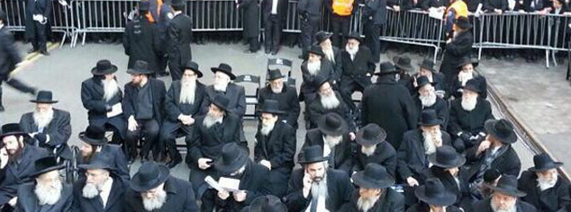
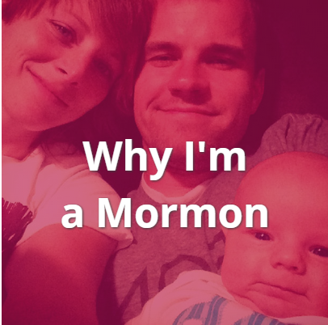
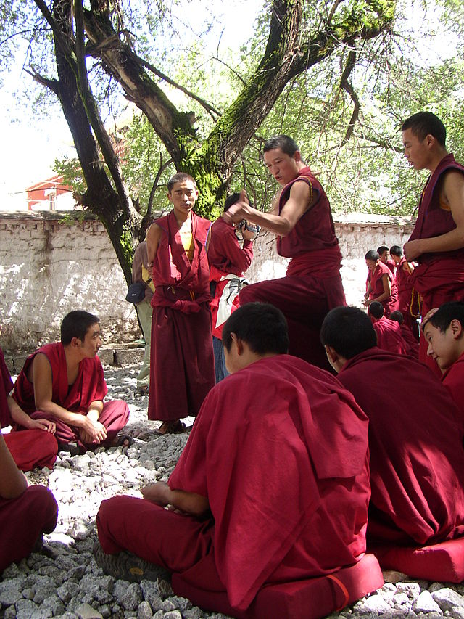

Slide 11
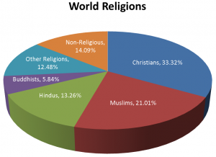

Slide 12
So what is the difference between Christianity and these other religions?

Slide 14
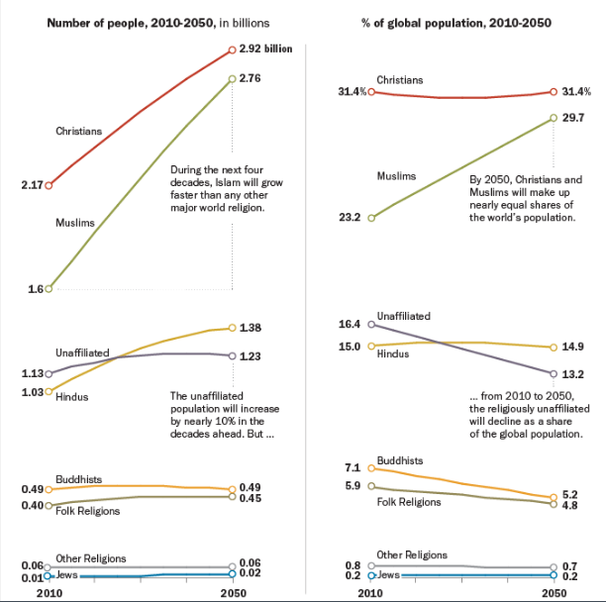

Slide 16
Our Safeguard
A thorough understanding of God’s Word

Slide 17
Background
I Timothy
Notes:
The Ephesian church had the best Bible instruction. Paul spent almost 3 years there during his 3rd missionary journey. Later, John moved to Ephesus and remained there the rest of his life until AD 98. But Ephesus struggled with false teaching. I Timothy attacks the teachings of the Judaizers, and the book of Ephesians attack early Gnostics, who were enemies of the church for decades.
In the early church, those who taught a combination of God’s grace and human effort were called “Judiazers.” The word Judaizer comes from a Greek verb meaning “to live according to Jewish customs.” The word appears in Galatians 2:14where Paul describes how he confronted Peter for forcing Gentile Christians to “Judaize.
A Judiazer taught that, in order for a Christian to truly be right with God, he must conform to the Mosaic Law. Circumcision, especially, was promoted as necessary for salvation. Gentiles had to become Jewish proselytesfirst, andthenthey could come to Christ. The doctrine of the Judiazers was a mixture of grace (through Christ) and works (through the keeping of the Law). This false doctrine was dealt with inActs 15and strongly condemned in the book of Galatians.
At the Jerusalem Council inActs 15, a group of Judaizers opposed Paul and Barnabas. Some men who belonged to the party of the Pharisees insisted that Gentiles could not be saved unless they were first circumcised and obeyed the Law of Moses. Paul made the case that, in Christ, there was no longer any distinction between Jew and Gentile, for God had purified the hearts of the Gentiles by faith (Acts 15:8–9). He said it plainly inGalatians 2:16: “A man is not justified by observing the law, but by faith in Jesus Christ. So we, too, have put our faith in Christ Jesus that we may be justified by faith in Christ and not by observing the law, because by observing the law no one will be justified.” Read more:http://www.gotquestions.org/Judaizers.html#ixzz3FP7qyb9b Read more:http://www.gotquestions.org/Judaizers.html#ixzz3FP7dbfDt
Read more:http://www.gotquestions.org/Judaizers.html#ixzz3FP7Fzn3A

Slide 18
I. Sound Doctrine Encouraged (3:14-16)
A. Importance of Sound Doctrine
We are to uphold God’s truth before an unbelieving world.
False doctrine hides the gospel from the lost.
Notes:
You may be the only Bible that some people ever read.
PTL story (Girls saved out of Catholicism)

Slide 19
I. Sound Doctrine Encouraged (3:14-16)
B. Specifics of Sound Doctrine (3:16)
Christ is both God and man—God in human flesh.
The gospel of Christ is open to people of any ethnic background.
Salvation comes through faith in Christ alone.
Christ will one day return for His own.
Notes:
3:16=probably a hymn sung in the early church
God was manifest in the flesh: Christ is fully God and yet fully human When did the Holy Spirit reveal this? At his baptism, ,through miracles, at His resurrection
2. Preached unto the Gentiles—believed on in the world. Given to everyone without any national, racial, social or cultural distinctions. What if the Judaizers were right? You and I would have little hope. Works would have to save us.
4. Christ’s ascension serves to vindicate His work and promised return.

Slide 20
II. Sound Doctrine in Danger (4:1-5)
A. Tragedy of False Teaching (4:1)
Paul predicted that some believers would distance themselves from sound doctrine.
True believers will always stand firm, led by the Spirit of God. (John 10:2-5; I John 2:19)
Notes:
Timothy was the first Christian leader to battle Gnosticism in Ephesus.
What do believers want to distance themselves from today? Gay marriage issues, drinking, abortion,

Slide 21
II. Sound Doctrine in Danger (4:1-5)
B. Source of False Teaching (4:1)
Satanic forces inspire false doctrine.
Satan knows how to ensnare people by appealing to their pride, intellect, and imagination.
Satan isn’t opposed to religion; false religion is his most powerful weapon.
Notes:
Evil spirits or demons (also called seducing spirits) are adept in the art of leading people astray by influencing their minds.
*We must evaluate all religious teaching by Scripture.

Slide 22
II. Sound Doctrine in Danger (4:1-5)
C. Proponents of False Teaching (4:2)
False teachers often pretend to be Christians.
They feel no guilt because their consciences have been “seared with a hot iron.”
Constant rejection of truth and acceptance of error has deadened their sensitivity to sin.
Notes:
Hypocrisy=to wear the mask of an actor

Slide 23
II. Sound Doctrine in Danger (4:1-5)
D. Specifics of False Teaching (4:3-5)
Mandatory celibacy and abstaining from certain foods were promoted by the Gnostics.
Paul said marriage and food were God’s gifts to mankind.
God simply demands a thankful heart.
Meat and plants can be eaten with joy.
Notes:
Gnostic Dualism=the physical was bad; the spiritual was good; the human body was inherently evil (marriage and child bearing corrupted the soul.); the body need only be nourished with the basics to sustain life
Monasticism and mandatory celibacy as taught by the Roman Catholics are wrong. Vegetarianism as a religious practice is similarly misguided. For health reasons=fine. God created meat and plants to be eaten with thanksgiving.

Slide 24
III. Sound Doctrine Preserved (4:6-16)
A. Affirming Sound Doctrine
Know the Word.
Exercise your God-given gifts.
Proclaim the truth.
Notes:
Be “nourished up in” “feed on” the Word; Scripture is the secret to a successful Christian life.
Elders laid hands on Timothy and GOD gave him the gift of pastoring.
Share Christ publicly. Encourages public reading of Scripture, exhortations and teaching doctrine. Salvation is dependent on proper belief.

Slide 25
III. Sound Doctrine Preserved (4:6-16)
B. Avoiding Speculation
Paul encouraged Timothy to avoid fables and genealogies.
His calling was to proclaim God’s truth.
Notes:
Be careful especially when you work with children. Telling stories is great…but make sure they don’t get them confused with Scripture/Bible history.

Slide 26
III. Sound Doctrine Preserved (4:6-16)
C. Pursuing Godliness (4:7-10)
Sound doctrine must be given by someone with godly character.
We need to exercise ourselves to godliness through prayer, Bible reading, and meditation.
*Are you a spiritual Olympian?
Notes:
Exercise=gymnasia=root of gymnasium; Olympic games—Ask about Olympic athletes’ preparation. Gabby Douglass?

Slide 28
I Timothy 4:12
Let no man despise thy youth; but be thou an example of the believers, in word, in conversation, in charity, in spirit, in faith, in purity.
Notes:
4:11-16 Men's youth will not be despised, if they keep from vanities and follies. Those who teach by their doctrine, must teach by their life. Their discourse must be edifying; their conversation must be holy; they must be examples of love to God and all good men, examples of spiritual-mindedness. Ministers must mind these things as their principal work and business. By this means their profiting will appear in all things, as well as to all persons; this is the way to profit in knowledge and grace, and also to profit others. The doctrine of a minister of Christ must be scriptural, clear, evangelical, and practical; well stated, explained, defended, and applied. But these duties leave no leisure for wordly pleasures, trifling visits, or idle conversation, and but little for what is mere amusement, and only ornamental. May every believer be enabled to let his profiting appear unto all men; seeking to experience the power of the gospel in his own soul, and to bring forth its fruits in his life.

Slide 29
III. Sound Doctrine Preserved (4:6-16)
D. Commanding Respect (4:12)
Chronological age doesn’t automatically bring respect; a godly life does.
Timothy needed to live a life worthy in . . .
Word (speech)
Conversation (manner of life)
Charity (love for God and others)
Faith (trust in God)
Purity (freedom from moral sins)
Notes:
A man was considered young until he was forty in that day. Timothy was probably 30 at this time, and some of the false teachers were older men.
Why do young people sometimes NOT gain respect of their elders? Immature, undisciplined lives Live above reproach!

Slide 30
LIVE ABOVE REPROACH
Live to the glory of God!

Slide 32
1 Timothy 6:8-9
8 And having food and raiment let us be therewith content.
9 But they that will be rich fall into temptation and a snare, and into many foolish and hurtful lusts, which drown men in destruction and perdition.
Notes:
Perdition=eternal punishment and damnation

Slide 33
A Final Challenge
Wisdom in All Things
I Timothy 5:1-6:21

Slide 34
Wisdom
The skill of responding appropriately to the changing circumstances of life.
Notes:
Only available to those who know God and His Word; unbelievers may possess great intellect, but without Christ they can never come to full knowledge of the truth.

Slide 35
Wise Tips
1. Be careful when you are tempted to correct an older Christian. (5:1)
Suggestion: Appeal to that person respectfully as you would to your own father or mother.
Notes:
With youth comes the tendency to be know-it-all

Slide 36
Wise Tips
2. Christians have an obligation to care for their own who are in need.
Suggestion: Keep your eyes open for ways to assist other believers, particularly older widows.
Notes:
With youth comes the tendency to be know-it-all

Slide 37
Wise Tips
3. God’s ministers deserve a proper reward for their labor among the flock. (5:17)
Suggestion: Thank your pastor regularly for his work and support him through your prayers and giving.
Notes:
With youth comes the tendency to be know-it-all

Slide 38
Wise Tips
4. Be careful about who takes a position of spiritual leadership.
Suggestion: Do not show favoritism, but prayerfully choose wise spiritual leaders.
Notes:
With youth comes the tendency to be know-it-all

Slide 39
Wise Tips
5. Don’t take advantage of an employer because he’s a fellow Christian.
Suggestion: Work hard and be honest in everything you do.
Notes:
With youth comes the tendency to be know-it-all

Slide 40
Wise Tips
6. Don’t support false teachers.
Suggestion: Be aware that they will use religion for personal gain.
Notes:
With youth comes the tendency to be know-it-all

Slide 41
Wise Tips
7. Seek to be godly, not wealthy.
Suggestion: If God blesses you materially, be ready to help those in need, to support your church faithfully, and to guard your heart from the love of money.
Notes:
With youth comes the tendency to be know-it-all

Slide 42
BIBLE FINAL EXAM
50 points
Know:
Know Philippians 2:5-8; I Tim. 4:12
Review Lessons 9, 10, 11, 13, & 14 in your book. Study the questions!
Study your notes.

