Slide 1
Welcome Back!
Have out…
your Poetry Worksheet 1: Casey at the Bat.
a grading pen.

Slide 2
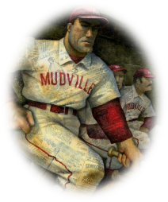
Poetry Worksheet #1
Alliteration: repetition of consonant sounds at the beginning of a group of words deep despair
Metaphor: a comparison (NOT using like or as) of two unlike things the former was a hoodoo; the latter was a cake
Simile: a comparison using like or as a muffled roar, like the beating of the storm waves
Onomatopoeia: using words that sound like what they mean whack, rumbled, rattled, roar
Hyperbole: exaggeration Cooney died at first
Personification: giving non-human things human characteristics sickly silence; the score stood
Imagery: use of pictures or images that appeal to your senses the town’s name—Mudville, the audience’s cheers echo over the valleys and mountains

Slide 3
POETRY WORKSHEET #2 DUE TOMORROW

Slide 4
REMINDER: Novel Project due Monday the 29th

Slide 5
*If you have been absent, I emailed you the notes and assignments. They are also on the website.

Slide 6
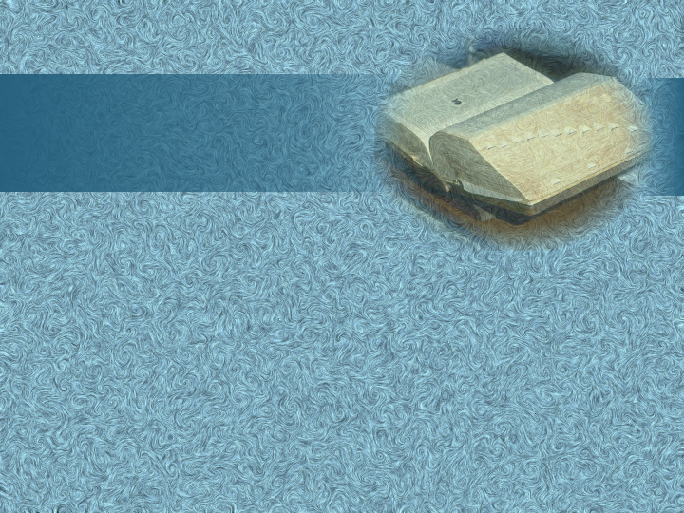
definition
rhymed verse
c
’
having rhyme and regular meter

Slide 7
definition
blank verse
c
’
unrhymed iambic pentameter

Slide 8
definition
free verse
c
’
having no regular rhyme or meter

Slide 9
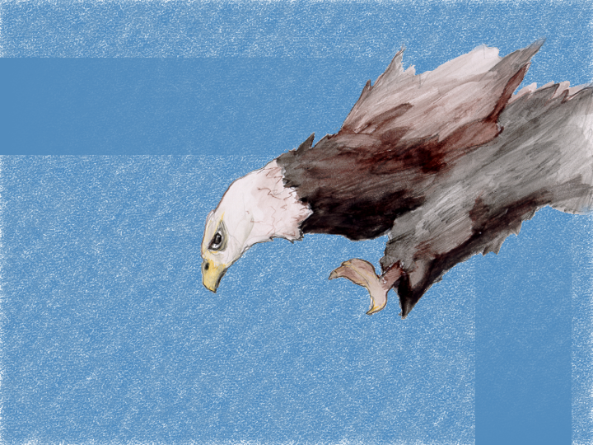
"The
Eagle"
by Alfred, Lord Tennyson

Slide 10
definition
rhymed verse
c
’
having rhyme and regular meter

Slide 11
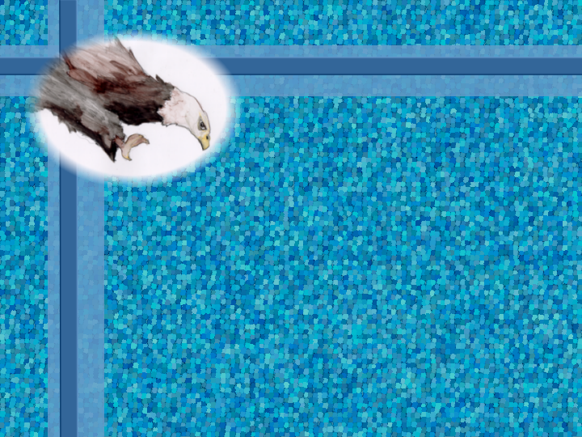
“The sound must seem an echo to the sense.”

Slide 12
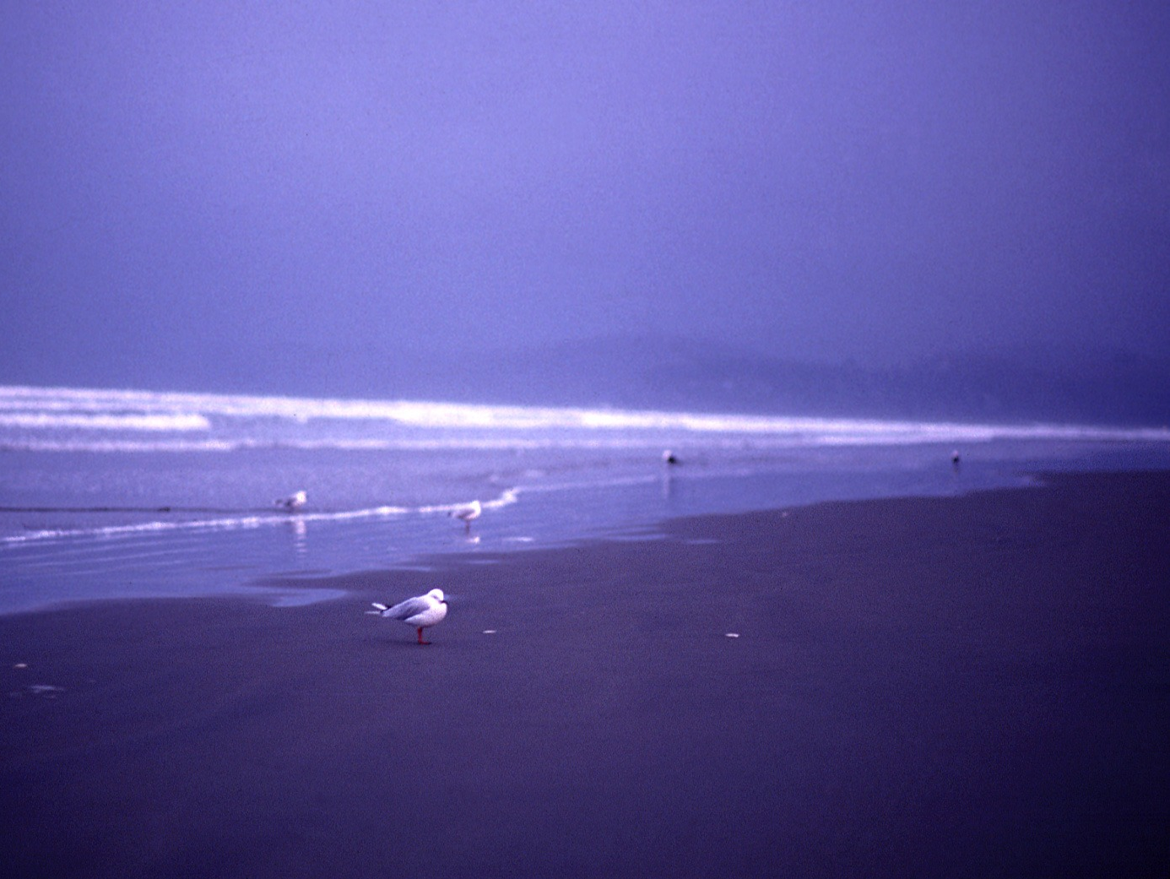
“ringed with the azure world”

Slide 13
definition
personification
’
when things or animals that are non-human are given human characteristics

Slide 14
“wrinkled sea”

Slide 15
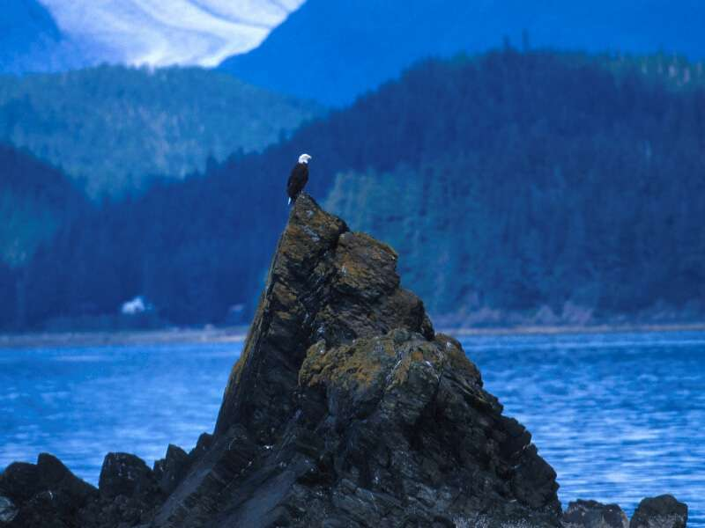
“He watches from his mountain walls”

Slide 16
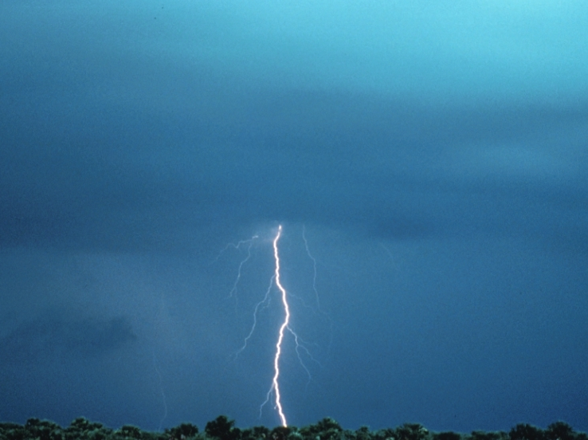
“like a thunderbolt he falls”

Slide 17
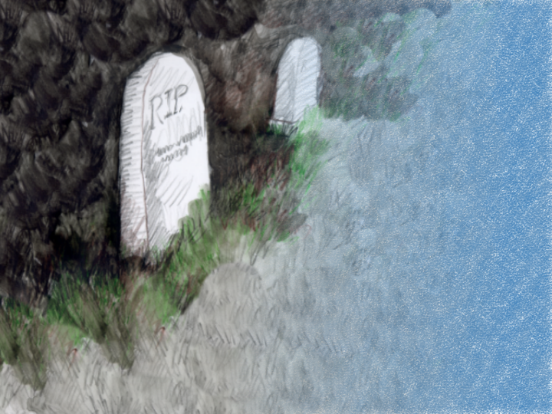
from
Julius
Caesar
by William Shakespeare

Slide 18
definition
blank verse
c
’
unrhymed iambic pentameter

Slide 19
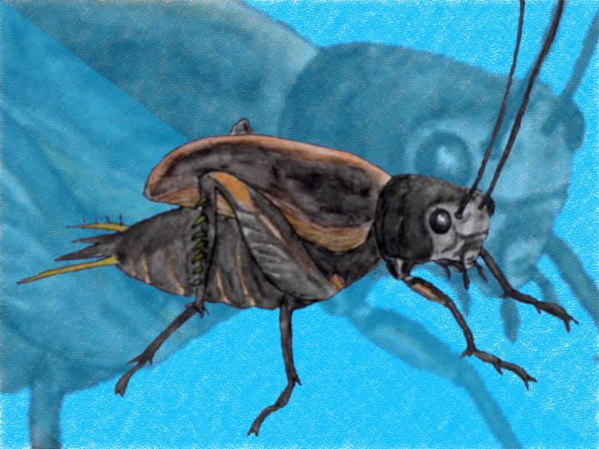
by Carl Sandburg
"Splinter"

Slide 25
definition
free verse
c
’
having no regular rhyme or meter

Slide 26
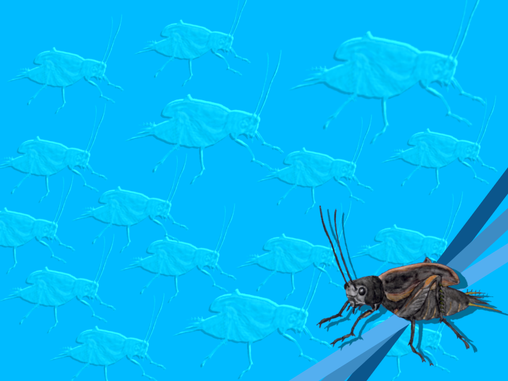
“The voice of the last cricket across the first frost is one kind of good-by. It is so thin a splinter of singing.”

Slide 27
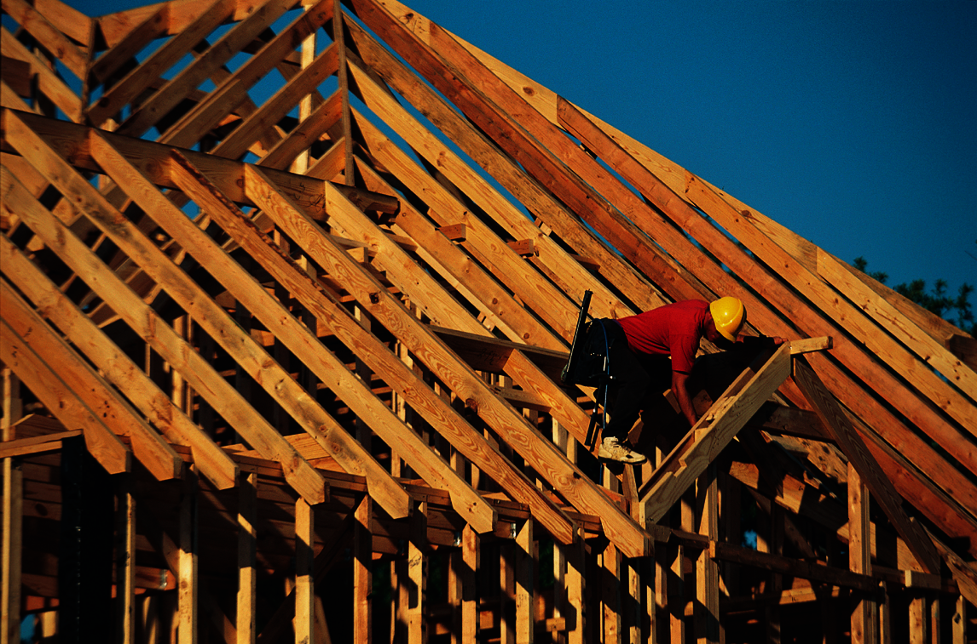
Structure

Slide 28
Study of Stanza
A stopping place or division of a poem based on thought, meter, or rhyme
Notes:
Essential Poetic Elements: _____ devices & _______ language

Slide 29
Classic Stanza Forms
1. couplet—2 line stanza
“In the winter, when the fields are white, I sing this song for your delight.”
2. triplet—3 line stanza
“He clasps the crag with crooked hands. Close to the sun in lonely lands, Ringed with the azure world he stands.”
Notes:
Essential Poetic Elements: _____ devices & _______ language

Slide 30
Classic Stanza Forms
3. quatrain—4 lines
4. quintet—5 lines
5. sestet—6 lines
6. septet—7 lines
7. octave—8 lines
Notes:
Essential Poetic Elements: _____ devices & _______ language

Slide 31
ESTABLISHED
STANZA FORMS
Notes:
Essential Poetic Elements: _____ devices & _______ language

Slide 32
Ballad Form
Narrative content
Dialogue in dialect form
Distinctive subject matter
Repetition
Notes:
List cont

Slide 33
“Bonnie George Campbell”
The Scottish Campbell clan was hated by other clans.
This balled effectively uses simplicity, compression, and restraint.
woman’s point of view
written in a Scottish brogue
Notes:
List cont

Slide 34
Rhyme Scheme:
a
High upon Highlands
And low upon Tay,
Bonnie George Campbell
Rade out on a day.
b
c
b
Notes:
List

Slide 35
Refrain
a line or group of lines repeated throughout a poem

Slide 36
Theme
Death comes unexpectedly.
Appreciate and cherish the people in your life!
Notes:
→ Appreciate and _____ the people in your ____!

Slide 37
Sonnet
a 14 line lyric poem
Notes:
3rd hour stopped here

Slide 38
“Holy Sonnet 10”
by John Donne
Notes:
Grave: clipart.com

Slide 39
Personification
= Donne’s facing Death head-on
Notes:
Grave: clipart.com
Apostrophe & Personification = Donne’s ________ death ____ - ____

Slide 40
Italian Sonnet
14 line poem
8 lines rhyming abba abba (memory trick: crazy Italian man)
Last 6 lines rhyme by twos and threes

Slide 41
Dactylic Foot
poetic foot that contains one stressed and then two unstressed syllables

Slide 42
“Sonnet 29”
by William Shakespeare
Notes:
Bird: © iStockphoto.com/BirdImages

Slide 43
Notes:
Clipart.com

Slide 44
English Sonnet
14 line poem
3 quatrains— abab, cdcd, efef
final couplet— gg
Notes:
3rd hour

Slide 45
Anapestic Foot
poetic foot that contains two unstressed and then one stressed syllable

Slide 46
Three Quatrains: Speaker’s Situation & State of Mind
1st Quatrain → Isolation
2nd Quatrain → Envy
3rd Quatrain → New Thought
Couplet: Mood Change
Contentment
Notes:
Bird: © iStockphoto.com/BirdImages
Add Couplet: Mood Change to Three Quatrains

Slide 47
Theme:
A friend’s loyal love is more valuable than social standing.
Notes:
Theme: A friend’s _________ love is more __________ than social standing.

Slide 48
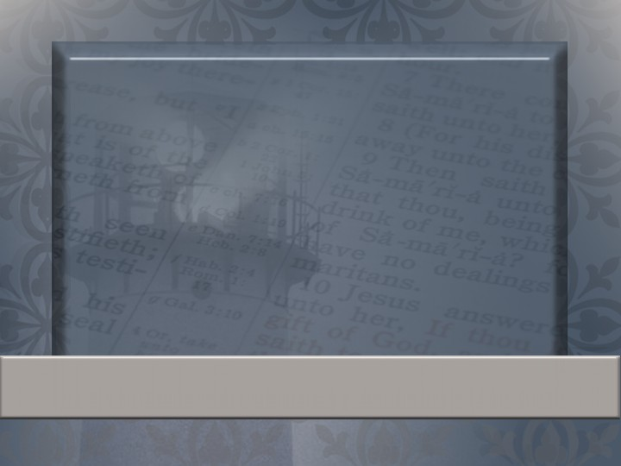
Iron sharpeneth iron; so a man sharpeneth the countenance of his friend.
Proverbs 27:17
Notes:
Verse about friends sharpening friends:

