Slide 1
Happy Wednesday!
Have out your biography and your poem.
Notes:
Pictures: Clipart.com
Change to stems list 2nd hour

Slide 2
Christian biography Check

Slide 3
Stem List 3

Slide 4
Notes:
Watch Video!

Slide 5
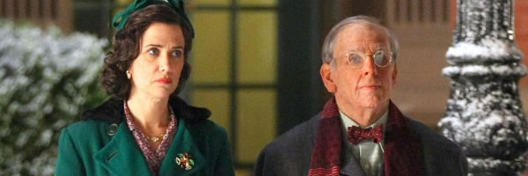
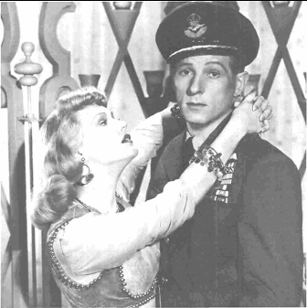
The Secret Life of Walter Mitty
by James Thurber
Notes:
Read aloud in class. Need class copies.

Slide 7
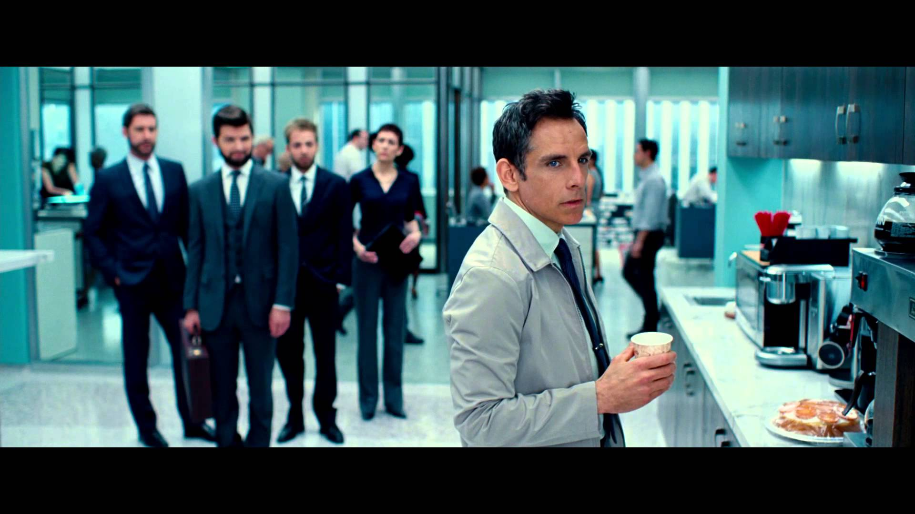

Slide 8
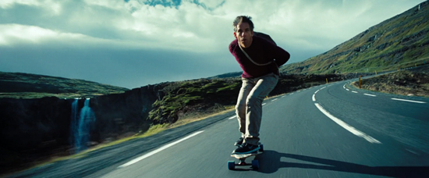

Slide 9
Cast
Walter Mitty
Mrs. Mitty
Berg
Crewman 1
Crewman 2
Cop
Pretty Nurse
Dr. Renshaw
Dr. Mitford
10. Dr. Remmington
11. Intern
12. Parking Attendant
13. District Attorney
14. Mitty’s Attorney
15. Clerk
16. Sergeant

Slide 10
WALTER MITTY ANALYSIS
How would you describe the man?
eccentric
dissatisfied daydreamer
Dictionary Definition: A Walter Mitty is…
An ordinary, often ineffectual person who indulges in fantastic daydreams of personal triumphs.

Slide 11
WALTER MITTY ANALYSIS
Round or Flat?
ROUND
Static or Dynamic?
STATIC

Slide 12
WALTER MITTY THEMES
Dissatisfaction
Escapism
Vicarious Adventure
Victorious Defeat

